Slide 1
Concept Mapping concepts and exercises
K. Yue

Slide 2
Why Learning is difficult?
When we learn a new ‘thing’?
There are many concepts: 10s to 1000s, depending on the task/problem?
  They have relative importance and relevance.
  They need to be accurately represented.
There are many relationships between concepts.
  They have relative importance and relevance.
  They need to be accurately represented.

Slide 3
What are resources for learning?
We learn from resources and experience that are:
scattered and partial information.
With various degrees of importance and relevance.
with various levels of accuracy.

Slide 4
What is (deeper) learning?
From: sources of scattered and partial information with varying degrees of relevance and accuracy.
To: a model with accurate interrelated concepts of known relevance.
Thus, many rounds of iterative refinement is needed.
  It takes a lot of energy and effort.
  We may do it unconsciously.

Slide 5
Why learning is hard?
Limitations of our brain
  Limit to be mindful up to may be 5 to 6 concepts at a time.
  Our mind is accustomed to inaccuracy and imprecision in relevance; to converse energy.
    E.g. traffic route from point A to point B.
    E.g. Select a restaurant for a family meal.

Slide 6
Why Learning is hard?
Limitations of resources
  Many unorganized sources with varying degree of qualities that may not be developed for learning.
  Even for resources developed for learning, many are linear in nature. They present concepts and their relationship in a sequential manner. E.g.
    Video
    Audio
    Textual content

Slide 7
Linear learning material example
Imagine that you don’t know anything about relational database and read the article on it at Wikipedia.

Slide 8
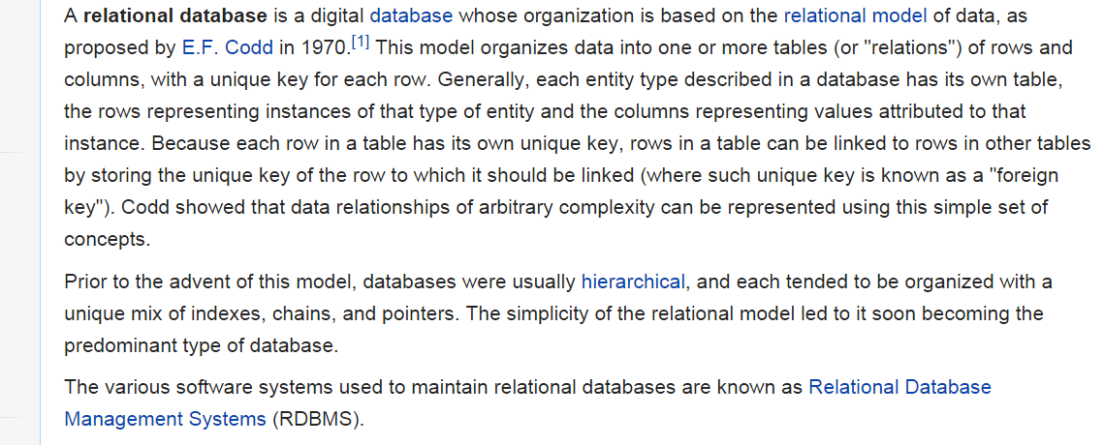
RDB in Wikipedia

Slide 9
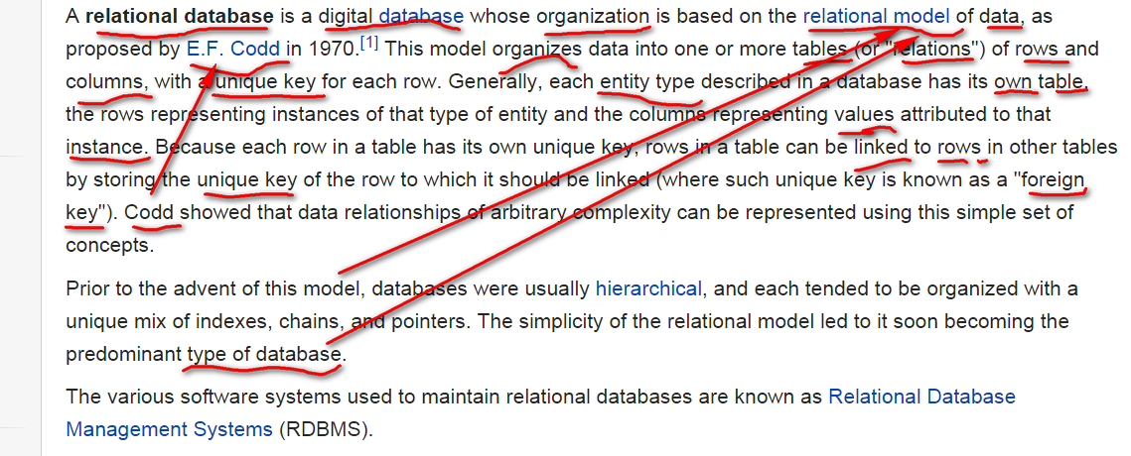
RDB in Wikipedia (slightly annotated)

Slide 10
Observations
There are many concepts.
Different terms may be used to refer to the same or tightly-related concepts: e.g. “model of data (in database)’ and ‘type of database’.
Relationship across spaces in the text. E.g. ‘model of data’ and ‘type of database’.
Relative importance of concepts: E.g. ‘Codd’

Slide 11
Observations
A newbie may read the first paragraph many times but may not be able to make full sense of it.
Concept mapping may be used as a visual tool to help organize concepts.

Slide 12
Web Example of CM on RDB
Read: http://files.software-carpentry.org/training-course/2014/09/Bild-2014-09-22-kl.-18.20.jpg

Slide 13
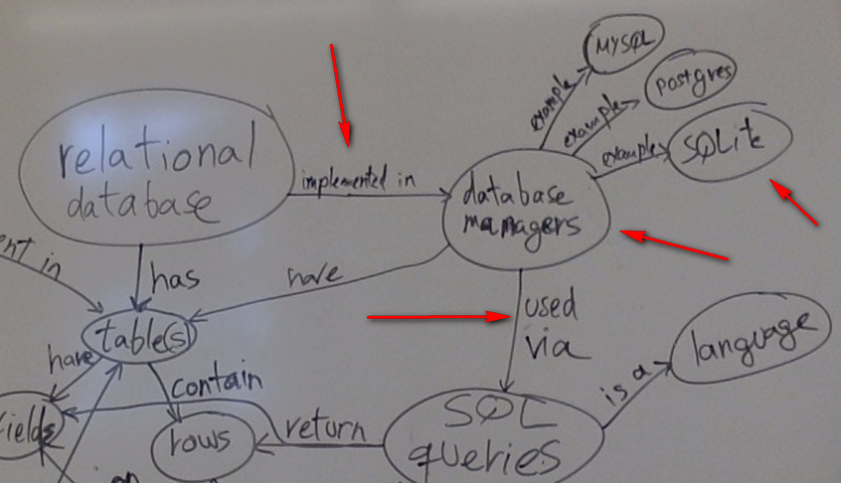
Example in details

Slide 14
Observations
“database managers” may mean:
  Database Management Systems (DBMS), software, or
  Database Administrator (DBA), a person.
“implemented in” and “used via” may mean DBMS => change to “DBMS”
“SQL queries”: may mean
  SQL: the language
  SQL commands: specific actions using SQL
  SQL queries: SQL commands for data retrieval.

Slide 15
Observations
“return rows” => SQL queries.
“used via” => SQL commands (e.g. create a user).
“as a language” => SQL language.
May not need to differentiate => replace “SQL queries” by SQL.
Finer detailed CM may not be needed to differentiate them.

Slide 16
Observations
MySQL, Postgres and SQLite as examples of “DB Managers” or “DBMS”
Good because we learn by examples,
but SQLite is not a DBMS.
It is a DB engine (claimed to be most popular): https://www.sqlite.org/.
May need to differentiate between DBMS and DB engine.

Slide 17
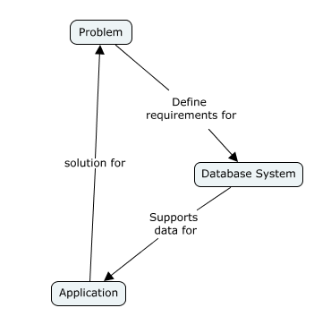
CM for RDB
A high level CM for Relational DB.

Slide 18
Observation
How do you compare with the previous Web example?
    Higher level: 3 concepts instead of 12 concepts.
    Highlight DB systems are for finding solutions to problems.

Slide 19
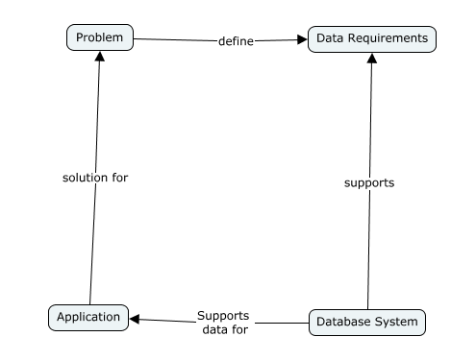
Refinement on Data Requirements

Slide 20
Observation
Promote “requirement” from a link (relationship) to a concept:
  Concepts are more flexibility. It can have links.
  A link cannot has a link.
Become more specific in interactive refinement:
  E.g. “requirement” becomes “data requirement”.

Slide 21
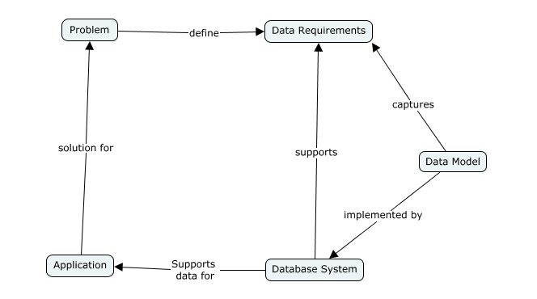
Data Model

Slide 22
Observation
Need to promote “data requirement” to a concept for it to have a link with “data model”.

Slide 23
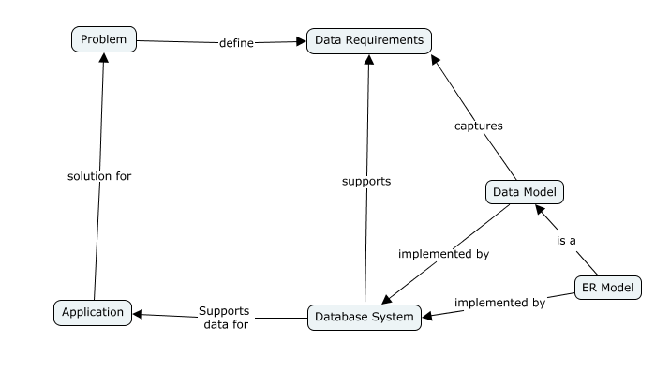
Introducing ER Model

Slide 24
Observation
ER model is a kind of data model.
There are other choices (e.g. using UML to form an object model).
An ER model captures data requirements of a problem

Slide 25
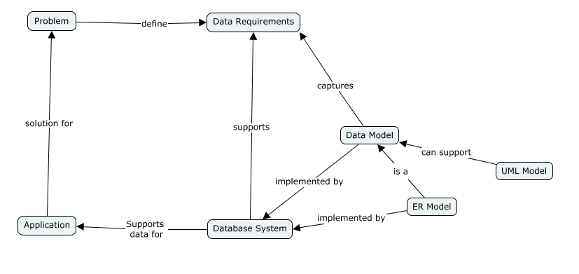
Adding UML model

Slide 26
Observation
Depending on your tasks or interests, you may add “UML model”.
Note the link name: “can support”, and not “is a”.
  ER model is basically a data model.
  UML model is more general. It can be used to support models other than data models.

Slide 27
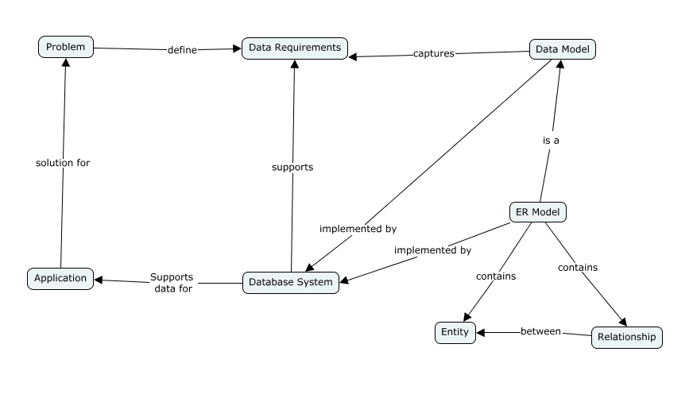
More ER Model details

Slide 28
Observations
To understand ER model, need to focus on:
  What is an entity?
  How should we use entities to capture data requirements?
  What is a relationship?
  How should we use relationships to model data requirements?
  How do we form relationships between entities?

