Slide 1
Effective Scholarship Program for STEM Majors
Sharon P. Hall
Kwok-Bun Yue

Slide 2
Contents
Need for STEM education
STEM opportunities
Need for scholarships
UHCL’s NSF S-STEM Scholarship program
Application process
Maintaining eligibility
Students served
Assessment
Next Steps …

Slide 3
Why STEM Education?
The need for computing majors continues
  The demand for computing professionals remains high for at least the next 8 years [2]
  The number of majors remains low
Keeping a competitive edge in the global economy
Underrepresented groups

Slide 4
Preparing the next STEM generation
National Science Board, “Preparing the Next Generation of STEM Innovators:
Identifying and Developing our Nation's Human Capital” May 2010 [3]:
  The Board “firmly believes that to ensure the long-term prosperity of our Nation, we must renew our collective commitment to excellence in education and the development of scientific talent.”

Slide 5
Three Recommendations
Provide opportunities for excellence
Cast a wide net
Foster a supportive ecosystem

Slide 6
STEM Opportunity Examples
I. C. Support rigorous, research-based STEM preparation for teachers, particularly general education teachers, who have the most contact with potential STEM innovators at young ages.
I. D. Provide Federal support to formal and informal programs that have a proven record of accomplishment in stimulating potential STEM innovators.

Slide 7
More Examples
I. E. Leverage NSF’s Broader Impacts Criterion to encourage large-scale, sustained partnerships among higher education institutions, museums, industry, content developers and providers, research laboratories and centers, and elementary, middle, and high schools to deploy the Nation’s science assets in ways that engage tomorrow’s STEM innovators.

Slide 8
More…
I. F. Create NSF programs that offer portable, merit-based scholarships for talented middle and high school students to participate in challenging enrichment activities.
II. D. Encourage pre-service education and professional development for education professionals (including teachers, principals, and counselors) in the area of talent identification and development.

Slide 9
More…
III. B. Encourage the creation of positive school environments that foster excellence by providing professional development opportunities for teachers, principals, counselors, and other key school staff.
III. C. Support the expansion of computing and communications infrastructure in elementary, middle, and high schools to foster peer-to-peer connections and collaborations, and direct connections with the scientific research community.

Slide 10
Need for Scholarships
In 2005 scholarships for computing majors were not keeping pace with program enrollment as compared with other disciplines [1]
Today there are many funding opportunities to attract students into STEM fields
The National Science Foundation (NSF) provides many of them

Slide 11
Example NSF STEM Programs
S-STEM: up to $600,000K.
Graduate STEM Fellows in K-12 Education (GK-12): up to $600,000 per year for 5 years
Science, Technology, Engineering, and Mathematics Talent Expansion Program (STEP): up to $1.5 million

Slide 12
Example NSF STEM Programs
Robert Noyce Teacher Scholarship Program: up to $1.2 million covering 5 years
Research and Evaluation on Education in Science and Engineering (REESE): $250K to $2.5 million
Others: STEP Center, Cyber-infrastruture, etc.

Slide 13
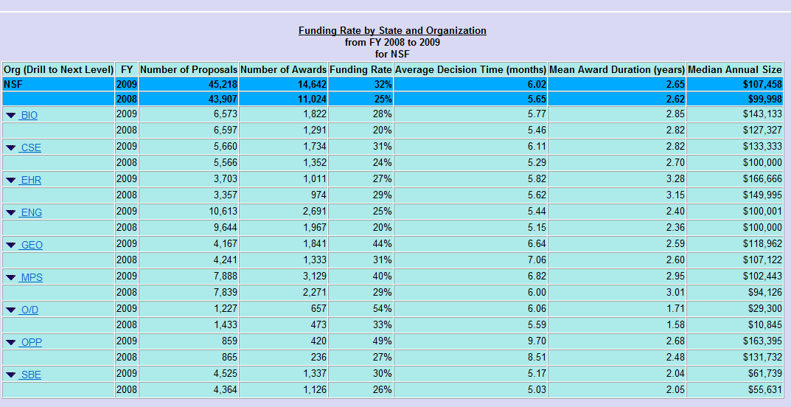
NSF Statistics

Slide 14
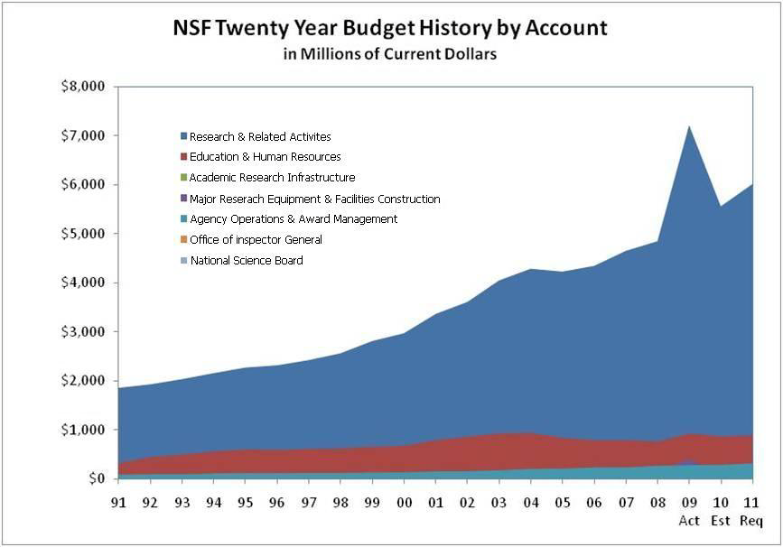
NSF Statistics

Slide 15
UHCL’s NSF S-STEM Program
Services the traditional four majors
  Computer Science
  Computer Information Systems
  Computer Engineering
  Mathematics
  And now the BAS in Information Technology
Demonstration of financial need
GPA of 3.0 or higher
United States citizen or permanent resident

Slide 16
NSF Scholars Organization
Run by the students
Programs to enhance professional skills
  Career counseling
  Student services
  Presentations from community and industry partners
  Field trips
  Conference participation
  Research opportunities

Slide 17
Career Enhancing Activities
Communications Workshops (each year since 2008)
Mock interviews
Seminars
Technical workshops
Field trip to companies
JSC visit
Speakers for NSF Scholars/wider community

Slide 18
Application and Approval
Student application
  Transcripts
  Personal statement
  FAFSA results
  Letters
Committee approval
NSF officer approval
Financial aid/scholarship officer award

Slide 19
Maintaining Eligibility
Semester GPA
Cumulative GPA
Participation in NSF Scholars Organization
Meeting with faculty mentor
Midterm meeting with program directors

Slide 20
Students Served
Total for CSEMS: 51 students from 2002 to 2006
  receiving an average of $1,562 per semester
Total for S-STEM: 46 students from 2006 to 2010
  receiving between $3,000 and $5,000 per semester
Demographics for the S-STEM scholars
  36.9% female
  23.9% Hispanic
  8.3% African-American

Slide 21
Retention Results
Of the 46 students served by S-STEM
  34 are active or have graduated
  12 did not complete the program
    2 left UHCL
    1 changed into a non-STEM major and still attends UHCL
    3 graduated after leaving the program
    6 are still progressing toward a STEM degree, but have not stayed in the program because of:
      GPA
      12 hours/semester, full load requirement

Slide 22
Assessment
Internal Reviewers
  Office of Sponsored Programs
  Office of Institutional Effectiveness
  Division Chair
External Reviewers
  Division Chairs from Community Colleges
  CEO of local industry

Slide 23
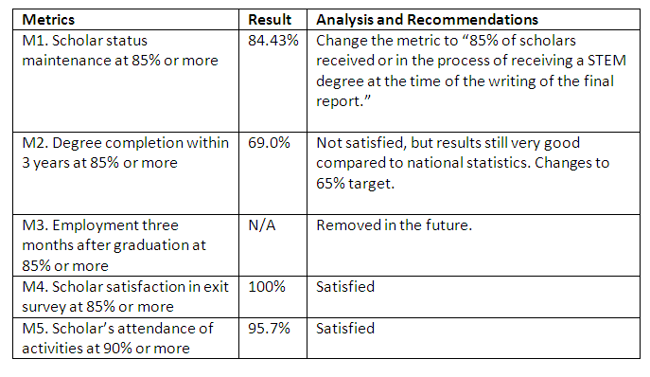
Results of Assessment

Slide 24
Next Steps
Status of new grant
Changes in assessment process
Changes in student allocation methods

Slide 25
References
Callaghan, G., Little, J. C., Morrell, C., Sabin, R., Sorkin, S., Scholarships for the computing sciences: panel discussion, Journal of Computing Sciences in Colleges, 20 (3), 171-172, February 2005.
Bureau of Labor Statistics, Occupational Outlook Handbook, 2010-11 Edition: Overview of the 2008-18 Projections, 2010, http://www.bls.gov/oco/oco2003.htm.
Preparing the next generation of STEM Innovators, May 2010, http://www.nsf.gov/news/news_summ.jsp?cntn_id=117713

