Slide 1
JAM: A Jammed-Area Mapping Service For Sensor Networks
Anthony D.Wood, A Stankovic & Sang H.Son
University Of Virginia
By,
Srikanth Pokala

Slide 2
Agenda
Introduction
Denial of Service (DoS) Attack
Detection: A mapping approach
Mapping Service
Assumptions
Design Principles
Evaluation
Conclusion

Slide 3
Introduction
Preventing DoS attacks in WSN is difficult primarily because of the limited resources and the ease with which these attacks are perpetrated.
Individual sensors are not reliable because of mass manufacturing defects ,battery death etc.
Aggregate behavior and robust algorithms provide the reliability that safety-critical applications demand.

Slide 4
Why JAM??
Rather than jeopardize design requirements which call for simple, inexpensive, mass- producible devices, a coping strategy has been proposed that detects and maps jammed regions.
Assuming that the entire network is not affected (in which case there is no hope), it can take action to avoid the area and report problem to the uplink control systems.

Slide 5
Denial of Service(DoS) Attacks
In a network that is mostly homogeneous that is, where there is little capability or functional differentiation except what is cooperative, distributed, or redundant, deliberate attacks may be strongly localized.
One such attack, most likely to occur in a battle field or urban warfare environment, is radio jamming.
Jamming is particularly easy since many will have single-frequency communication.

Slide 6
Detection: A Mapping Approach
A mapping service for WSNs that can provide the following benefits has been proposed:
Feedback to routing and directory services
An effective abstraction at a high-level than local congestion etc.
Reports to a base-station for further jamming localization, and
Aid to power management strategies

Slide 7
Mapping Service
Two primary components form the basis of mapping service
A Jamming detection, and
A Mapping module
Both operate on every node in the network.
The figure below shows the architectural diagram of a mapping service. Jamming Detection and Mapping interact remotely that is between nodes using radio.

Slide 8
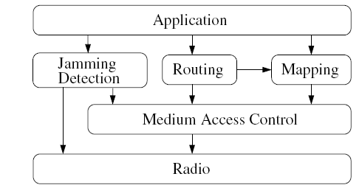
Mapping Service

Slide 9
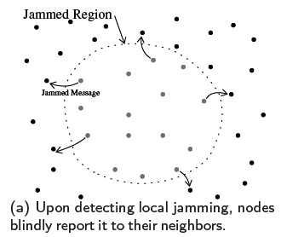
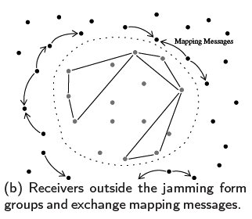
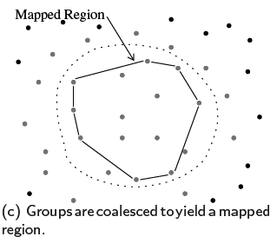
Overview

Slide 10
Jamming Detection
Jamming is interfering with the ability of an adversary to communicate
A receiver may recognize known type of jamming by their unique energy patterns
However, this approach requires digital signal processing (DSP) capabilities and a library of patterns

Slide 11
Jamming Detection
All the patterns may not be available so the users can apply heuristics to determine whether the current node is experiencing non-transient interference that might be called jamming
Due to the complexity of jamming detection and its sensitivity to the deployment environment, the authors constructed it as a separate module , with a limited interface to the mapping protocol

Slide 12
Jamming Detection
The output of the jamming detection is a JAMMED or UNJAMMED message broadcast to the node’s neighbors
To overcome this problem the MAC must provide (by modification, if necessary) a way to over-ride carrier-sense for this purpose of sending a brief, high-priority, unacknowledged broadcast message.

Slide 13
Mapping Protocol
When a node receives a Jammed message, it initiates the mapping protocol
A build message is not sent immediately rather a short announce timer is started
This allows multiple received Jammed messages to be aggregated before sending a Build message , reducing the number of broadcasts containing little information

Slide 14
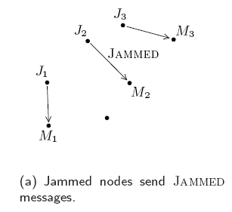
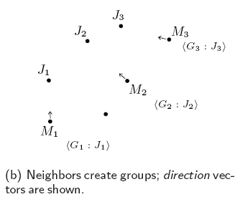
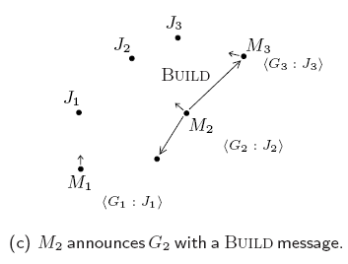
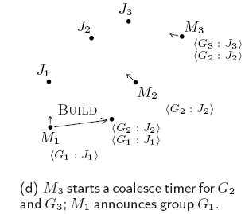
Mapping Protocol Sequence

Slide 15
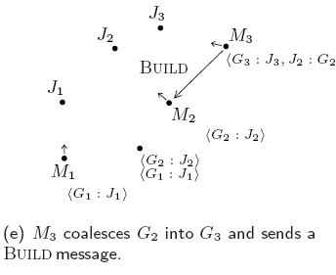
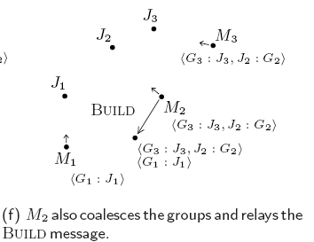
Mapping Protocol Sequence

Slide 16
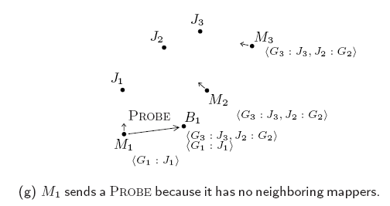
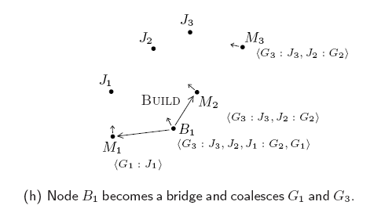
Mapping Protocol Sequence

Slide 17
Assumptions
The authors approach to mapping in sensor networks makes the following assumptions about the network or environment:
Nodes know their own location and ID, and that of their neighbors
Location information is used only for group compatibility calculation, so it need not be very accurate
After deployment, nodes move mainly by external environment forces and are otherwise static

Slide 18
Assumptions
Mapping and bridging nodes are strongly connected but individual radio links need not be bi-directional. Nodes broadcast messages to whichever neighbors are listening

Slide 19
Assumptions
The following are the authors assumptions and limitations on jamming:
The network uses single channel wireless communication
Though multiple jammers is allowed, either the sensor network is large enough , or the jamming is limited enough, that attackers cannot jam the entire network

Slide 20
Assumptions
The MAC can provide an unacknowledged, carrier-sense defeating broadcast mechanism for jamming notification
Whether simple or complex, jamming can be quantified by sensor devices using signal strength , bit error rates or other information

Slide 21
Design Principles
The unique characteristics of WSNs present many challenges to designers of MAC, routing, and group management protocols . The following design principles are suggested and how each is represented in the mapping service.

Slide 22
Design Principles
1. Loose Group Semantics:
The authors used this in addressing, messaging and membership
When creating a group in response to a JAMMED message, we randomly generate group IDs
Messaging within the group is unacknowledged and unreliable
Members do not have a shared and consistent view of the global membership

Slide 23
Design Principles
2. Eager Eavesdropping
Since our goal is to quickly diffuse knowledge of the jammed region to as many mapping members as possible, they eagerly eavesdrop on all received build messages

Slide 24
Design Principles
3. Supremacy of Local Information:
Local information is considered more up-to-date than that received by relayed messages
Each node maintains a separate list of its neighboring nodes
They also consider local information to be more trustworthy and verify it against information received in a relayed message

Slide 25
Design Principles
4. Early use of Results:
Nodes do not wait until a complete picture of the jammed region is available to perform avoidance strategies.
Whatever local information is available is used to influence routing, power management etc.

Slide 26
Evaluation
Types of Groups:
Member Groups are those held by any mapping member of a group at the end of the simulation
Dominant Groups were determined by considering the subsumed group ID list in every group remaining at the end of the simulation.

Slide 27
Evaluation
Simulation Methodology
A WSN using the GloMoSim simulator has been simulated
The dimensions are 4000 by 400 meter field
400 nodes were placed at 200meter intervals on a grid

Slide 28
Evaluation
Two sets of experiments have been performed:
The first experiment tested the correctness of the jammed region mapping and performance for varying jammed region sizes from 5 nodes affected to 144 nodes affected
Secondly , the performance of the 8 and 12 neighborhood sizes under mapping node failure have been tested

Slide 29
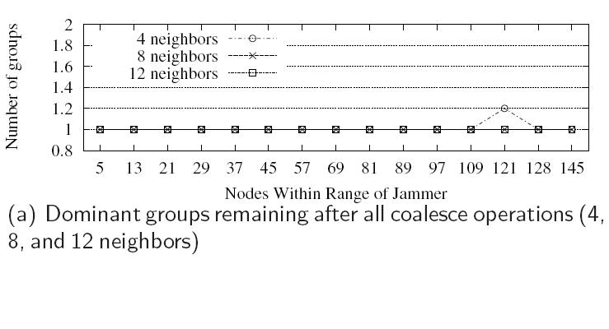
Results
Experiment 1: Varying Jammer Range

Slide 30
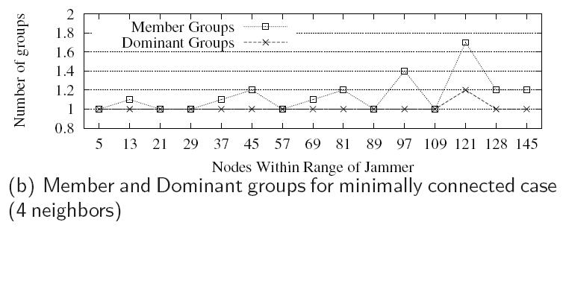
Results

Slide 31
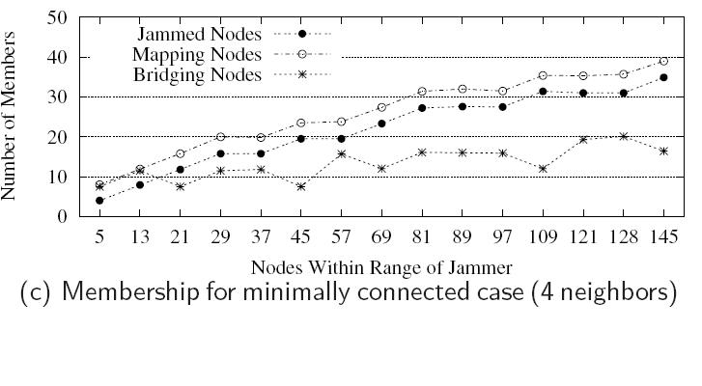
Results

Slide 32
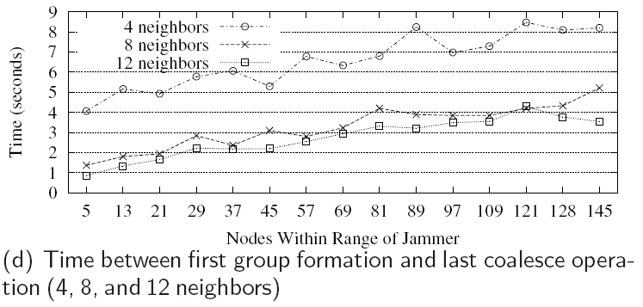
Results

Slide 33
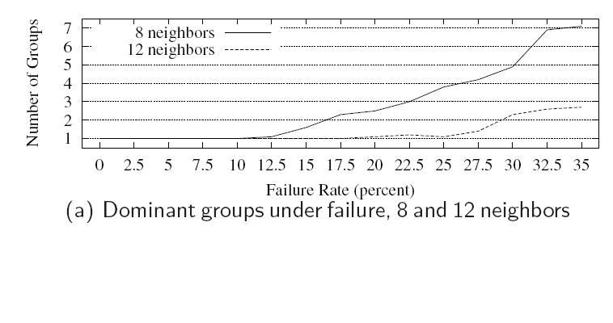
Results
Experiment 2: Varying Failure

Slide 34
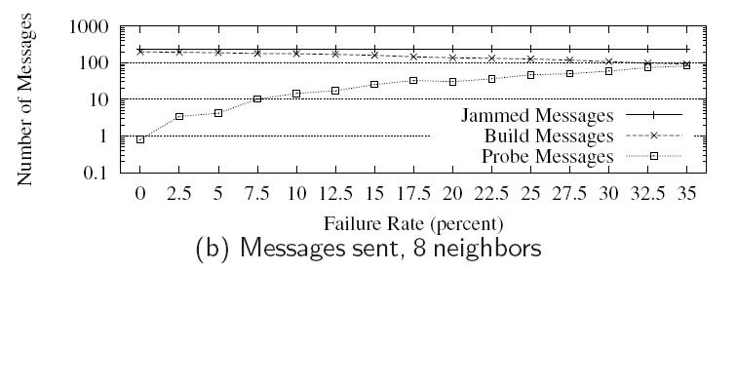
Results

Slide 35
Conclusion
A protocol for mapping the extent of the jammed region is proposed and evaluated for jamming by radio interference.
The authors evaluated a mapping protocol by simulation, showing its correctness and performance for varying size jammed regions and failure rates.

Slide 36
References
“JAM: A jammed-area mapping service for sensor networks”, Anthony D. Wood, John A.Stankovic, and Sang H.Son, Department of Computer Science, University of Virginia.

Slide 37
Thank You

