Slide 1
Enhancing Security Using Mobile Based Anomaly Detection in Cellular Mobile Networks
Authors
Bo Sun, Fei Yu, Kui Wu, Yang Xiao, and Victor C. M. Leung.
Presented by
Aniruddha Barapatre

Slide 2
Introduction
Importance of Cellular phones.
Due to the open radio transmission environment and the physical vulnerability of mobile devices , security is a cause of concern.
Approaches to protect a system
  Prevention based approach
  Detection based approach
Notes:
Cellular phones are now being used in E-Shopping and E banking

Slide 3
Prevention and Detection Based Approach
Prevention based approach :
Encryption and authentication – allows legitimate users to enter into the system.
Detection based approach: IDS ( Intrusion detection systems)
  Misuse based detection – to detect known used patterns
  Anomaly based detection –
    Used to detect known and unknown patterns.
    Creates a profile for user behavior and path and compares it with the current activity .
    Deviation observed is reported

Slide 4
Goal !
To design a mobility based anomaly detection scheme.
To provide an optional service to end users.
A useful administration tool to service providers.

Slide 5
Assumptions
There exists a mobility database for each mobile user that describes it normal activities.
Once the device has been compromised all the security details are available to the attacker .
All users have got a regular itinerary .

Slide 6
Mobility Based Anomaly Detection Schemes
LZ Based Intrusion detection :
  Feature Extraction
  Optimized data compression
  Probability Calculation – Markov model is used .
  Anomaly detection algorithm
Markov-Based Anomaly Detection.

Slide 7
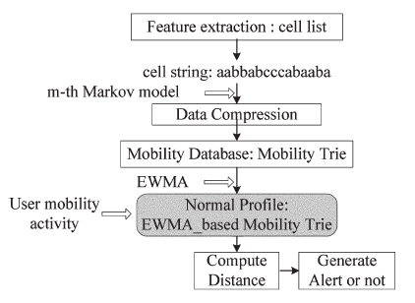
LZ Based Anomaly detection

Slide 8
LZ Based Intrusion Detection – Feature Extraction
Features are security related measures that could be used to construct suitable detection algorithms.
General pattern of the cellular mobile network is formed for each user.
Each cell is denoted by character.
String represents path taken by user.
A mobility trie or fixed order Markov model is constructed by this string.

Slide 9
Data Compression
Encoding of data to minimize representation.
Commonly used lossless compression algorithms are dictionary based.
Dictionary D = (M, C)
  M – set of phrases and C – function
  C maps M onto set of codes.

Slide 10
Probability Calculation
Based on prediction by partial matching scheme.
Consecutive previous m characters are used to predict the next character and calculate probability.
  m = 1 → Next event only depends on the last event in the past
  m > 1 → Next event depends on multiple M events in the past
m – small → prediction will be poor as little data to audit.
m – large → most contexts will seldom happen.

Slide 11
Contd…
Blended probability P(α) = ∑^{m}_{i = 0} w_{i} * p_{i}(α)
  m – maximum order
  α – next character predicted
  i – previous characters
  p_{i}(α) – probability assigned to α
  w_{i} – weight given to model of order i

Slide 12
Anomaly Detection Algorithm
  Integration of EWMA into mobile trie.(changed frequency)
    F(i) = λ * 1 + (1 - λ) * F(i) → i – one item of corresponding events
    F(i) = λ * 0 + (1 - λ) * F(i) → i – not one item of corresponding events
      λ – smoothing constant which determines decay rate

Slide 13
Markov Based Anomaly Detection
P(X_{(t+1 = j)}) = N(j)/N
  X(t) = state visited by the user or the users activity at time t .
  N is the total number of observations (cells)
  N(j) total number of observations of destination .
For o = 0, probability Po is –
  ∑^{n}_{i = 1} P (x_{i} = j)
Similarity metric (S) = Po / Length (S)
  Length (S) – length of string

Slide 14
Similarities between Markov and LZ based algorithm
Examine the history so far.
Extract the current context.
Predict the next cell location.
Append history with one character (standing for one cell).
Predictor updates its history to prepare for next prediction.

Slide 15
Difference between Markov and LZ based algorithm
LZ
LZ has compression
Has EWMA
There exists a concept of Modified frequency
Markov
In Markov there is No compression
No EWMA
Only one frequency exists

Slide 16
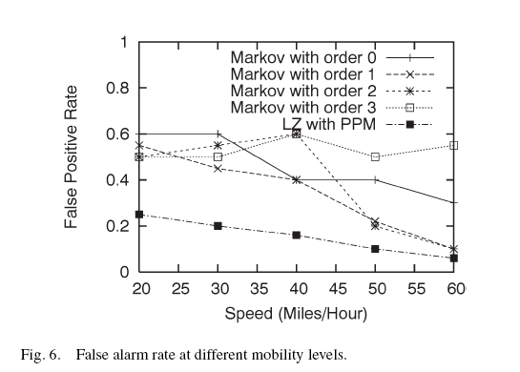
Conclusion
False alarm rate of LZ is lower than that of Markov, this is due to EWMA used in LZ
As the mobility increases the false alarm rate decreases.

Slide 17
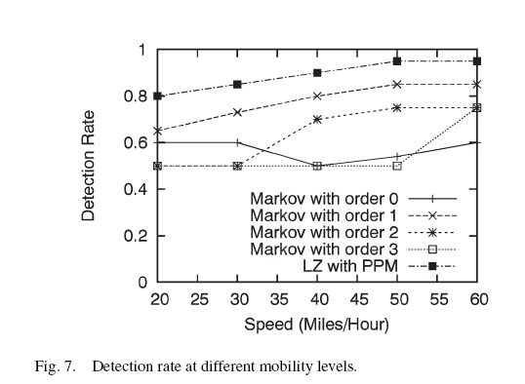
Contd…
Detection Rate :
  The detection rate of the LZ-based scheme is higher than those of Markov based schemes with different orders
  Reason – Use of EWMA in LZ
  Detection rate of all schemes increases with the increase in mobility.
  Thus the detection rate is improved in case of mobility.

Slide 18
References
Bo Sun, Fei Yu, Kui Wu, Yang Xiao and Victor C. M. Leung, “Enhancing Security Using Mobility-Based Anomaly Detection in Cellular Mobile Networks”, IEEE Transactions on vehicular technology, 3 May 2006.

