Slide 1
Attack-Resistant Location Estimation in Sensor Networks
Presented by: Rohit Rangera

Slide 2
Topics
Introduction
Terms
Assumption
Method 1. Attack-Resistance Minimum Mean Square Estimation
Method 2. Voting Based Location Estimation
Limit

Slide 3
Threat
Security of location discovery, enhanced by authentication
- If authentication is failed, means our beacon nodes have compromised.

Slide 4
Methods
1. Filters out malicious beacon signals on the basis of “consistency” among multiple beacon signals.
2. Tolerate malicious beacon by adopting an iteratively refined voting scheme.

Slide 5
Beacon nodes
They know their position and location either GPS or manually.
Useful to communicate non-Beacon nodes.

Slide 6
Working
Steps
1. Non-beacon nodes receive radio signals called beacon signals from the beacon nodes ( x,y,d).
2. The sensor nodes determine its own location when it have enough number of location references from different beacon nodes.

Slide 7
Assumption and Threat model
1. All beacon nodes are uniquely identified.
2. Each non-beacon node uses at most one location reference derived from the beacon signals sent by each beacon node (for safety).
An attacker may change any field in a location reference (x,y,d).

Slide 8
Attack-Resistance Minimum Mean Square Estimation

Slide 9
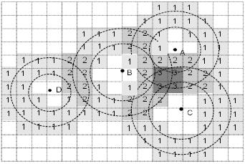
Voting-based location estimation

Slide 10
Security Analysis
To defeat this approach, 1. the attacker has to distribute to a victim node more malicious location references than the benign ones, and control the declared locations and the physical features (like signal strength) of beacon signals so that the malicious location references are considered consistence.
2. The attacker needs similar efforts so that the cell containing the attacker’s choice gets more voted then those containing the sensor’s real location

Slide 11
What attacker can do
1. The attacker may compromise beacon nodes and then generate malicious beacon signals.
2. Attacker may launch wormhole attacks or replay attack to tunnel benign beacon signals from one area to another.

Slide 12
Limit
If all the beacon nodes are compromised, their techniques will fails.

Slide 13
Reference
1. Attack-Resistance Location Estimation in Sensor Networks
By: D. Liu and P, Ning.
W. Du.

Slide 14
Thank You
Any question please ?

