Slide 1
Outline
Introduction
Background
Distributed Database Design
Database Integration
  Schema Matching
  Schema Mapping
Semantic Data Control
Distributed Query Processing
Multimedia Query Processing
Distributed Transaction Management
Data Replication
Parallel Database Systems
Distributed Object DBMS
Peer-to-Peer Data Management
Web Data Management
Current Issues

Slide 2
Problem Definition
Database Integration: Given existing databases with their Local Conceptual Schemas (LCSs), how to integrate the LCSs into a Global Conceptual Schema (GCS) (also called a mediated schema)
  a bottom-up design process
  Result: a Multidatabase system
The more general problem: information system interoperability
  Querying multiple data sources, including both databases and non-databases
  Interoperability at the database vs Interoperability at the application level (e.g., Enterprise Application Integration (EAI) allows data exchange and transformation between applications.)

Slide 3
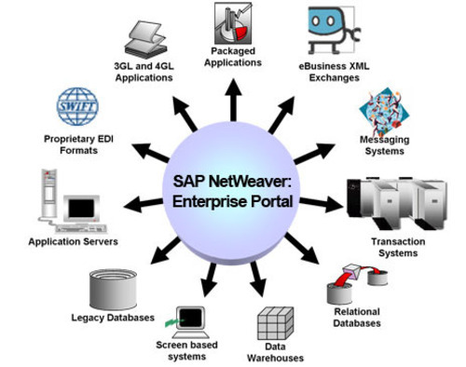
Enterprise Application Integration (EAI)
The chaos of computer applications existing in an enterprise
→ The need of integrating applications across the enterprise

Slide 4
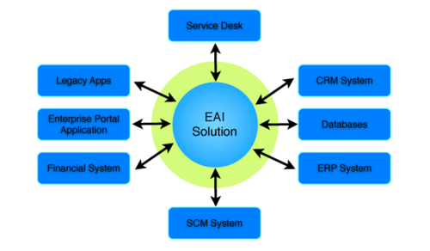
Using EAI technology to bring order to an enterprise

Slide 5
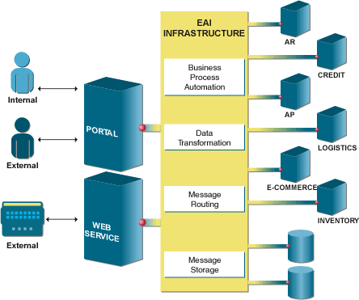

Slide 6
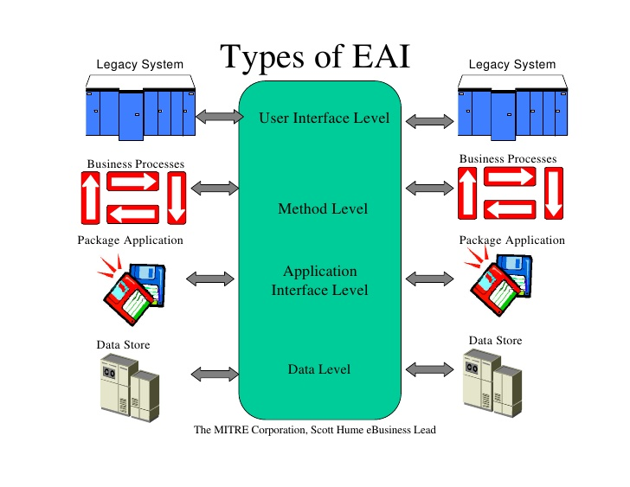
Types of EAI

Slide 7
Alternatives of Database Integration
Physical integration
  Source databases are integrated and the integrated database is materialized
    e.g., Data warehouses
Logical integration
  Global conceptual schema is virtual and not materialized
    e.g., Enterprise Information Integration (EII)

Slide 8
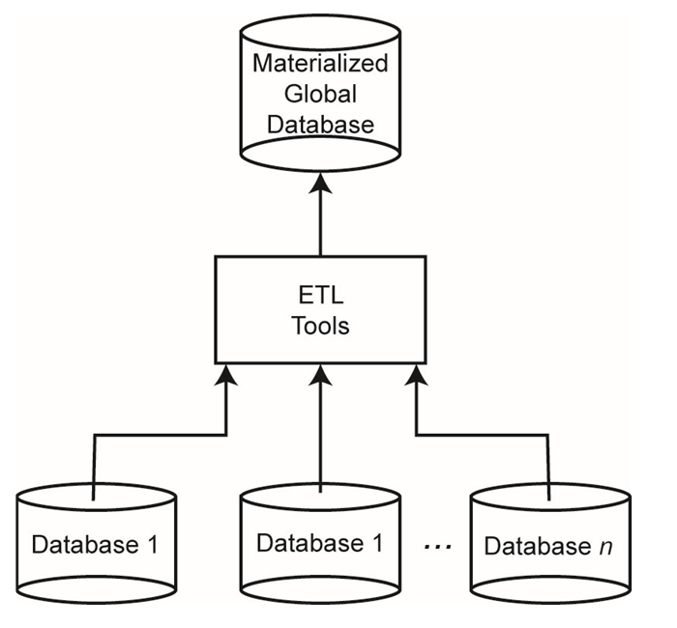
Data Warehouse Approach
The integration is aided by extract-transform-load (ETL) tools that enable extraction of data from sources, their transformation to match the GCS, and their loading (i.e., materialization).

Slide 9
Bottom-up Design
GCS (also called mediated schema) is defined first
  Map LCSs to this GCS
  As in data warehouses
GCS is defined as an integration of parts of LCSs
  Generate GCS and map LCSs to this GCS

Slide 10
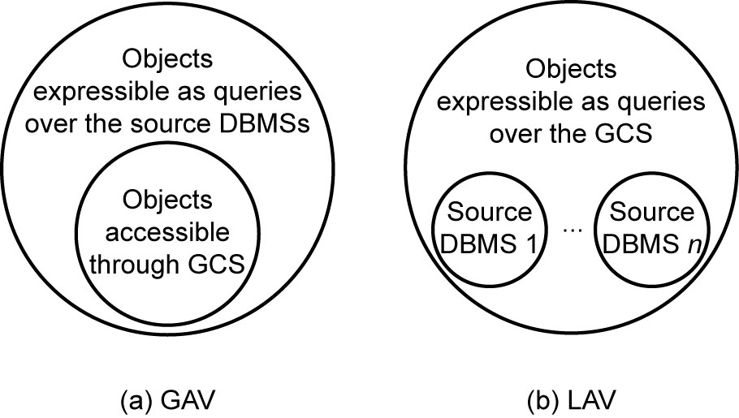
GCS/LCS Relationship
 | Global-as-view (GAV) | Local-as-view (LAV)
Meanings | The GCS is defined as a set of views over the LCSs. | The GCS definition is assumed to exist, and each LCS is treated as a view definition over the GCS.
constraints | The query results are constrained to the set of objects that are defined in the GCS, although the local DBMSs may be considerably richer. | The results are constrained by the objects in the local DBMSs, while the GCS definition may be richer.

Slide 11
Distributed Multidatabase System
Distributed DBMSs vs Distributed Multi-DBMSs
  Differences in how the GCS is defined
  Differences in level of autonomy
  Design differences: Top-down approach vs Bottom-up approach
 | Distributed DBMSs | Distributed Multi-DBMSs
GCS
Autonomy
Design approach

Slide 12
Distributed Multidatabase System Architecture (Fig. 1.16)
...
GES: Global External Schema
LES: Local External Schema
LIS: Local Internal Schema
GES₁
GES₂
GES_{n}
LES₁₁
…
LES_{1n}
GCS
LES_{n1}
…
LES_{nm}
LCS₁
LCS₂
…
LCS_{n}
NOTE: GCS may come from LES
…
LIS₁
LIS₂
LIS_{n}

Slide 13
MDBS Components & Execution
Global
User Request
Local
User
Request
Local
User
Request
Multi-DBMS
Layer
Global
Subrequest
Global
Subrequest
Global
Subrequest
DBMS₁
DBMS₂
DBMS₃

Slide 14
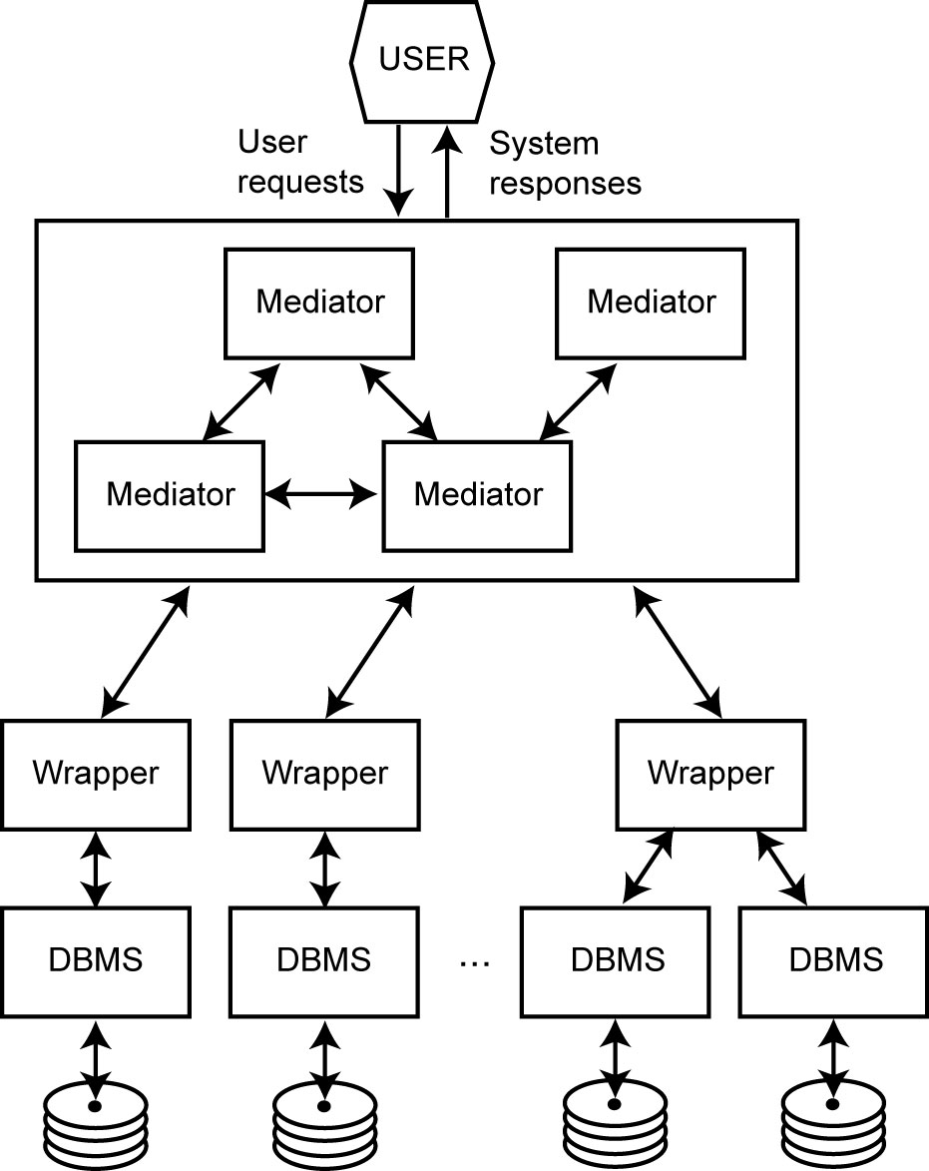
An Example of MDBSs
- Mediator/Wrapper Architecture
Mediator: a software
Each mediator performs a particular function with clearly defined interfaces.
a middleware layer
Implements the GCS
Wrapper
Provide a mapping between a source DBMS view and the mediators’ view.

Slide 15
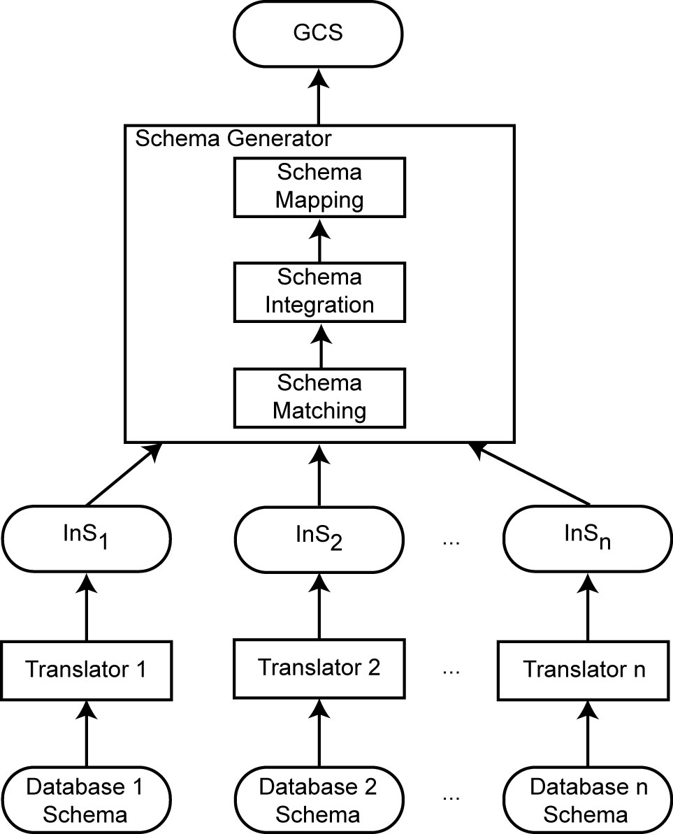
Database Integration Process
Two steps:
Schema generation
  Intermediate schemas are used to create a global conceptual schema (GCS).
Schema translation
  - Component database schemas translated to a common intermediate canonical representation.

Slide 16
Database Integration Process
Steps in Schema Generation
Schema matching determines the syntactic and semantic correspondences among the translated LCS elements (if the GCS is not defined yet) or between individual LCS elements and the pre-defined GCS elements.
Integration is to integrate the common schema elements into the GCS (if one has not yet been defined).
Schema mapping determines how to map the elements of each LCS to the other elements of the GCS.

Slide 17
Schema Translation
What is the canonical data model?
  Relational
  Entity-relationship
    DIKE
  Object-oriented
    ARTEMIS
  Graph-oriented
    DIPE, TranScm, COMA, Cupid
    Preferable with emergence of XML
    No common graph formalism
Mapping algorithms
  These are well-known

Slide 18
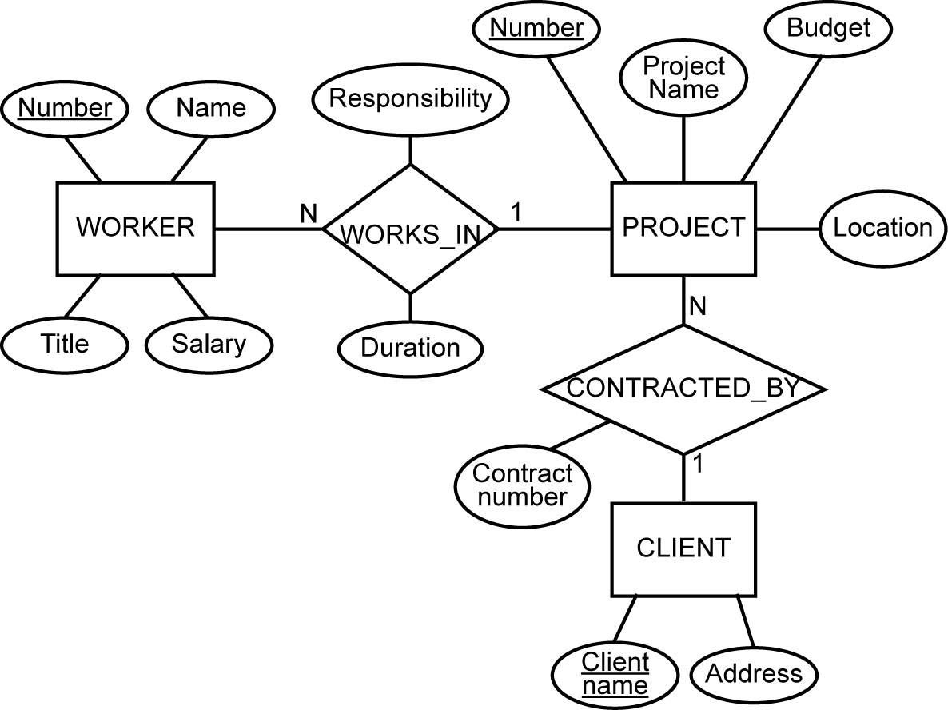
Example: mapping an E-R Model to the Relational Model
E-R Model
Relational
EMP(ENO, ENAME, TITLE)
PROJ(PNO, PNAME, BUDGET, LOC, CNAME)
ASG(ENO, PNO, RESP, DUR)
PAY(TITLE, SAL)

Slide 19
Schema Matching
- which concepts of one schema match those of another?
Issues:
Schema heterogeneity
  Structural heterogeneity
    Type conflicts: attributes vs entities
    Dependency conflicts: different relationship modes
    Key conflicts: different primary keys
    Behavioral conflicts: Different modeling mechanisms may imply conflicts (e.g., when the last employee is deleted from a department)
  Semantic heterogeneity
    More important and harder to deal with
    Synonyms, homonyms, hypernyms
    Different ontology
    Imprecise wording

Slide 20
Schema Matching (cont’d)
Other complications
  Insufficient schema and instance information
  Unavailability of schema documentation
  Subjectivity of matching
Issues that affect schema matching
  Schema versus instance matching
  Element-level versus structure-level matching
  Matching cardinality

Slide 21
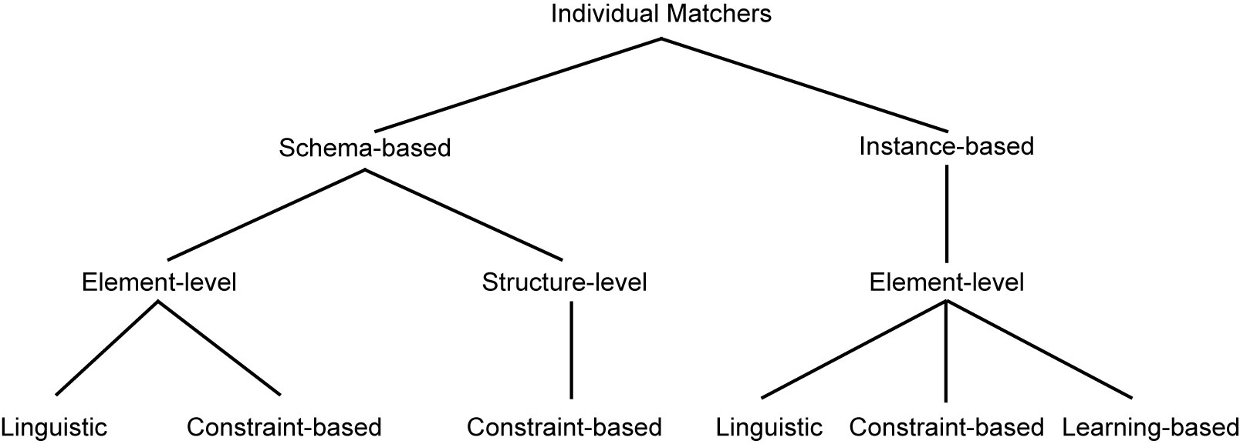
Schema Matching Approaches

Slide 22
Linguistic Schema Matching
Use element names and other textual information (textual descriptions, annotations) to match the elements
May use external sources (e.g., Thesauri)
〈SC1.element-1 ≈ SC2.element-2, p, s〉
  Element-1 in schema SC1 corresponds to element-2 in schema SC2 if predicate p holds with a similarity value of s.
Two approaches:
Schema level matching: similarities are established among elements
  Deal with names of schema elements
  Handle cases such as synonyms, homonyms, hypernyms, data type similarities
Instance level: similarities are specified among elements of individual data instances
  Focus on information retrieval techniques (e.g., word frequencies, key terms)
  “Deduce” similarities from these

Slide 23
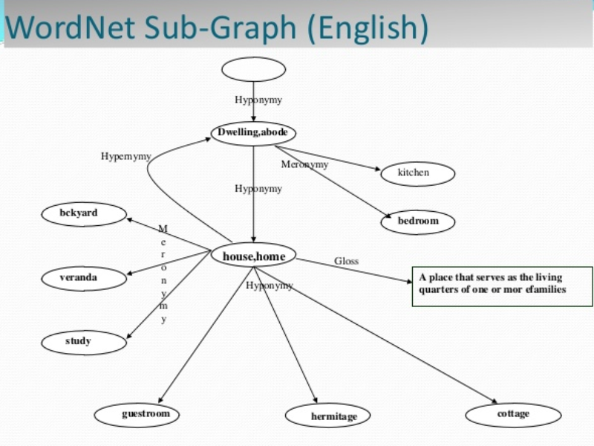
Linguistic Matchers
Use a set of linguistic (terminological) rules
Basic rules can be hand-crafted or may be discovered from outside sources (e.g., WordNet)
source: https://www.slideshare.net/govindraj15/wordnet-27805299

Slide 24
Linguistic Matchers (cont.)
Predicate p and similarity value s
  hand-crafted ⇒ specified,
  discovered ⇒ may be computed or specified by an expert after discovery
Examples
  〈uppercase names ≈ lower case names, true, 1.0〉
  〈uppercase names ≈ capitalized names, true, 1.0〉
  〈capitalized names ≈ lower case names, true, 1.0〉
  〈DB1.ASG ≈ DB2.WORKS_IN, true, 0.8〉

Slide 25
Automatic Discovery of Name Similarities
Affixes
  Common prefixes and suffixes between two element name strings
N-grams
  Comparing how many substrings of length n are common between the two name strings
Edit distance (aka the Lewenstein metric)
  Number of character modifications (additions, deletions, insertions) that needs to be performed to convert one string into the other
Soundex code
  Phonetic similarity between names based on their soundex codes
Also look at data types
  Data type similarity may suggest stronger relationship than the computed similarity using these methods or to differentiate between multiple strings with same value

Slide 26
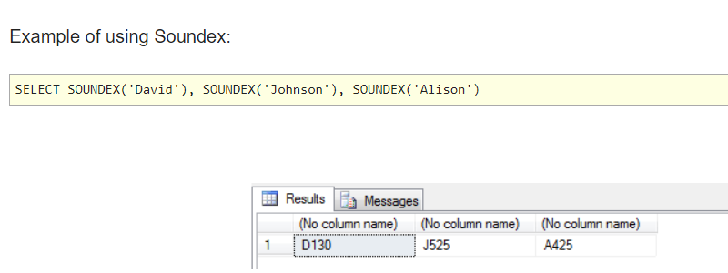
Soundex codes and SQL https://www.mssqltips.com/sqlservertip/2905/forgotten-sql-server-functions--varp-soundex-and-ntile/

Slide 27
N-gram Example
- RESP vs RESPONSIBILITY
3-grams of string “Responsibility” are the following:
    Res  sib
    ibi  esp
    bip  spo
    ili  pon
    lit  ons
    ity  nsi
3-grams of string “Resp” are
  Res
  esp
3-gram similarity: 2/12 = 0.17

Slide 28
Edit Distance Example
- RESP vs RESPONSIBILITY
Again consider “Responsibility” and “Resp”
To convert “Responsibility” to “Resp”
  Delete characters “o”, “n”, “s”, “i”, “b”, “i”, “l”, “i”, “t”, “y”
To convert “Resp” to “Responsibility”
  Add characters “o”, “n”, “s”, “i”, “b”, “i”, “l”, “i”, “t”, “y”
The number of edit operations required is 10
Edit distance similarity is 1 − (10/14) = 0.29

Slide 29
Constraint-based Matchers
Data always have constraints – use them
  Data type information
  Value ranges
  …
Examples
  RESP and RESPONSIBILITY: n-gram similarity = 0.17, edit distance similarity = 0.19 (low)
  If they come from the same domain, this may increase their similarity value.
  ENO in relational, WORKER.NUMBER and PROJECT.NUMBER in E-R
  ENO and WORKER.NUMBER may have type INTEGER while PROJECT.NUMBER may have STRING

Slide 30
Constraint-based Structural Matching
The structural similarities in the two schemas can be exploited in determining the similarity of the schema elements.
  If two schema elements are structurally similar, then there is a higher likelihood that they represent the same concept.
Structural similarity:
  Same properties (attributes)
  “Neighborhood” similarity
    Using graph representation
    The set of nodes that can be reached within a particular path length from a node are the neighbors of that node.
    If two concepts (nodes) have similar set of neighbors, they are likely to represent the same concept.

Slide 31
Learning-based Schema Matching
Use machine learning techniques to determine schema matches
Classification problem
  Classify concepts from various schemas into classes according to their similarities.
  Those that fall into the same class represent similar concepts.
  Similarity is defined according to features of data instances.
  Classification is “learned” from a training set.

Slide 32
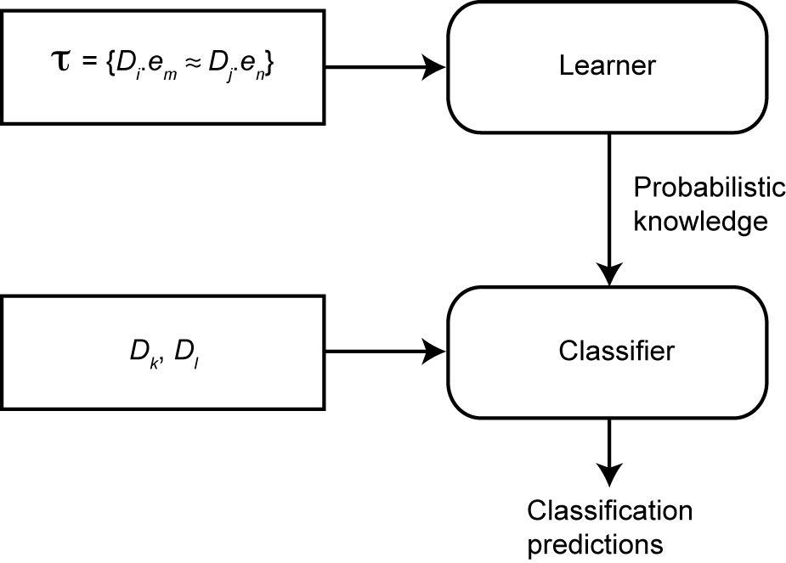
Learning-based Schema Matching
A training set (t) is prepared that consists of instances of example correspondences between the concepts of two databases Di and Dj.
Given two other database instances (Dk and Dl )

Slide 33
Combined Schema Matching Approaches
Use multiple matchers
  Each matcher focuses on one area (name, etc)
Meta-matcher integrates these into one prediction
Integration may be simple (take average of similarity values) or more complex (see Fagin’s work)

Slide 34
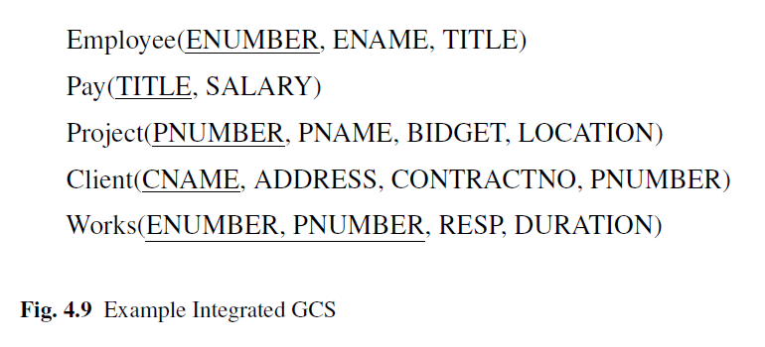
An Example GCS after schema integration

Slide 35
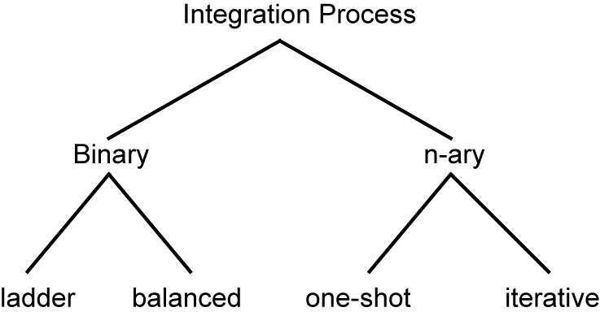
Schema Integration
Use the correspondences to create a GCS
Mainly a manual process, although rules can help

Slide 36
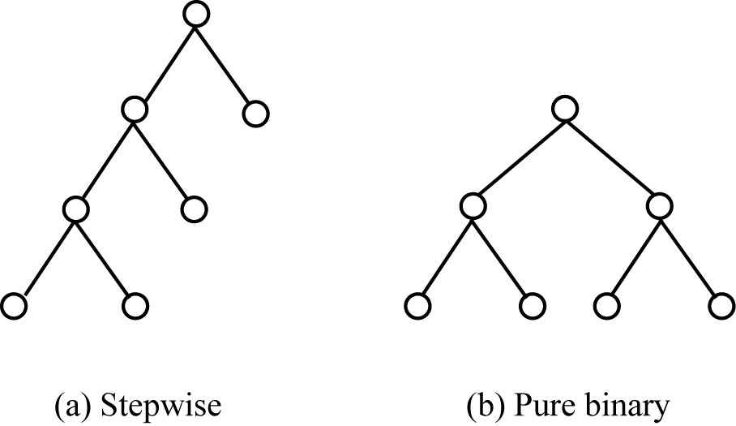
Binary Integration Methods
manipulation of two schemas at a time
stepwise (ladder) fashion, where intermediate schemas are created for integration with subsequent schemas;
purely binary fashion, where each schema is integrated with one other, creating an intermediate schema for integration with other intermediate schemas

Slide 37
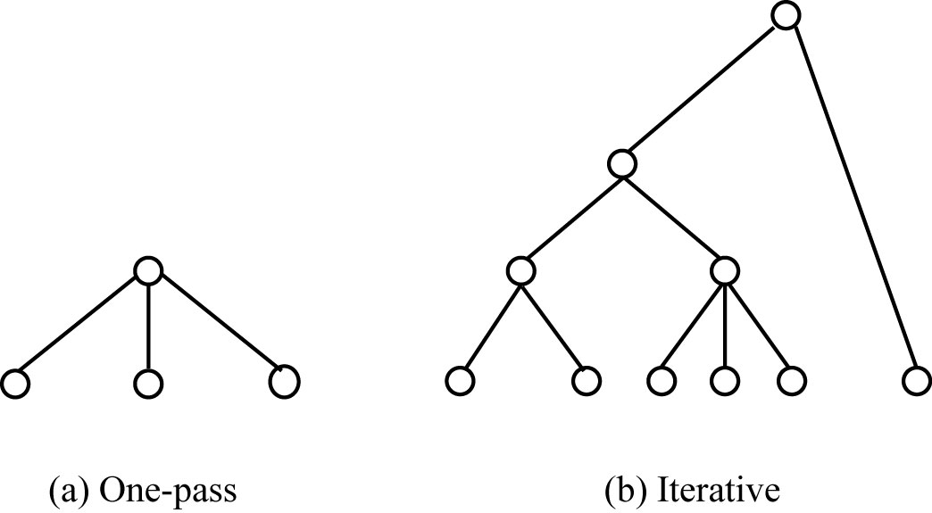
N-ary Integration Methods

Slide 38
Schema Mapping
Mapping data from each local database (source) to GCS (target) while preserving semantic consistency as defined in both source and target.
Data warehouses ⇒ actual translation
Data integration systems ⇒ discover mappings that can be used in the query processing phase
Mapping creation
Mapping maintenance

Slide 39
Mapping Creation
Given
  A source LCS
  A target GCS
  A set of value correspondences discovered during schema matching phase
Produce a set of queries that, when executed, will create GCS data instances from the source data.
We are looking for, for each T_{k}, a query Q_{k} that is defined on a (possibly proper) subset of the relations in S such that, when executed, will generate data for T_{i} from the source relations

