Slide 1
Outline
Introduction
What is a distributed DBMS
Distributed DBMS Architecture
Background
Distributed Database Design
Database Integration
Semantic Data Control
Distributed Query Processing
Multidatabase query processing
Distributed Transaction Management
Data Replication
Parallel Database Systems
Distributed Object DBMS
Peer-to-Peer Data Management
Web Data Management
Current Issues

Slide 2
File Systems
program 1
File 1
data description 1
program 2
data description 2
File 2
program 3
data description 3
File 3

Slide 3
Database Management
Application
program 1
(with data
semantics)
DBMS
description
Application
program 2
(with data
semantics)
manipulation
database
control
Application
program 3
(with data
semantics)

Slide 4
Motivation
Database
Technology
Computer
Networks
integration
distribution
Distributed
Database
Systems
integration
integration ≠ centralization

Slide 5
Distributed Computing
A number of autonomous processing elements (not necessarily homogeneous) that are interconnected by a computer network and that cooperate in performing their assigned tasks.
What is being distributed?
Processing logic
Function
Data
Control

Slide 6
What is a Distributed Database System?
A distributed database (DDB) is a collection of multiple, logically interrelated databases distributed over a computer network.
A distributed database management system (D–DBMS) is the software that manages the DDB and provides an access mechanism that makes this distribution transparent to the users.
Distributed database system (DDBS) = DDB + D–DBMS

Slide 7
What is NOT a DDBS?
A timesharing computer system
A loosely or tightly coupled multiprocessor system
A database system which resides at one of the nodes of a network of computers - this is a centralized database on a network node

Slide 8
Centralized DBMS on a Network
Site 1
Site 2
Site 5
Communication
Network
Site 4
Site 3

Slide 9
Distributed DBMS Environment
Site 1
Site 2
Site 5
Communication
Network
Site 4
Site 3

Slide 10
Implicit Assumptions of DDBS
Data stored at a number of sites → each site logically consists of a single processor.
Processors at different sites are interconnected by a computer network → not a multiprocessor system
c.f., Parallel database systems
https://en.wikipedia.org/wiki/Parallel_database
A parallel database system seeks to improve performance through parallelization of various operations, such as loading data, building indexes and evaluating queries.
Parallel databases improve processing and input/output speeds by using multiple CPUs and disks in parallel.

Slide 11
Implicit Assumptions of DDBS
Distributed database is a database, not a collection of files → data logically related as exhibited in the users’ access patterns
Relational data model
D-DBMS is a full-fledged DBMS
Not remote file system, not a TP system

Slide 12
Data Delivery Alternatives
Delivery modes
Pull-only
Push-only
Hybrid
Frequency
Periodic
Conditional
Ad-hoc or irregular
Communication Methods
Unicast
One-to-many
Note: not all combinations make sense

Slide 13
Distributed DBMS Promises
Transparent management of distributed, fragmented, and replicated data
Improved reliability/availability through distributed transactions
Improved performance
Easier and more economical system expansion

Slide 14
Transparency
Transparency is the separation of the higher level semantics of a system from the lower level implementation issues.
Fundamental issue is to provide data independence in the distributed environment
Network (distribution) transparency
Replication transparency
Fragmentation transparency
horizontal fragmentation: selection
vertical fragmentation: projection
hybrid

Slide 15
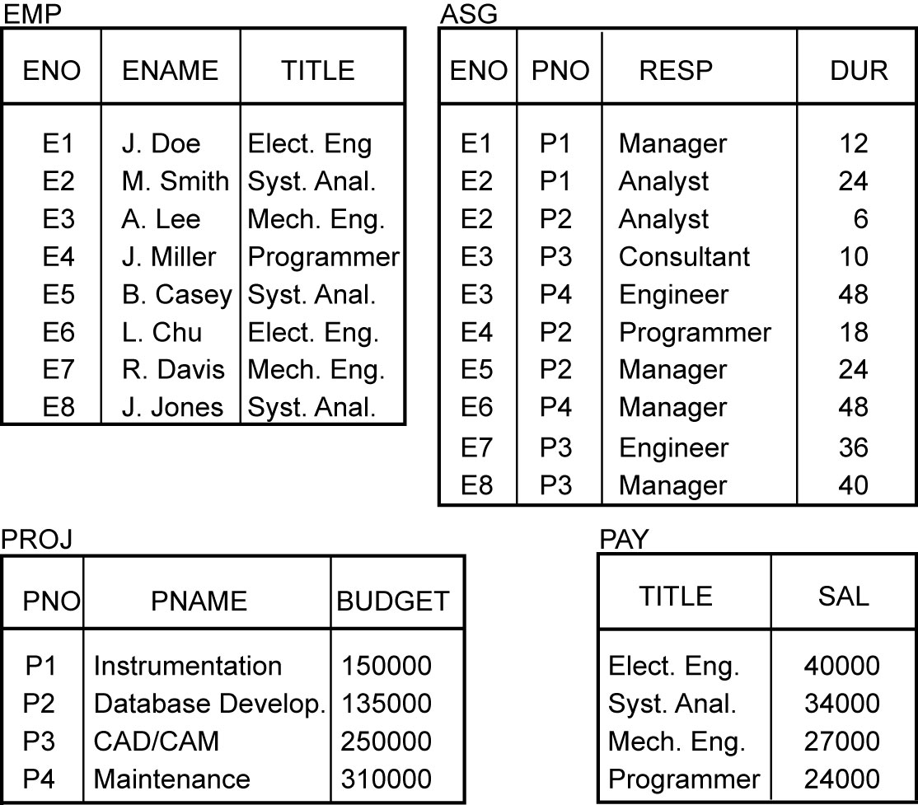
Example

Slide 16
Transparent Access
Tokyo
SELECT ENAME,SAL
FROM EMP,ASG,PAY
WHERE DUR > 12
AND EMP.ENO = ASG.ENO
AND PAY.TITLE = EMP.TITLE
Boston
Paris
Paris projects
Paris employees
Paris assignments
Boston employees
Communication
Network
Boston projects
Boston employees
Boston assignments
Montreal
New
York
Montreal projects
Paris projects
New York projects
with budget > 200000
Montreal employees
Montreal assignments
Boston projects
New York employees
New York projects
New York assignments
Notes:
Animated slide

Slide 17
Distributed Database - User View
Distributed Database

Slide 18
Distributed DBMS - Reality
User
Query
DBMS
Software
User
Application
DBMS
Software
DBMS
Software
Communication
Subsystem
User
Application
DBMS
Software
User
Query
DBMS
Software
User
Query

Slide 19
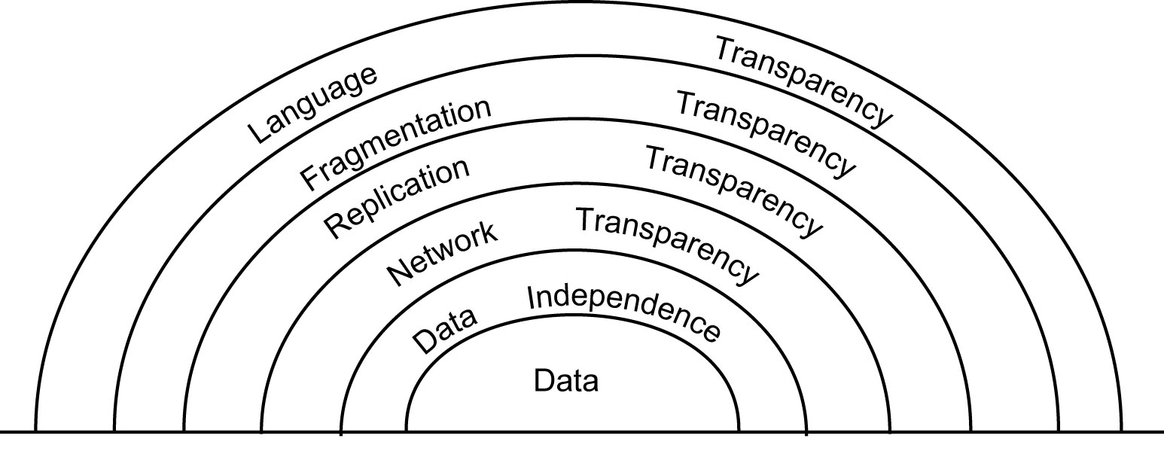
Types of Transparency

Slide 20
Types of Transparency
Data independence
The immunity of user applications to changes in the definition and organization of data, and vice versa
When a user application is written, it should not be concerned with the details of physical data organization.
The user application should not need to be modified when data organization changes occur due to performance considerations.
Network transparency (or distribution transparency)
Location transparency
Fragmentation transparency

Slide 21
Types of Transparency
Replication transparency
Fragmentation transparency
For reasons of performance, availability, and reliability, it is commonly desirable to divide each database relation into smaller fragments and treat each fragment as a separate database object
horizontal fragmentation vs vertical fragmentation
requires a translation from what is called a global query to several fragment queries.

Slide 22
ACID principle of Transactions
Atomicity
All changes to data are performed as if they are a single operation.
That is, all the changes are performed, or none of them are.
Consistency
Data is in a consistent state when a transaction starts and when it ends.
Isolation
The intermediate state of a transaction is invisible to other transactions.
As a result, transactions that run concurrently appear to be serialized.
Durability
After a transaction successfully completes, changes to data persist and are not undone, even in the event of a system failure.

Slide 23
Reliability Through Transactions
Replicated components and data should make distributed DBMS more reliable.
Distributed transactions provide concurrency transparency and failure atomicity.
It transforms a consistent database state to another consistent database state even when a number of such transactions are executed concurrently (concurrency transparency), and even when failures occur (failure atomicity).
Distributed transaction support requires implementation of distributed concurrency control protocols and commit protocols.
Data replication
Great for read-intensive workloads, problematic for updates
Replication protocols

Slide 24
Potentially Improved Performance
Proximity of data to its points of use
Requires some support for fragmentation and replication
Parallelism in execution
Inter-query parallelism
Intra-query parallelism

Slide 25
Parallelism Requirements
Have as much of the data required by each application at the site where the application executes
Full replication
How about updates?
Mutual consistency
Freshness of copies

Slide 26
System Expansion
Issue is database scaling
Emergence of microprocessor and workstation technologies
Demise of Grosch's law
Expensive high-end computers vs Client-server model of computing

Slide 27
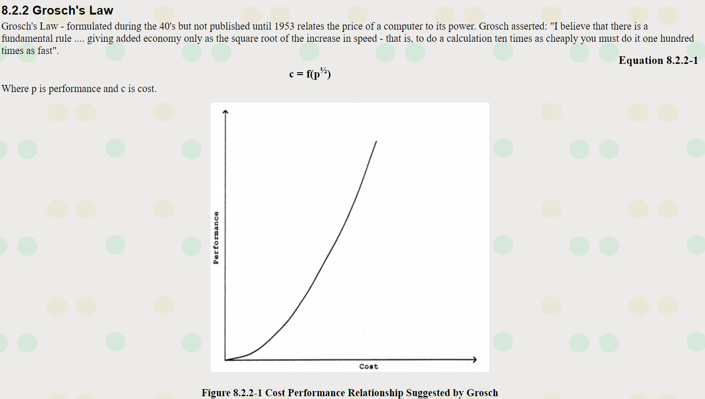
https://www.gigaflop.co.uk/comp/chapt8.shtml

Slide 28
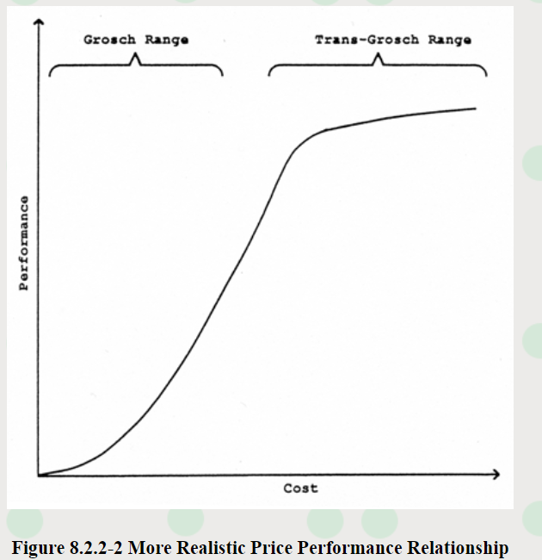
https://www.gigaflop.co.uk/comp/chapt8.shtml

Slide 29
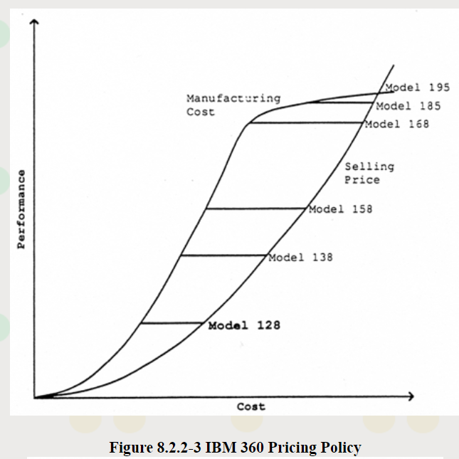
https://www.gigaflop.co.uk/comp/chapt8.shtml

Slide 30
System Expansion
Other costs?
Telecommunication cost
Data communication cost
Cost associated with processing of distributed queries

Slide 31
Distributed DBMS Issues
Distributed Database Design
How to distribute the database
Replicated & non-replicated database distribution
A related problem in directory management
Query Processing
Convert user transactions to data manipulation instructions
Optimization problem
min{cost = data transmission + local processing}
General formulation is NP-hard
(See discussions about P, NP, and NP-hard at https://en.wikipedia.org/wiki/NP-hardness)

Slide 32
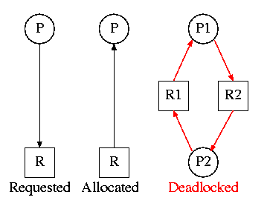
Distributed DBMS Issues
Concurrency Control
Synchronization of concurrent accesses
Consistency and isolation of transactions' effects
Deadlock management
A deadlock is a situation in which two computer programs sharing the same resource are effectively preventing each other from accessing the resource, resulting in both programs ceasing to function. (https://whatis.techtarget.com/definition/deadlock)
Reliability
How to make the system resilient to failures
Atomicity and durability

Slide 33
Relationship Between Issues
Directory
Management
Query
Processing
Distribution
Design
Reliability
Concurrency
Control
Deadlock
Management

Slide 34
Related Issues
Operating System Support
Operating system with proper support for database operations
Dichotomy between general purpose processing requirements and database processing requirements
Open Systems and Interoperability
Distributed Multidatabase Systems
More probable scenario
Parallel issues

Slide 35
Architecture
Defines the structure of the system
components identified
functions of each component defined
interrelationships and interactions between components defined

Slide 36
ANSI/SPARC Architecture 1975, 1977
Users
External
Schema
External
view
External
view
External
view
Conceptual
Schema
Conceptual
view
Internal
Schema (per DBMS)
Internal view

Slide 37
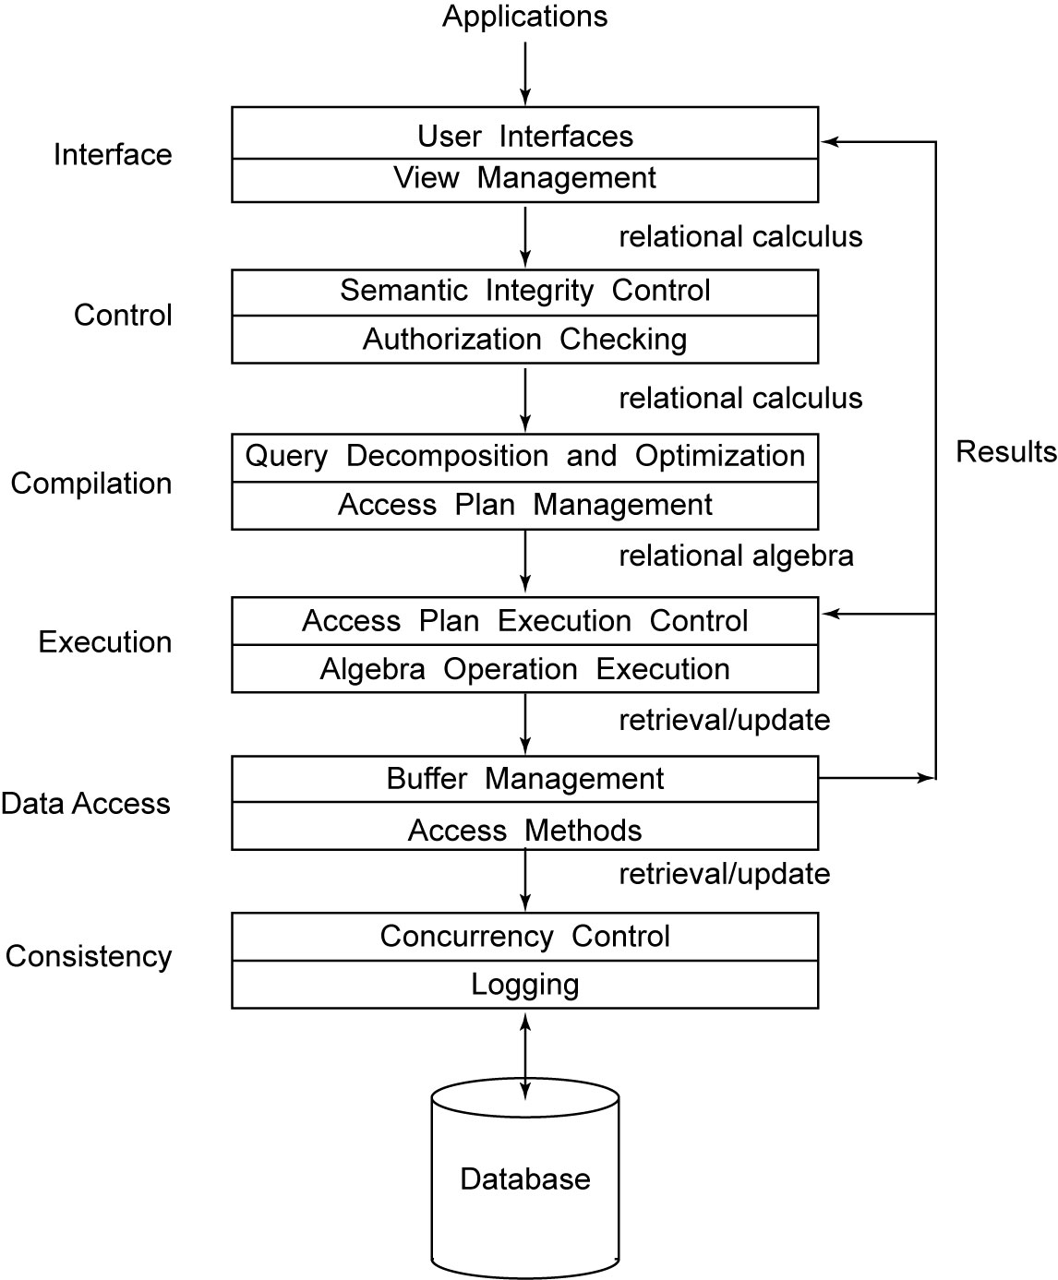
Generic DBMS Architecture

Slide 38
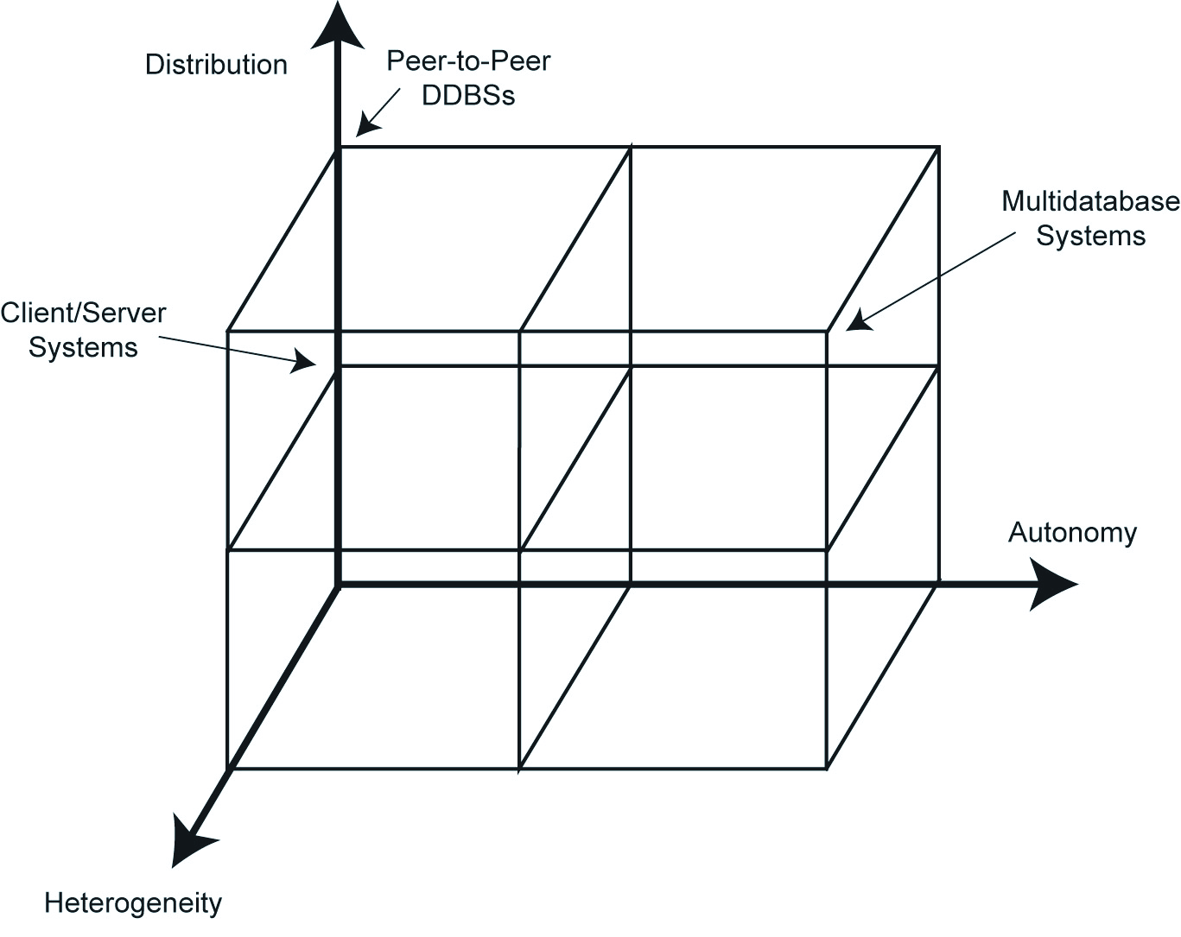
DBMS Implementation Alternatives

Slide 39
Dimensions of the Problem
Distribution
Whether the components of the system are located on the same machine or not
Heterogeneity
Various levels (hardware, communications, operating system)
DBMS important one
data model, query languages, transaction management algorithms
Autonomy
Not well understood and most troublesome
Various versions
Design autonomy: Ability of a component DBMS to decide on issues related to its own design.
Communication autonomy: Ability of a component DBMS to decide whether and how to communicate with other DBMSs.
Execution autonomy: Ability of a component DBMS to execute local operations in any manner it wants to.

Slide 40
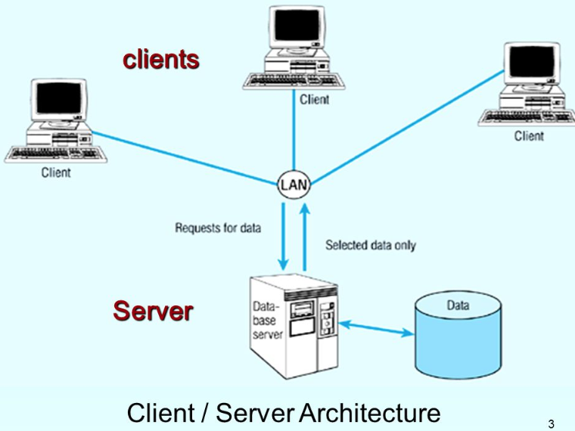
Client/Server Architecture

Slide 41
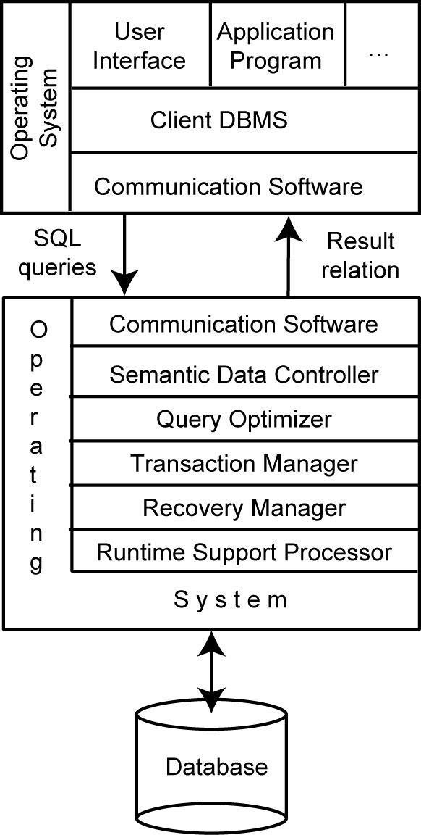
Client/Server Architecture
Client functionalities
Server functionalities

Slide 42
Advantages of Client-Server Architectures
More efficient division of labor
(client vs server functionalities)
Horizontal and vertical scaling of resources
Better price/performance on client machines
Ability to use familiar tools on client machines
Client access to remote data (via standards)
Full DBMS functionality provided to client workstations
Overall better system price/performance

Slide 43
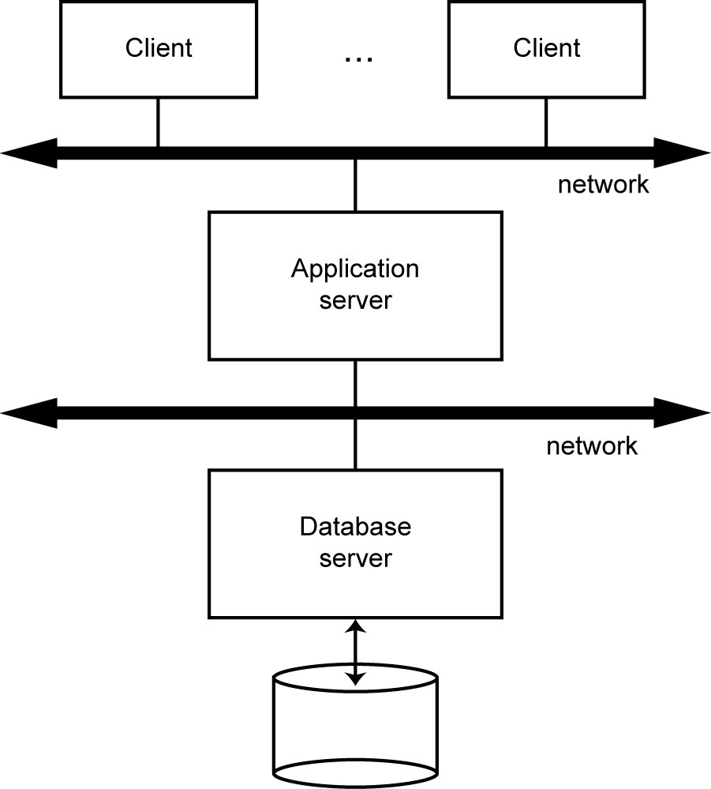
3-tier Database Server approach

Slide 44
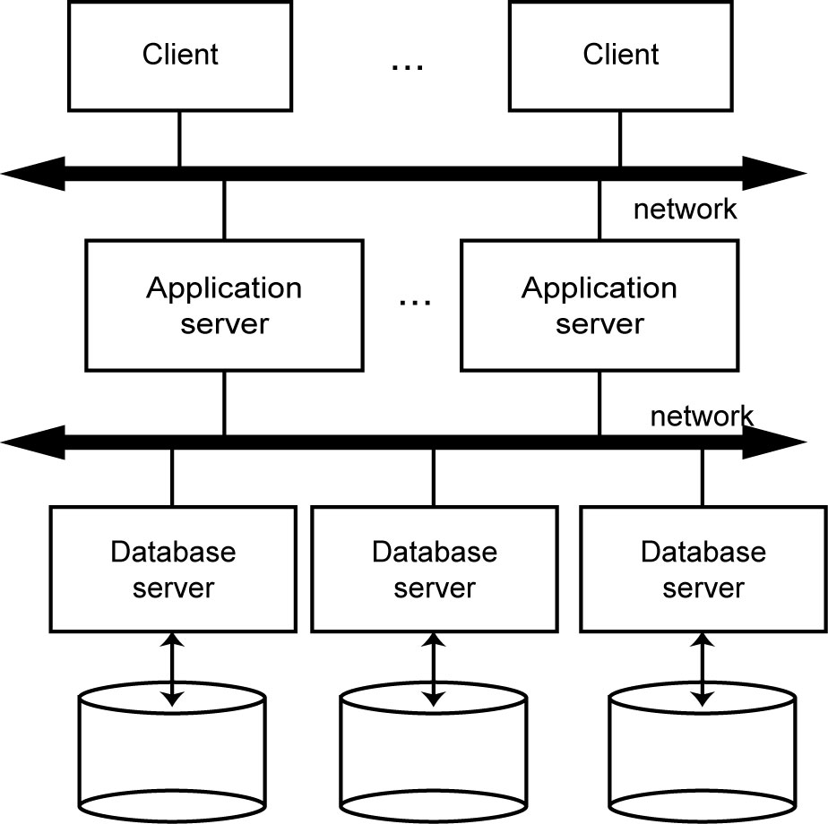
Distributed Database Servers approach

Slide 45
Peer-to-Peer Systems
In peer-to-peer systems, there is no distinction of client machines versus servers.
Each machine has full DBMS functionality and can communicate with other machines to execute queries and transactions.
Most of the very early work on distributed database systems have assumed peer-to-peer architecture.

Slide 46
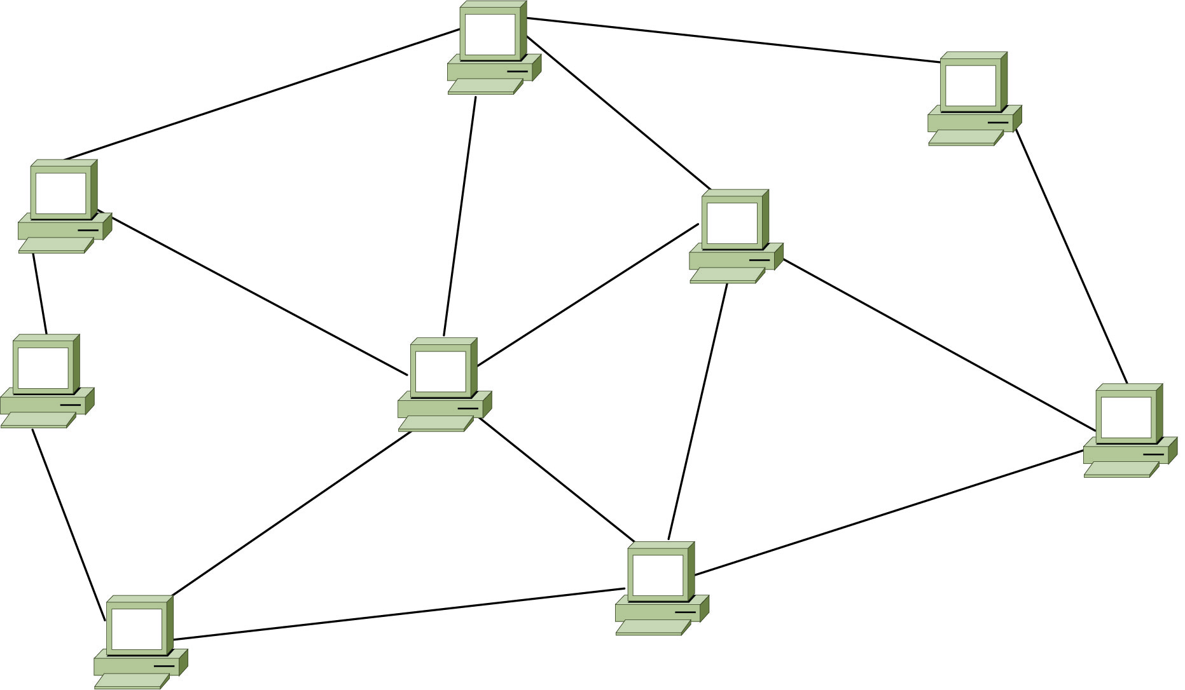
Peer-to-Peer Systems
Unstructured P2P Network

Slide 47
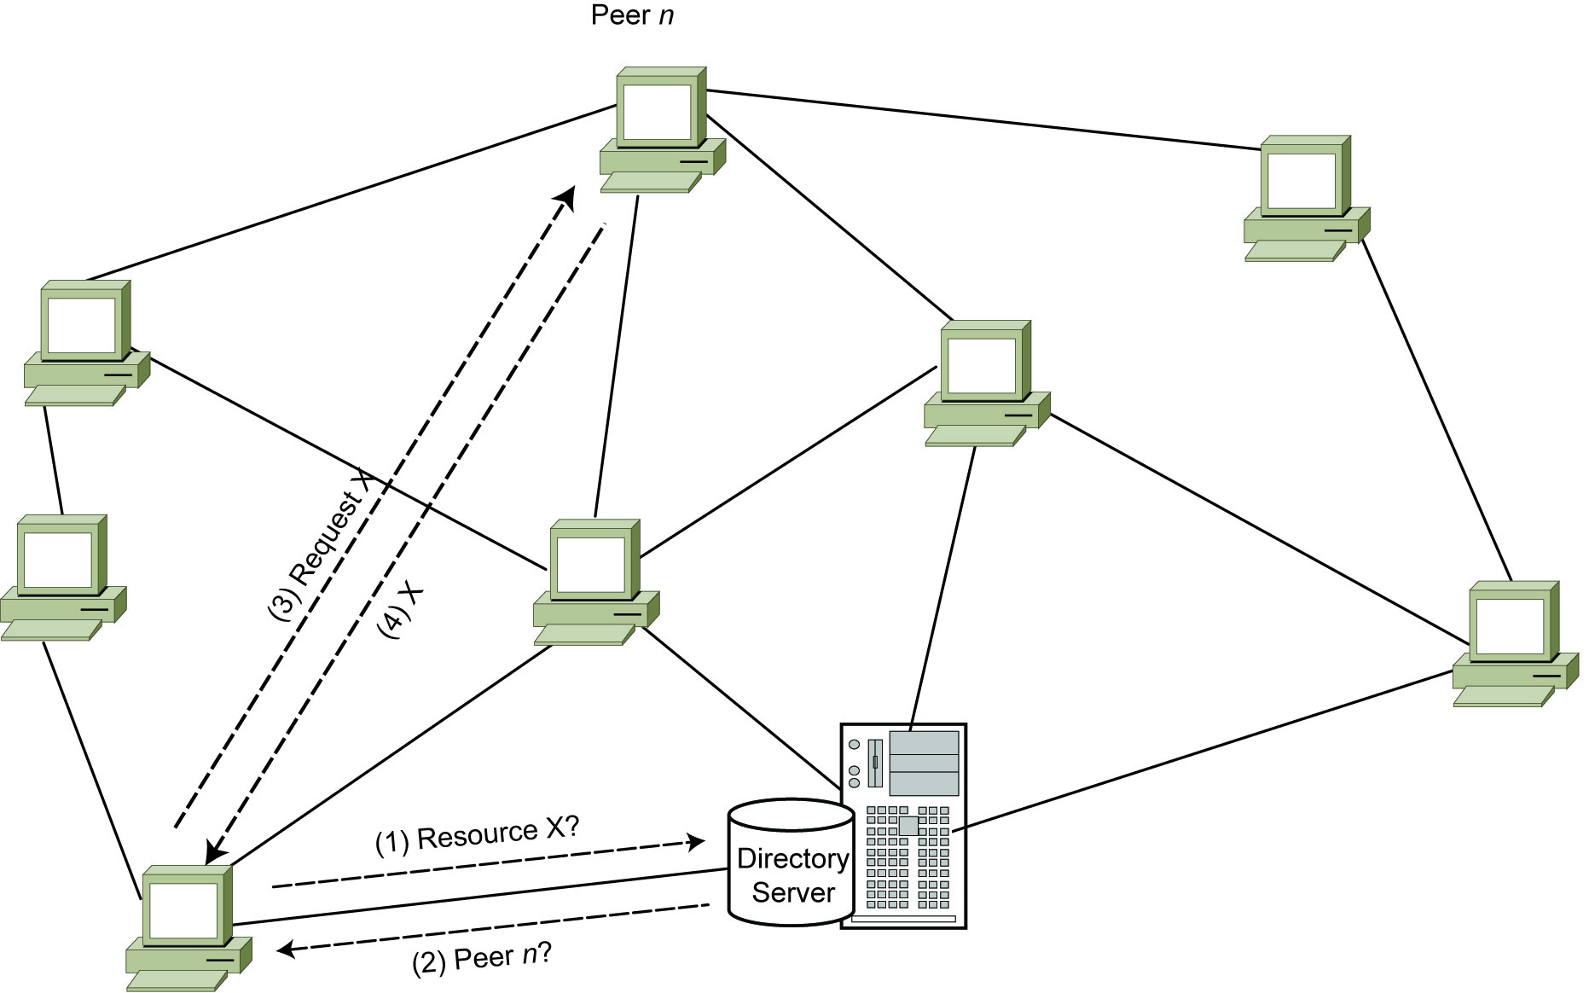
Peer-to-Peer Systems
Fig. 16-3 Search over a Centralized Index

Slide 48
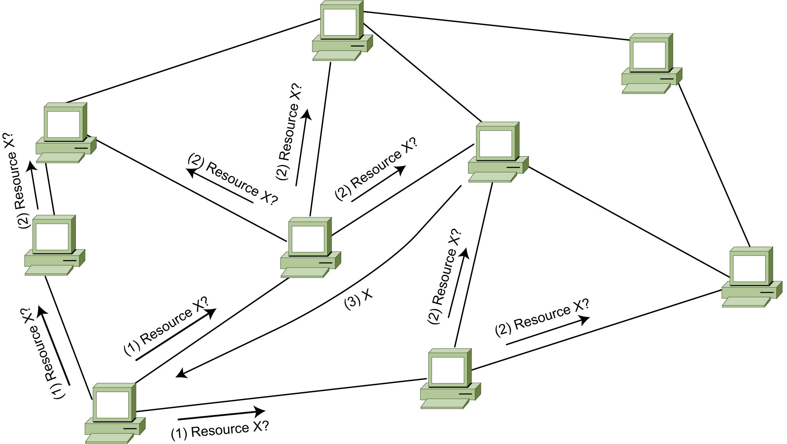
Peer-to-Peer Systems
Fig. 16.4 Search over a Decentralized Index

Slide 49
Distributed Database Reference Architecture
...
ES: External Schema, supporting user applications and user access to the database
GCS: Global Conceptual Schema, the enterprise view of the data (the union of the LCS)
LCS: Local Conceptual Schema
LIS: Local Internal Schema
ES₁
ES₂
ES_{n}
GCS
...
LCS₁
LCS₂
LCS_{n}
...
LIS₁
LIS₂
LIS_{n}

Slide 50
Peer-to-Peer Component Architecture (Fig. 1.15)
USER PROCESSOR
DATA PROCESSOR
External
Schema
Global
Conceptual
Schema
Local
Conceptual
Schema
System
Log
Local
Internal
Schema
GD/D
User
requests
Database
User Interface
Handler
Semantic Data
Controller
Global Query
Optimizer
Global
Execution
Monitor
Local Query
Processor
Local Recovery
Manager
Runtime
Support
Processor
USER
System
responses

Slide 51
Distributed Database Reference Architecture
User Processor
User interface handler
interpreting user commands as they come in
formatting the result data as it is sent to the user
Semantic data controller
uses the integrity constraints and authorizations that are defined as part of the global conceptual schema to check if the user query can be processed
authorization and other functions

Slide 52
Distributed Database Reference Architecture
User Processor (cont.)
Global query optimizer and decomposer
determines an execution strategy to minimize a cost function
translates the global queries into local ones using the global and local conceptual schemas as well as the global directory
Generating the best strategy to execute distributed join operations
Distributed execution monitor
aka distributed transaction manager
coordinates the distributed execution of the user request
The execution monitors at various sites may, and usually do, communicate with one another.

Slide 53
Distributed Database Reference Architecture
Data Processor
Local query optimizer
acts as the access path selector
choosing the best access path to access any data item
Local recovery manager
- making sure that the local database remains consistent even when failures occur
Run-time support processor
physically accesses the database according to the physical commands in the schedule generated by the query optimizer
the interface to the operating system and contains the database buffer (or cache) manager, which is responsible for maintaining the main memory buffers and managing the data accesses.

Slide 54
Distributed Multidatabase System
Distributed DBMSs vs Distributed Multi-DBMSs
Differences in how the GCS is defined
Differences in level of autonomy
Design differences: Top-down approach vs Bottom-up appraoch
Distributed DBMSs | Distributed Multi-DBMSs

Slide 55
Distributed Multidatabase System Architecture (Fig. 1.16)
...
GES: Global External Schema
LES: Local External Schema
GES₁
GES₂
GES_{n}
…
…
LES₁₁
LES_{1n}
GCS
LES_{n1}
LES_{nm}
…
NOTE: GCS may come from LES
LCS₁
LCS₂
LCS_{n}
…
LIS₁
LIS₂
LIS_{n}

Slide 56
MDBS Components & Execution
Global
User Request
Local
User
Request
Local
User
Request
Multi-DBMS
Layer
Global
Subrequest
Global
Subrequest
Global
Subrequest
DBMS₁
DBMS₂
DBMS₃

Slide 57
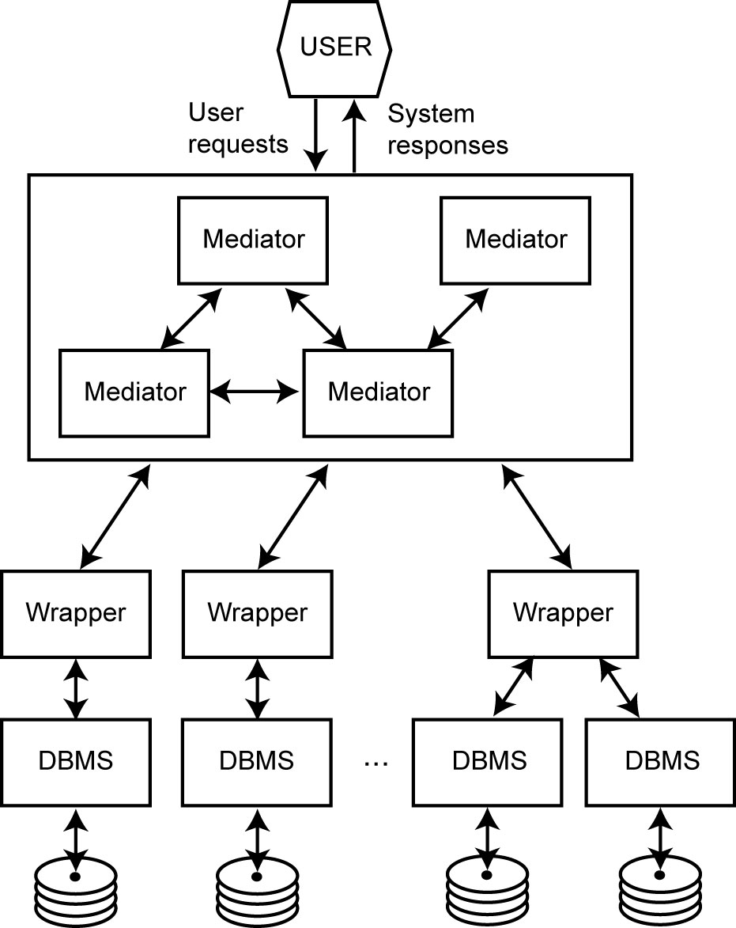
An Example of MDBSs - Mediator/Wrapper Architecture
Mediator: a software
Each mediator performs a particular function with clearly defined interfaces.
a middleware layer
Implements the GCS
Wrapper
Provide a mapping between a source DBMS view and the mediators’ view.

