Slide 1

Slides for Chapter 6: Indirect Communication (Part B)
From Coulouris, Dollimore, Kindberg and Blair Distributed Systems: Concepts and Design
Edition 5, © Addison-Wesley 2012

Slide 2
Outline
6.1 Introduction
6.2 Group communication
6.3 Publish-subscribe systems
6.4 Message queues
6.5 Shared memory approaches

Slide 3
Group Communication
A message is sent to a group, then delivered to all members in that group.
Group membership is dynamic.
When sending a message, the sender is not aware of the identities of the receivers.
an abstraction over multicast communication and may be implemented over IP multicast
Adding reliability, failures detection and ordering guarantees over IP multicast (c.f., TCP vs IP)

Slide 4
Publish-Subscribe Systems
Sometimes referred to as a distributed event-based system
Publishers publish structured events to an event service.
Subscribers express interest in a particular event thru subscription.
One-to-many communication: A given event will be delivered to potentially many subscribers.
the most widely used of all the indirect communication techniques discussed in this chapter

Slide 5
Publish-Subscribe Systems
particularly suitable for applications related to the large-scale dissemination of events
Example Applications:
Financial information systems
RSS Feeds (Really Simple Syndication)
support for cooperative working
support for ubiquitous computing (e.g., location events)
applications that monitor events in the Internet
Web-based events related to advertisements (e.g., ‘ad clicks’ events)
…

Slide 6
Example publish-subscribe application: Dealing Room System
An example of financial information systems
To allow dealers to see, using computers, the latest information about stocks
Market price for a stock is represented by an associated object.
Info. arrives from several external sources in the form of updates to the objects representing the stocks → fed to “information providers”
Dealing room implemented by processes with different tasks:
Information provider process continuously receives new trading info from a single external source.
The info provider publishes this information.
separate info. provider for each external source.
A dealer process creates a subscription representing each named stock that the user asks to display.
It receives all information sent to it via notifications and displays to the user.

Slide 7
Figure 6.7 Dealing room system
Dealer’s computer
External
Dealer’s computer
source
Dealer
Notification
Notification
Dealer
Notification
Information
provider
Notification
Notification
Notification
Notification
Dealer’s computer
Dealer’s computer
Notification
Information
provider
Notification
Dealer
Notification
Dealer
External
source

Slide 8
Example publish-subscribe application: Dealing Room System (cont.)
Q1: In the Dealing Room System application, who play the role of publishers?
Q2: Who play the role of subscribers?
Q3: A publish-subscribe system is also known as a distributed event-based system. What are the events in the dealing room system application?

Slide 9
Characteristics of Publish-Subscribe systems
Heterogeneity
When event notifications are used as means of communication, components that are not designed to work together, can now work together.
Event-gathering objects publish the types of events they offer.
Asynchronicity
Notifications are sent asynchronously by event-gathering publisher to all subscribers that expressed interest in them.
Publishers do not need to synchronize with subscribers.

Slide 10
Characteristics of Publish-Subscribe systems (cont.)
Delivery of Notifications
Reliability: Is delivery of a notification guaranteed?
Some applications can tolerate loss of notifications.
Some applications require all notifications be delivered (e.g., for the sake of fairness).
Timing: How fast should a notification be delivered?
Real-time, or
Delayed delivery is acceptable.

Slide 11
The Programming Model
Three types of entities: publishers, the publish-subscribe system, the subscribers (Figure 6.8)
Interface functions:
publish(e) // e is an event
subscribe (f) // f is a filter (a pattern defined over set of events)
unsubscribe(f)
notify(e) // The system notifies a subscriber of an event
Some systems have advertise(f) to declare the nature of future events
Revoke advertisement with unadvertise(f)

Slide 12
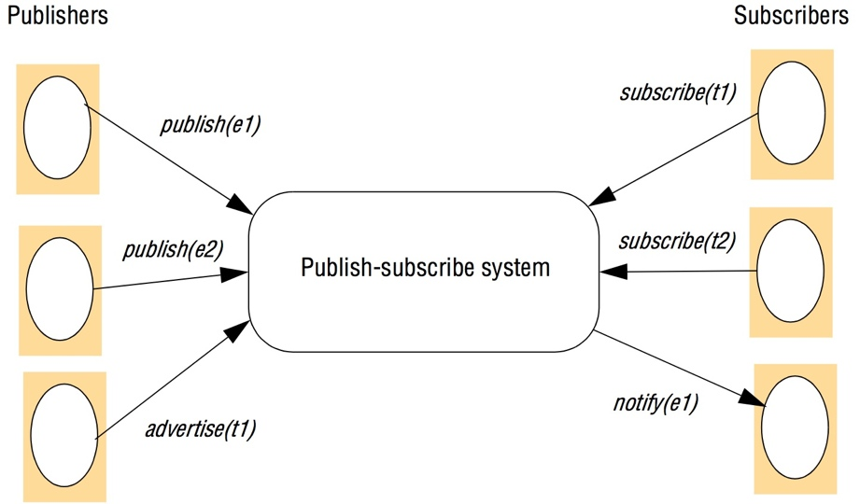
Figure 6.8 The publish-subscribe paradigm

Slide 13
Subscription filter models
Schemes listed in order of sophistication
Channel-based:
publisher publishes a named channel and subscriber subscribes to one of the channels to receive the events. (all or none)
Topic-based (subject-based):
Notification is expressed in terms of a number of fields, with one field denoting the topic.
Subscriptions are defined in terms of the topic of interest.

Slide 14
Subscription filter models (cont.)
Content-based (constraints-based):
A content-based filter is a query defined in terms of compositions of constraints over the values of event attributes.
Type-based:
This is linked to the object-based approaches where objects have a specified type.
Subscriptions are defined in terms of types of events and matching is defined in terms of types or subtypes of the given filter.

Slide 15
Implementation Issues
Task of the P-S model is to ensure that events are delivered efficiently to all subscribers that have filters defined to match the events.
Issues: security, scalability, failure handling, concurrency, QoS, …
Centralized vs. Distributed Implementation
Centralized: Publisher publishes events to a server (event broker) and subscribers access the server. Implementation is simple.
Distributed: Centralized broker is replaced by a network of brokers that cooperate to offer the desired functionality. (Figure 6.9)

Slide 16
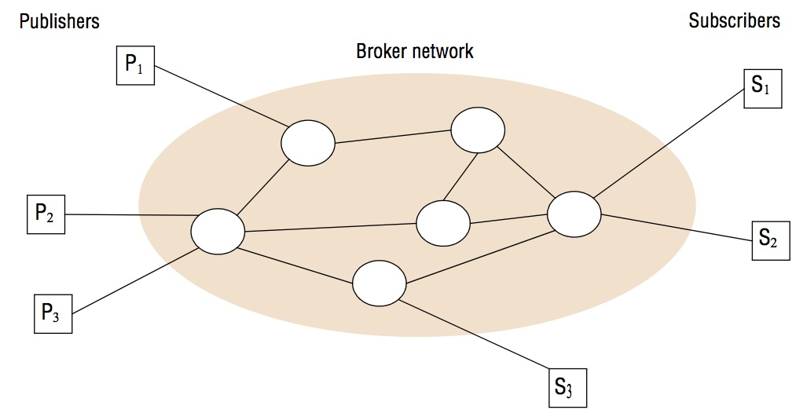
Figure 6.9 A network of brokers

Slide 17
Implementation Issues (cont.) - Overall System Architecture
Centralized schemes are relatively straightforward to implement.
Central service maintains repository of subscriptions and match event notifications with subscriptions.
Distributed schemes
Channel-based or topic-based filtering in a DS are relatively straightforward to implement.
Channels or topics may be mapped onto associated groups.
Events are multicasted to interested subscribers.
Content-based (or type-based) filtering in a DS is more complex. Why?
Peer-to-peer schemes
no distinction between publishers, subscribers and brokers;
all nodes act as brokers, cooperatively implementing the required event routing functionality

Slide 18
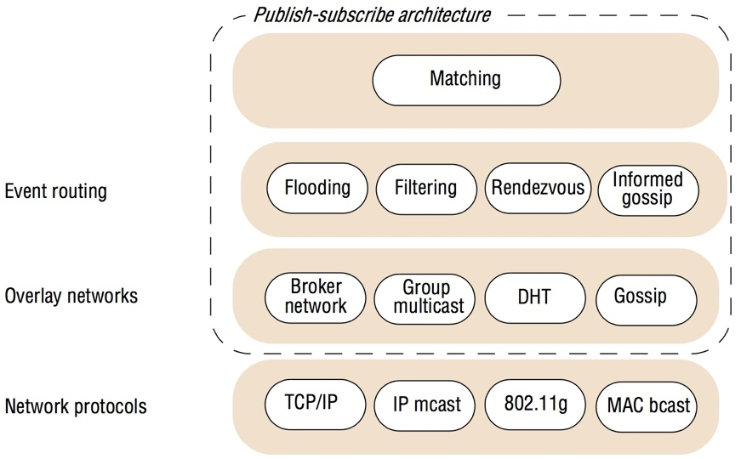
Figure 6.10 The architecture of publish-subscribe systems
Notes:
Rendezvous nodes are broker nodes responsible for a given subset of the event space. (p.252)
Informed gossip: “A pure gossip approach is effectively an alternative strategy for implementing flooding, as described above. However, it is possible to take into account local information and, in particular, content to achieve what is referred to as informed gossip.” (page 253 from the book)
IEEE 802.11g-2003 or 802.11g is an amendment to the IEEE 802.11 specification that operates in the 2.4 GHz microwave band. The standard has extended throughput to up to 54 Mbit/s using the same 20 MHz bandwidth as 802.11b uses to achieve 11 Mbit/s. (source: https://en.wikipedia.org/wiki/IEEE_802.11g-2003)
A gossip protocol or epidemic protocol is a procedure or process of computer peer-to-peer communication that is based on the way epidemics spread.^{[1]} Some distributed systems use peer-to-peer gossip to ensure that data is disseminated to all members of a group. Some ad-hoc networks have no central registry and the only way to spread common data is to rely on each member to pass it along to their neighbors. (source: https://en.wikipedia.org/wiki/Gossip_protocol)
A distributed hash table (DHT) is a distributed system that provides a lookup service similar to a hash table: key–value pairs are stored in a DHT, and any participating node can efficiently retrieve the value associated with a given key. The main advantage of a DHT is that nodes can be added or removed with minimum work around re-distributing keys. (source: https://en.wikipedia.org/wiki/Distributed_hash_table)

Slide 19
System Architecture cont’d
In the bottom layer, the network protocols layer, P-S system makes use of a range of IPC services (e.g., TCP/IP, IP multicast, …).
The heart of the architecture is provided by event routing layer supported by an infrastructure of overlay networks.
To ensure event notifications are routed as efficiently as possible to appropriate subscribers
For content based approach, this is known as “content-based-routing (CBR)”.
The goal of CBR is to exploit content information to efficiently route events to their required destination.
The top layer implements matching – that is, ensuring that events match a given subscription.
While this can be implemented as a discrete layer, often matching is pushed down into the event routing mechanisms. Why?
Notes:
An overlay network is a computer network that is layered on top of another network.^{[1]} … Nodes in the overlay network can be thought of as being connected by virtual or logical links, each of which corresponds to a path, perhaps through many physical links, in the underlying network. … The overlay has no control over how packets are routed in the underlying network between two overlay nodes, but it can control, for example, the sequence of overlay nodes a message traverses before reaching its destination. (source: https://en.wikipedia.org/wiki/Overlay_network)

Slide 20
System Architecture cont’d
The general architecture in Figure 6.10 can be implemented/specialized for a variety of P-S systems.
Take the Content-based Routing as an example, various implementations will be examined:
Flooding
Filtering
Advertisements
Rendezvous

Slide 21
CBR Approaches
Flooding
send an event notification to all nodes in the network
matching is carried out at the subscriber end
There exist alternative implementations.

Slide 22
CBR Approaches (cont.) - Filtering-based-routing
Filtering is applied in the network of brokers.
Subscription information are propagated through the network towards potential publishers.
Each broker stores associated state (of publishers-subscriptions).
A broker only forwards notifications through the network where there is a path to a valid subscriber.

Slide 23
CBR Approaches (cont.) - Filtering-based-routing
Each broker node needs to keep
a list of neighbors (brokers)
a subscription list (containing all directly connected subscribers serviced by this node)
a routing table (maintaining a list of neighbors and valid subscriptions for that pathway)
Each broker needs to implement a match() function.
a match function takes a given event notification and a list of nodes together with associated subscriptions and returns a set of nodes where the notification matches the subscription.

Slide 24
Figure 6.11 Filtering-based routing
upon receive publish(event e) from node x 1
matchlist := match(e, subscriptions) 2
send notify(e) to matchlist; 3
fwdlist := match(e, routing); 4
send publish(e) to fwdlist - x; 5 //recursive call is not sent to x itself
upon receive subscribe(subscription s) from node x 6
if x is client then 7
add x to subscriptions; 8
else add(x, s) to routing; 9
send subscribe(s) to neighbours - x; 10 //recursive call is not sent to x itself

Slide 25
CBR Approaches cont’d
Advertisement
Instead of flooding, propagate advertisements towards subscribers.
Rendezvous
Event space is the set of possible events.
Partition the event space among the set of brokers in the network. (load balancing)
SN(s): takes a subscription s and returns one or more rendezvous nodes that are responsible for that subscription.
When an event e is published, EN(e) returns one or more rendezvous nodes that are responsible for matching e against subscriptions in the system.

Slide 26
Figure 6.12 Rendezvous-based routing
upon receive publish(event e) from node x at node i
rvlist := EN(e);
if i in rvlist then begin
matchlist :=match(e, subscriptions);
send notify(e) to matchlist;
end
send publish(e) to rvlist - i; //recursive call is not sent to i itself
upon receive subscribe(subscription s) from node x at node i
rvlist := SN(s);
if i in rvlist then
add s to subscriptions;
else
send subscribe(s) to rvlist - i; //recursive call is not sent to i itself

Slide 27
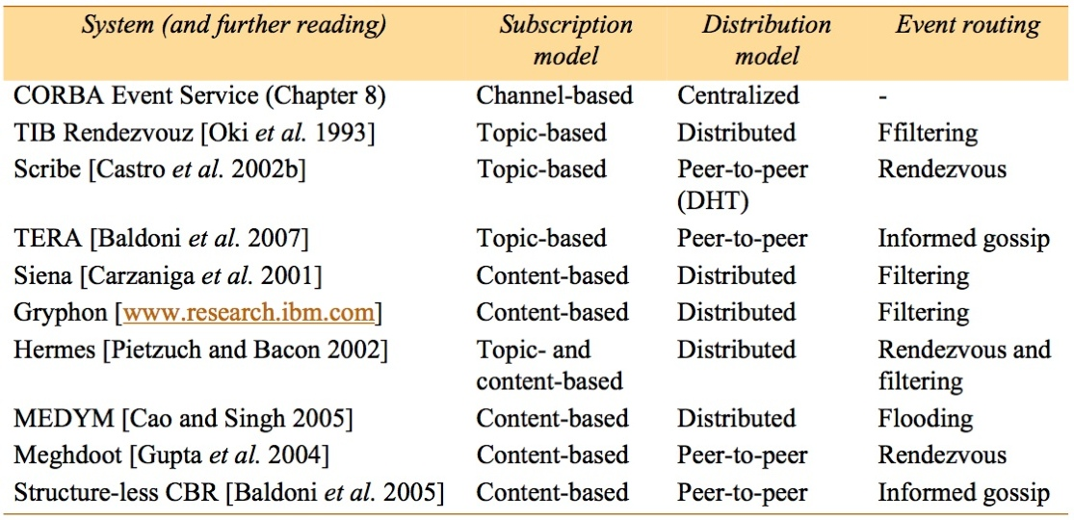
Figure 6.13 Example publish-subscribe systems

Slide 28
(Distributed) Message Queues
provide a point-to-point service
The sender places the message into a queue, and it is then removed by a single process (a consumer of that queue).
c.f., one-to-many in Groups and P-S
Message Queues are also called message oriented middleware (MOM).
Examples:
IBM WebSphere MQ
Microsoft’s MSMQ
Oracle’s Streams Advanced Queuing (AQ)
…

Slide 29
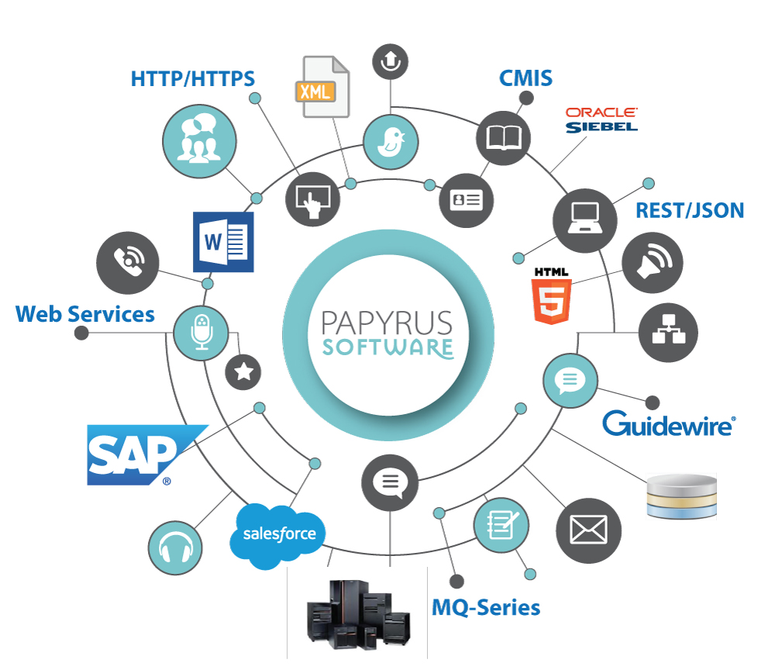
(Distributed) Message Queues (cont.)
Main purpose of Message Queues products is to achieve Enterprise Application Integration.
EAI: integration between applications within a given enterprise
Also used in commercial transaction processing systems (TPS)
Source: https://www.isis-papyrus.com/e15/pages/business-apps/enterprise-application-integration.html

Slide 30
The Programming Model
Communicate thru queues.
Producer processes can send messages to a specific queue;
Consumer processes can receive messages from the queue.
3 styles of receive
Blocking receive: block until message is available.
Non-blocking receive: check status of the queue (poll) and return message if available.
Notify: issue an event notification if a message is available.

Slide 31
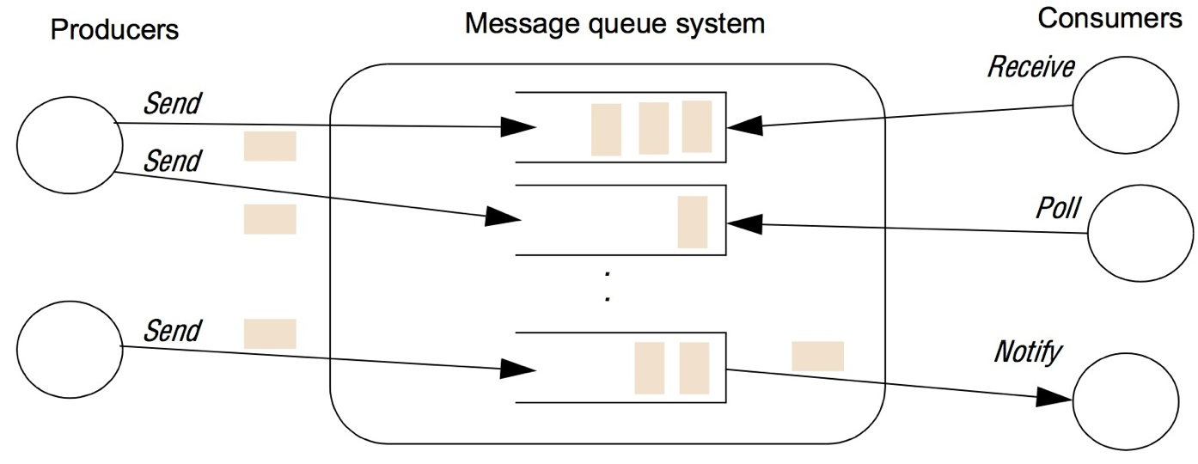
Figure 6.14 The message queue paradigm

Slide 32
The Programming Model (cont.)
A number of processes can send messages to the same queue, and likewise a number of receivers can remove messages from a queue. (many-to-many)
Queuing policy is normally FIFO, except
priority queuing: Higher priority messages are delivered first.
Selective retrieval of messages by the consumers
A message = destination queue id + meta data (priority, delivery mode, …) + body of the message
A crucial Property: Messages are persistent.
Messages remain in the queue indefinitely (until they are consumed).
will commit messages to disk (to enable reliable delivery)

Slide 33
Programming Model cont’d
Message passing system support additional functionality:
Most commercially available systems provide support for the sending or receiving of a message to be contained within a transaction.
to ensure all steps in the transaction are completed, or none of the steps is completed (atomicity)
Some systems support message transformation.
An arriving message can be transformed.
e.g., Transforming from one format to another (for dealing with heterogeneity in data representations)
Message broker is responsible for transformation.
Essential for supporting EAI
Security support
WebSphere MQ uses Secure Sockets Layer (SSL).

Slide 34
Comparison
 | Message Passing systems | Message Queuing systems
Queues | Implicit (message buffers) (part of the sender or receiver) | Explicit (3rd-party entities) (part of the middleware)
Communication mode | Direct communication (time-coupled, space-coupled) | Indirect communication (time and space uncoupled)

Slide 35
Implementation Issues
The key issue here is the choice of centralized or distributed implementation.
Centralized architecture is simple to implement.
May suffer single-point failure, bottleneck issues
WebSphere MQ as an illustration of distributed architecture
It is a middleware developed by IBM based on the concept of message queues.
Queues are managed by a queue manager.
Applications access queues thru a Message Queue Interface (MQI).
Operations include MQCONN, and MQDISC, MQPUT, and MQGET.
Multiple queue managers can reside on a single physical server.

Slide 36
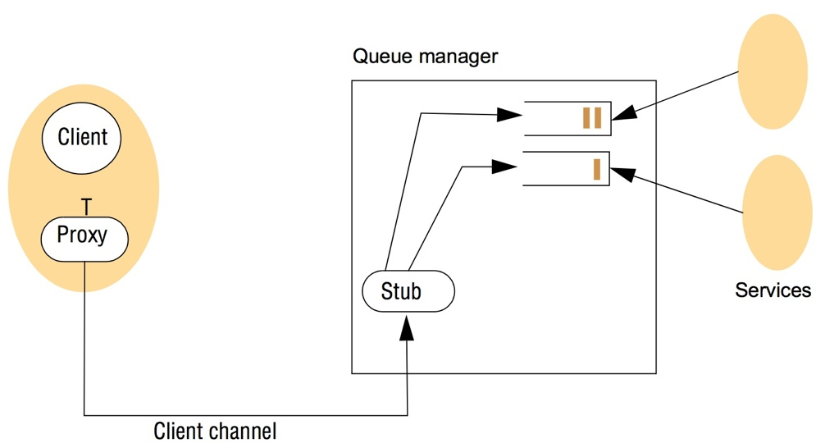
Figure 6.15 A simple networked topology in WebSphere MQ
Clients communicate thru a “client channel” with the queue manager.
MQI commands are issued on a proxy, and sent transparently to queue manager using RPC.

Slide 37
Implementation Cont’d
MQIs can be linked together into a federated structure.
A message channel is a unidirectional connection between two queue managers that forward messages asynchronously from one queue to another.
A message channel is managed by a message channel agent (MCA) at each end. (i.e., a pair of MCAs per channel)
Routing tables are included in each queue manager.
A wide range of topologies can be created with WebSphere (Tree, Mesh, bus, hub-and-spoke)

Slide 38
Distributed Shared Memory
Two approaches:
Distributed Shared Memory (DSM)
Originally developed mainly for parallel computing
Tuple Space
Higher-level than DSM
 | DSM | Tuple Space
Data representation | bytes | Semi-structured data (tuples)
Accessing | By address | Associative (content-addressable memory)

Slide 39
DSM
An abstraction that shares data between computers that do not share physical memory
Processes access DSM by reads from and updates to what appears to be local memory.
The underlying DSM runtime system ensures transparently that processes running at different computers observe the updates made by one another.

Slide 40
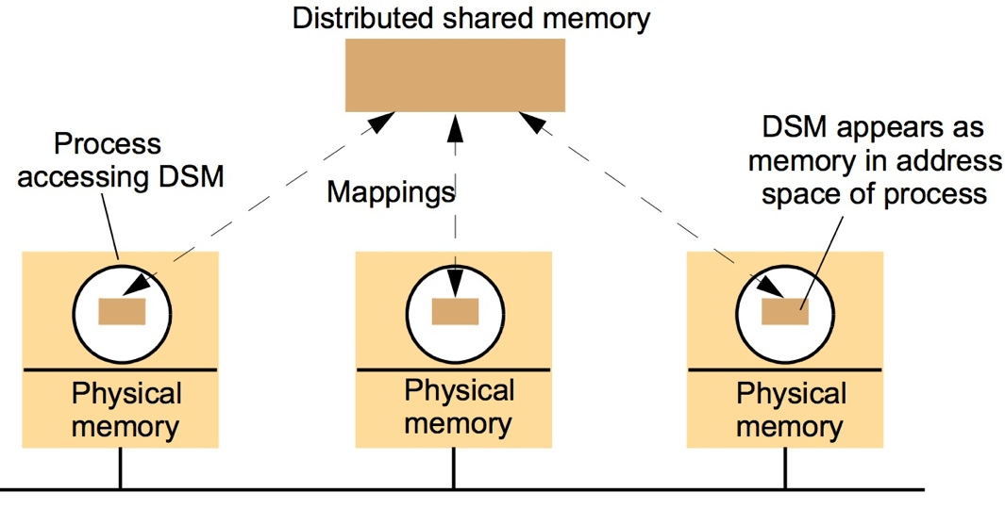
Figure 6.19 The distributed shared memory abstraction

Slide 41
DSM
DSM spares the programmer the concerns of message passing.
DSM is a tool for parallel, distributed, or applications where individual shared data items can be accessed directly.
DSM runtime has to send the messages at runtime to perform the updates.
Example of DSM is the Apollo Domain File System [Leach et al. 83].
Processes on different hosts share files by mapping them directly onto their address space.
Persistent DSM
DSM became significant with the growth of shared-memory multiprocessors.

Slide 42
Message Passing vs. DSM
DSM, as a communication mechanism, is comparable with message passing.
Both entails asynchronous communication.
How are they different?
Services Offered:
Message Passing:
Marshalling and unmarshalling of variables.
Processes have their private address so they’re protected from each other.
Synchronization is done by the message passing primitives.
DSM:
Variables are shared and no marshalling is needed.
In DSM, a process could cause others to fail.
Synchronization is done via semaphores and locks.

Slide 43
Message Passing vs. DSM (cont.)
Efficiency:
Experiments show that certain parallel programs written in DSM can be made to perform about as well as functionally equivalent programs written for message-passing platforms on the same hardware. [Carter et al. 1991]
This cannot be generalized as there are other factors to take into consideration (e.g., the pattern of data sharing).

Slide 44
Tuple Space Communication
“Tuple spaces were the theoretical underpinning of the Linda language developed by David Gelernter and Nicholas Carriero at Yale University in 1986.” (https://en.wikipedia.org/wiki/Tuple_space)
Processes communicate directly by placing tuples in a tuple space, from which other processes can read or remove them.
Tuples do not have an address but are accessed by pattern matching on content (content-addressable memory).

Slide 45
The Programming Model
Tuples consist of a sequence of one or more typed data fields, e.g., <“fred”, 1958>, <4, 9.8, “Yes”>.
Any combination of types of tuples may exist in the same tuple space.
Processes share data by accessing the same tuple space.
Operations
write: place a tuple in the tuple space.
read: return the value of a tuple
take: return and remove the tuple.
The read and take operations both block until there is a matching tuple in the tuple space. This is a form of synchronization.

Slide 46
The Programming Model (cont.)
Example operations
take(<String, integer>): This can extract <“fred”, 1958>, <“sid”, 1964>.
take (<String, 1958>) only extracts the tuple for fred only.
Tuples are Immutable (can not be accessed directly) and have to be replaced in the case of a modification.
To implement a counter <“counter”, 64> in order to increment the counter:
<s, count> := myTS.take (<“counter”, integer>);
myTS.write (<“counter”, count + 1>);

Slide 47
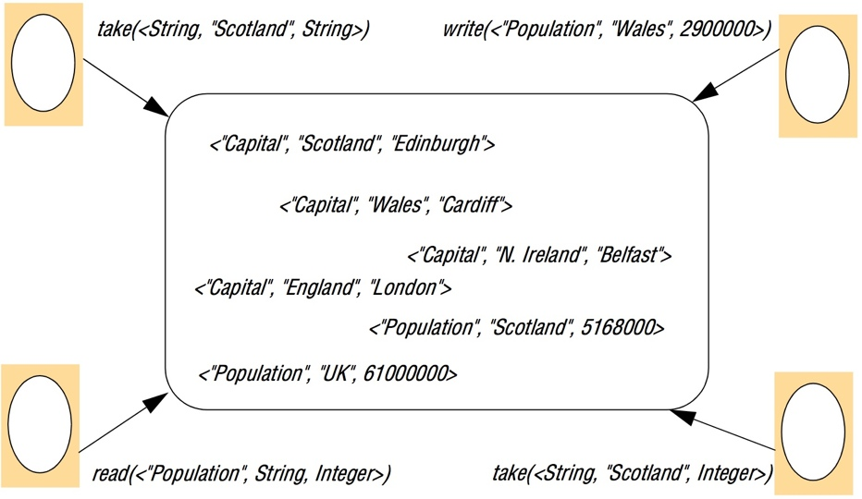
Figure 6.20 The tuple space abstraction

Slide 48
Programming Model (cont.)
Properties of Tuple Spaces:
Space Uncoupling:
A tuple placed in tuple space may originate from any number of sender processes and may be delivered to any one of a number of potential recipients.
Time Uncoupling:
A tuple placed in tuple space will remain in that tuple space until removed (potentially indefinitely), and hence the sender and receiver do not need to overlap in time.

Slide 49
Implementation Issues
Centralized Solutions (single server)
Simple but not fault-tolerant.
Distributed replication overcomes the problems.
The state machine approach to replication:
A tuple space behaves like a state machine, maintaining state and changing this state in response to events received from other replicas or from the environment.
Replicas must
start in the same state;
Execute events in the same order, and
react deterministically to each event.
Another approach
Optimize replication by using semantics of the tuple space operations {write, read, take}

Slide 50
Case Study
JavaSpaces.

Slide 51
Summary
indirect communication
communication through an intermediary, with a resultant uncoupling between producers and consumers of messages
Five styles of indirect communication (this chapter):
group communication
publish-subscribe systems
message queues
distributed shared memory
tuple spaces

