Slide 1

Slides for Chapter 6:
Indirect Communication
From Coulouris, Dollimore, Kindberg and Blair
Distributed Systems:
Concepts and Design
Edition 5, © Addison-Wesley 2012

Slide 2
Outline
6.1 Introduction
6.2 Group communication
6.3 Publish-subscribe systems
6.4 Message queues
6.5 Shared memory approaches

Slide 3
Introduction
Indirect Communication (IC) is defined as
  communication between entities in a distributed system through an intermediary with no direct coupling between the sender and the receiver(s)
  NOTE: one-to-one or one-to-many
Examples:
  Group communication (where the sender is unaware of the identity of the recipients)
  Publish-subscribe systems
  Message queueing systems
  Shared memory-based system (e.g., distributed shared memory, tuple space)
  Q: What is the intermediary in each of the above examples?

Slide 4
Introduction (cont.)
Direct coupling?
  A specific sender communicating with a specific receiver
Examples (from previous chapters):
  Request/Reply messaging in client-server communication
  RPC, RMI, …
Q: Issues associated with direct coupling?
  Failure processing when the receiver is not available or the message is lost
  e.g., (in a simple client-server interaction) It is more difficult to replace a server with an alternative one or when the server has failed.

Slide 5
Introduction (cont.)
Two key properties stem from the use of intermediary in Indirect Communication:
  Space uncoupling – Sender doesn’t need to know the identity of the receiver(s) and vice versa.
    So the developer has many degrees of freedom in dealing with changes.
      Participants (senders or receivers) can be replaced, updated, replicated or migrated.
  Time uncoupling – Sender and receiver(s) can have independent lifetimes; they do not need to exist at the same time to communicate.
    very important in volatile environments where participants may come and go

Slide 6
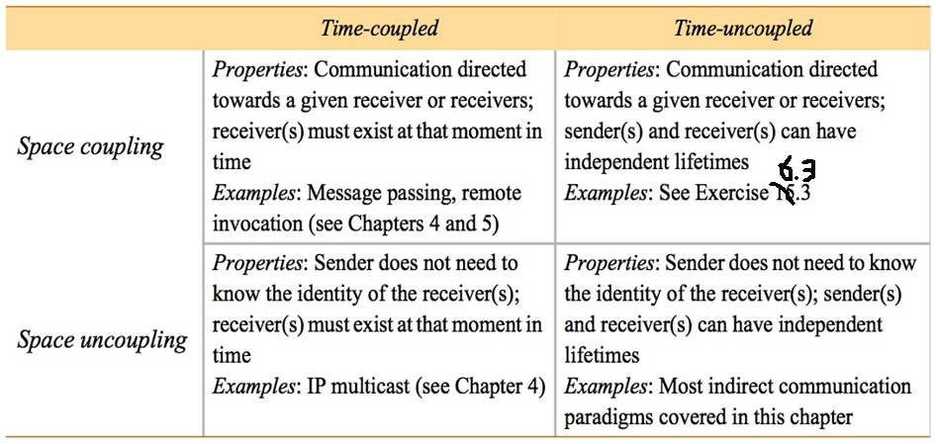
Figure 6.1
Space and time coupling in distributed systems
Emails?
Publish/Subscribe?
Notes:
(From Chapter 4) IP multicast
IP multicast is built on top of the Internet Protocol (IP). Note that IP packets are addressed to computers – ports belong to the TCP and UDP levels. IP multicast allows the sender to transmit a single IP packet to a set of computers that form a multicast group. The sender is unaware of the identities of the individual recipients and of the size of the group. A multicast group is specified by a Class D Internet address (see Figure 3.15) – that is, an address whose first 4 bits are 1110 in IPv4.
Being a member of a multicast group allows a computer to receive IP packets sent to the group. The membership of multicast groups is dynamic, allowing computers to join or leave at any time and to join an arbitrary number of groups. It is possible to send datagrams to a multicast group without being a member.

Slide 7
Relationship with Asynchronous Communication
Asynchronous Communication – sender sends a message and continue without blocking.
Time uncoupling – adds an extra dimension that the sender and the receiver can have independent existences
  Q1. Are there systems that are synchronous but indirect communication?
  Ans: MessageDispatcher and RpcDispatcher operations in JGroups, discussed in Section 6.2.3.
  Q2: Does time uncoupling imply that the sender’s message is stored (waiting for the receiver(s) to retrieve)?
  Ans: Yes. Persistency is implied in time-uncoupled communication (page 231).
Notes:
page 231: “… the communication paradigm must store messages so that they can be delivered when the receiver(s) is ready to receive.”

Slide 8
Trade-offs analysis
Q: What are the advantages and disadvantages of Indirect Communication?
Advantages? No time or space coupling
  Easiness in sending a message
  Flexibility in system design
  Accommodating changes
Disadvantages?
  management overhead
  Performance overhead

Slide 9
Group Communication
A message is sent to a group, then delivered to all members in that group.
  Group membership is dynamic.
  When sending a message, the sender is not aware of the identities of the receivers.
  an abstraction over multicast communication and may be implemented over IP multicast
  Adding reliability, failures detection and ordering guarantees over IP multicast (c.f., TCP vs IP)
Key areas of application:
  reliable dissemination of information to a large number of clients
  support for collaborative application, e.g., multiuser games
  support for a range of fault-tolerance strategies, e.g., in highly available (replicated) servers
  support for system monitoring and management, e.g., load-balancing systems

Slide 10
Group Communication (cont.)
The Programming Model
  A group with associated group membership is the central concept.
    Processes may join or leave the group.
    A message sent to a group is propagated to all members of that group with certain guarantees in terms of reliability and ordering.
  Group communication implements multicast communication.
  One process sends a single message to the group:
    aGroup.send(aMessage)
    This is more efficient than multiple sends to individual members.
    May benefit from hardware support for multicasts
  Single multicast is important in reliability of delivery and order of delivery. → atomicity
  c.f., Individual sends may have messages received by some but not all processes. → a series of sends

Slide 11
Group Communication (cont.)
Process groups and object groups
Process Groups:
  groups where the communicating entities are processes. These services are low-level:
    Messages are delivered to processes and no further dispatch is provided.
    Messages are typically unstructured byte arrays with no support for marshalling complex data.
Object Groups:
  Object-oriented programming
  An object may send a message to a collection of objects that process the same set of invocations concurrently with each returning responses.
  Object groups have promise but process groups still dominate in terms of usage.

Slide 12
Group Communication (cont.)
Various assumptions:
  Different assumptions impact how the underlying multicast algorithms would be implemented.
  Closed and Open Groups
    closed groups: Only members of the group can multicast to it.
    open groups: Processes outside may send to it.

Slide 13
Group Communication (cont.)
Various assumptions (cont.):
  Overlapping and non-overlapping groups
    overlapping groups: Entities may be members of multiple groups.
    non-overlapping groups: Membership doesn’t overlap.
  Synchronous and asynchronous systems –
    To consider group communication in both environments

Slide 14
Implementation Issues
Issue #1: Reliability and Ordering in Multicast
  All members of a group must receive messages with delivery guarantee and order agreed upon by members.
  Reliability
    In one-to-one communication, we discussed integrity and validity.
      Validity: Any message in the outgoing message buffer is eventually delivered to the incoming message buffer.
      Integrity: The message received is identical to one sent, and no messages are delivered twice.
    Reliable multicast builds upon these properties.
      Integrity (same as one-to-one)
      Validity (same)
      Agreement: If a message is delivered to one process, it is delivered to all processes.

Slide 15
Implementation Issues
Issue #1: Reliability and Ordering in Multicast (cont.)
  Ordering
    Ordering may not be guaranteed by the underlying IP multicast.
    Solution? Ordered Multicast
      Message will be delivered in the same order at all processes (from the perspective of the sender).
    Ordered Multicast has one or more of the following properties:
      FIFO ordering, aka Source ordering
        If a process sends one message before another, it will be delivered in this order at all processes in the group.
      Causal Ordering
        If a message happens before another message in the distributed system, this so-called causal relationship will be preserved in the delivery of the associated messages at all processes.
      Total Ordering
        If one message is delivered before another on one process, this must happen at all processes.
    More discussion in Chapter 15 (Coordination and Agreement)

Slide 16
Implementation Issues (cont.)
Issue #2: Group Membership Management
  Maintains an accurate view of the current membership of a dynamic group
  Four main tasks for group membership management (Figure 6.3):
    Providing an interface for group membership change
      create a group, add a member, delete a member, …
    Detecting failures
      use a failure detector to reach a decision about a group membership
      Exclude failed and unreachable members from the group
    Notifying members of group membership changes
    Performing group address expansion
      you don’t send a message by listing group members, but rather you supply the group id, and then the id is expanded into the current group members.

Slide 17
Figure 6.3
The role of group membership management
Group
address
expansion
Group
Leave
send
Multicast
Group membership
communication
Fail
management
Join
Process group

Slide 18
Case Study: JGroups Toolkit
A toolkit for reliable group communication written in Java.
Processes are able to join and leave the group.
Send message to all members or a single member, and receive from the group.
It supports reliability and order guarantees.
Components of Jgroups (Figure 6.4):
  Channels
  Building Blocks
  Protocol stack

Slide 19
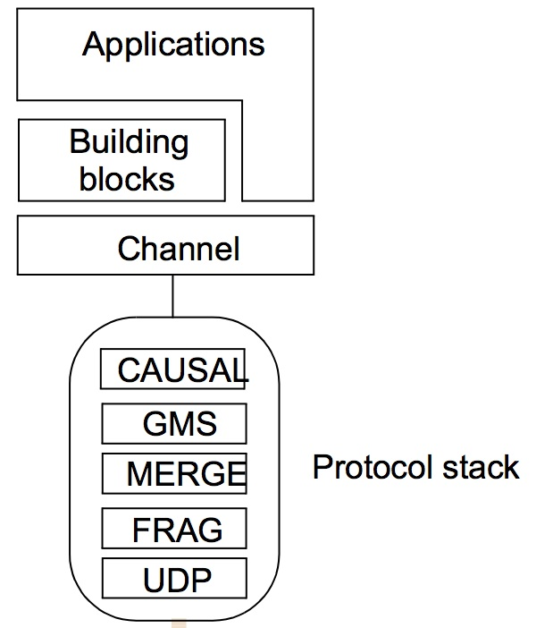
Figure 6.4
The architecture of JGroups
Components of JGroups:
  Channels
    Represents the most primitive interface for application developers.
    Offering core function for joining, leaving, sending and receiving.
  Building Blocks
    offers a high level abstractions, building on the underlying service offered by channels.
  Protocol stack
    provides the underlying communication protocol, constructed as a stack of composable protocol layers.

Slide 20
JGroups Toolkit (cont.)
Channels
  A process interacts with a group through a channel object.
  A channel object acts as a handle into the groups.
    A group is represented as a channel in JGroups.
  When created, the channel object is disconnected; a subsequent “connect” operation binds the handle to a particular named group.
  To leave the group → “disconnect”
  “close” renders the channel unusable.
  channel can only be connected to one group at a time.
  Other management operations:
    getView() returns the current view in terms of the current member list.
    getState() returns the historical application state associated with the group (for new members to catch up with previous events).

Slide 21
Figure 6.5
Java class FireAlarmJG
import org.jgroups.JChannel;
public class FireAlarmJG {
public void raise() {
  try {
    JChannel channel = new JChannel();
    channel.connect("AlarmChannel");
    Message msg = new Message(null, null, "Fire!"); channel.send(msg);
  }
  catch(Exception e) {
}
}
  Prepare a fire alarm message.
  Send the alarm mesg to the channel.

Slide 22
Figure 6.6
Java class FireAlarmConsumerJG
import org.jgroups.JChannel;
      public class FireAlarmConsumerJG {
        public String await() {
try {
JChannel channel = new JChannel();
channel.connect("AlarmChannel");
Message msg = (Message) channel.receive(0);
return (String) msg.GetObject();
} catch(Exception e) {
return null;
}
}
}
  receive(0) is a blocking receive and returns the top element of the buffer.

Slide 23
JGroups Toolkit (cont.)
Building Blocks
  Channels are similar to sockets.
  Building Blocks are more advanced communication paradigms than channels.
  Example building blocks:
    MessageDispatcher
      Send to a group and wait/block for some replies
      The castMessage() method sends a message to a group and blocks until a specified number of replies are received.
    RpcDispatcher
      take a method with optional parameters and results and invoke it on all objects associated with the group.
      Caller will block waiting for replies.
    NotificationBus
      A distributed event bus, where the event is any serializable Java object.

Slide 24
JGroups Toolkit (cont.)
The Protocol Stack
  A bidirectional stack of protocol layers
  Each layer implements the up( ) and down() methods.
  Protocol processing happens by passing events up and down the stack.
  Events may be incoming or outgoing.
  Each layer can carry out arbitrary processing on the message including modifying its contents.

Slide 25
JGroups Toolkit (cont.)
Layers in the Protocol Stack:
  UDP:
    the most common transport layer in JGroup.
    Utilizes IP multicasts for sending to all members in a group.
    It assumes IP multicast is available.
  FRAG: implements packetization (max message size: 8192 by default).
  MERGE: protocol that deals with unexpected network partitioning and the subsequent merging of subgroups.
  GMS implements a group membership protocol to maintain consistent views of membership across the group.
  CAUSAL implements causal ordering.
  …

Slide 26
Publish-Subscribe Systems
Sometimes referred to as a distribute event-based system
  Publishers publish structured events to an event service.
  Subscribers express interest in a particular event thru subscription.
Applications:
  Financial Info. Systems
  RSS Feeds (Really Simple Syndication)
  cooperative working support
  ubiquitous computing (location events)
  applications that monitor the internet

Slide 27
Message Queues
provide point-to-point service.
  They’re called message oriented middleware
Examples
  IBM WebSphere MQ
  Microsoft’s MSMQ
  Oracle’s Streams Advanced Queuing (QA)
Main purpose of these produces is Enterprise Application Integration (EAI).

Slide 28
Distributed Shared Memory
Approaches:
  Distributed Shared Memory (DSM)
  Tuple Spaces

