Slide 1
Anomaly Detection and Mitigation

Slide 2
Outline
DoS and DDoS
Anomaly Detection and Mitigation Systems
Cisco DDoS Anomaly Detection and Mitigation Solutions
Cisco Traffic Anomaly Detector
Cisco Guard DDoS Mitigation
Example

Slide 3
Denial of Service Attack
Denial of Service (DoS)
  Resource removal
  Resource modification
  Resource saturation

Slide 4
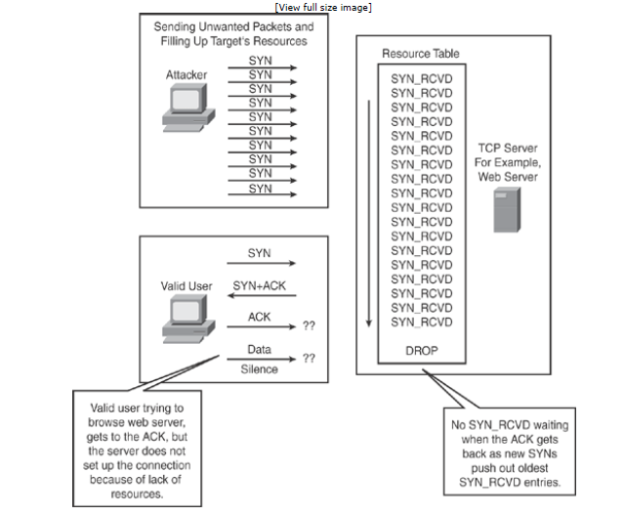
DoS (continued)

Slide 5
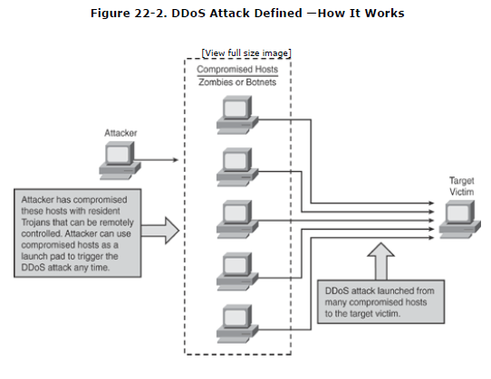
Distributed Denial of Service Attack

Slide 6
Anomaly Detection and Mitigation Systems
Establish baseline for network traffic through observation
Checks traffic against baseline profile to look for:
  Protocol anomaly
  Network anomaly
  Behavioral anomaly

Slide 7
Anomaly Detection and Mitigation Systems (cont)
Anomaly Detection Technique Characteristics:
  Signatureless
  Granular
  Perform relational and behavioral based detection
  Supports dynamic filtering
  Includes antispoofing techniques
  Detects day zero and minute zero attacks
  Can highlight any interesting traffic
  Traffic Diversion architecture for topological flexibility

Slide 8
Cisco DDoS Anomaly Detection and Mitigation Solutions
The system uses Cisco Traffic Anomaly Detector and Cisco Guard DDoS Mitigation to:
Detect and mitigate DDoS attacks
Distinguish between legitimate and attack traffic
Block attack traffic using source based dynamic filters
Block large botnets and zombie attacks
Deliver multigigabit performance at line rate for detection and mitigation

Slide 9
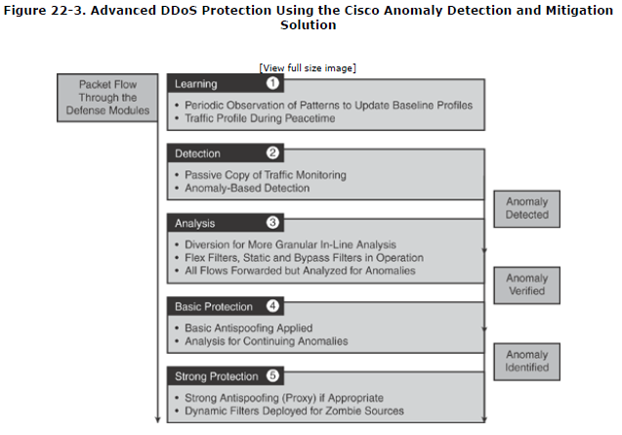
Cisco Advert(continued)

Slide 10
Cisco Advert(continued)
Protects against broad range of DDoS attacks:
  TCP/UDP based attacks
  HTTP attacks
  DNS attacks
  SIP(VOIP) attacks
  Botnets and Zombie attacks

Slide 11
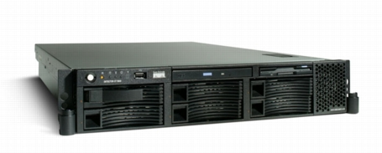
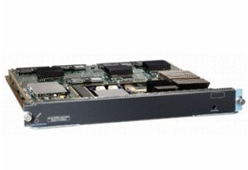
Cisco Traffic Anomaly Detector
Monitors mirrored copy of traffic to detect anomalies
Traffic Learning
Traffic Anomaly Detection

Slide 12
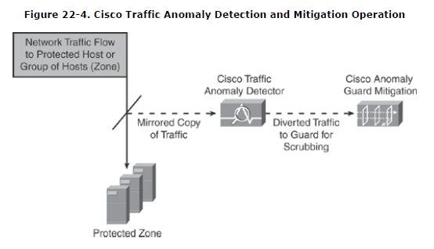
Cisco Traffic Anomaly Detector(cont)

Slide 13
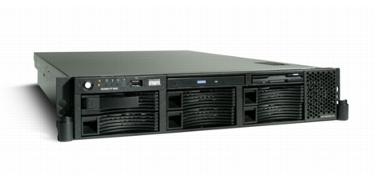

Cisco Guard DDoS Mitigation
Traffic Learning
Traffic Protection
Traffic Diversion
Uses Multi-Verification Process(MVP) architecture in a non-inline process.

Slide 14
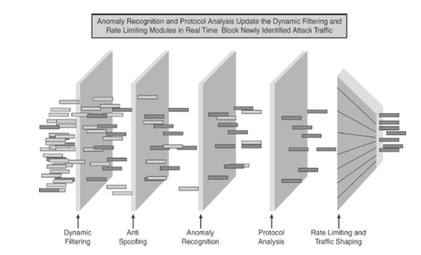
Cisco Guard DDoS Mitigation

Slide 15
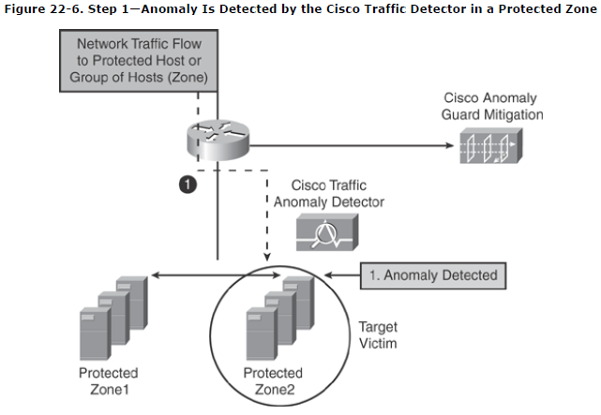
Example
1. Anomaly Detected

Slide 16
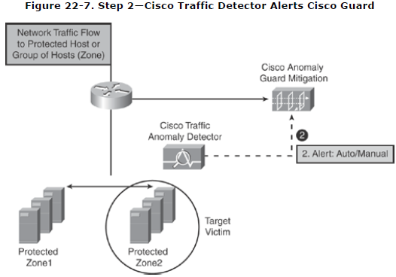
Example(cont)
2. Anomaly Detector alerts Cisco Guard

Slide 17
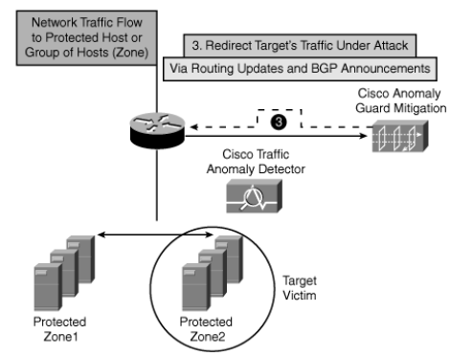
Example(cont)
3. Redirects victim traffic to Guard

Slide 18
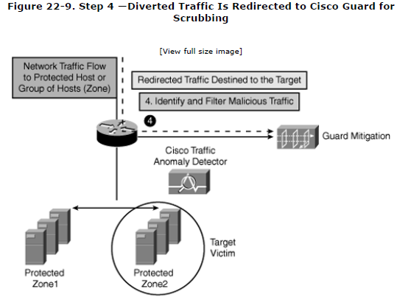
Example(cont)
4. Diverted Traffic is scrubbed

Slide 19
Resources
http://www.cisco.com/en/US/prod/collateral/vpndevc/ps5879/ps6264/ps5888/product_data_sheet0900aecd800fa55e.html
http://www.cisco.com/en/US/prod/collateral/modules/ps2706/ps6236/product_data_sheet0900aecd80220a6e_ps708_Products_Data_Sheet.html
http://www.cisco.com/en/US/prod/collateral/vpndevc/ps5879/ps6264/ps5887/product_data_sheet0900aecd800fa552.html
Bhaiji, Yusuf. Network Security Technologies and Solutions. Cisco Press. 2008.

