Slide 1
Open Source Firewalls & Routers
Abdul-Wahab Derwish
UHCL
CSCI5235 Summer 2010

Slide 2
The Open Source Projects
Promote Software Engineering methodologies
Collaboration
Reuse & Code sharing
Opportunities for the less experienced to gain experience solving real-world problems

Slide 3
Open Source
Source code is published and made available to the public, anyone to copy, modify and redistribute the source code without paying royalties or fees, some conditions may apply. Separate movements:
Open Source Initiatives
Free Software Foundation
Other
http://www.gnu.org/philosophy/free-software-for-freedom.html

Slide 4
Licenses
Some open source have dual licenses. Popular open source software license follows:
Apache Foundation
Sun Microsystem
GNU
GPL
LGPL
Eclipse Foundation
FreeBSD
MIT
Free to use, free to modify but fees may apply to commercial deployment/support

Slide 5
Open Source Firewalls & Routers
BSD
Pfsense, free
Monowall, free
Linux
Vyatta, free plus paid version
Zero shell, free

Slide 6
Selection
Package dependency
Upgradability
Support
Stability
Security
Licensing
Extensibility
Target Audience
Supported Hardware

Slide 7
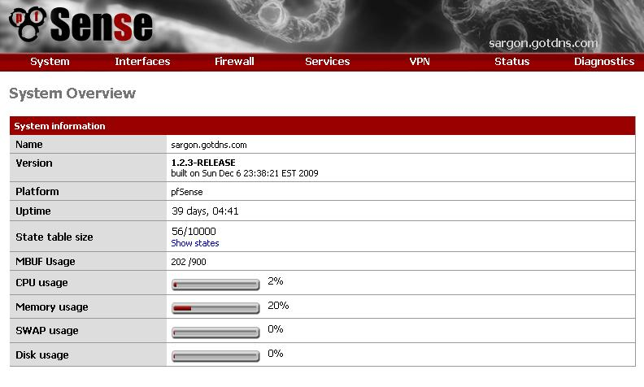
PFSense
Extension to MOnOwall project
User interfaces
Web
Menu
Command Line
WAN & LAN routers
VLAN 802.1q
Wireless Access point
Perimeter Firewall
VOIP appliance / Softswitch
Sniffer , snort
VPN, IPsec, OpenVPN, PPTP
Scalable embedded as well as desktop deployment
Support of multi WAN, load balancing as well as redundancy
Customizable

Slide 8
Open source and the fight for the redundant protocol
Hot Standby Routing Protocol HSRP, proprietary CISCO patented http://www.ietf.org/rfc/rfc2281.txt
Virtual Router Redundancy Protocol VRRP, http://www.ietf.org/rfc/rfc3768.txt CISCO claim it include some of it’s HSRP
Net Screen Redundancy Protocol NSRP, http://www.juniper.net/techpubs/software/screenos/screenos5.3.0/ce_v11.pdf
Heartbeat, Linux High Availability project http://www.linux-ha.org/Heartbeat
Common Addressable Routing Protocol CARP, http://www.ope nbsd.org/lyrics.html#35

Slide 9
Pf, pfsync, CARP
High availability load balancing package
Multiple hosts on the same network segment to share an IP address
Secure SHA-1 HMAC
IPV4 & IPV6
Open source & Free
Uses BSD Package Filter firewall
Uses Packet Filter state table synchronization interface
Redundancy
Load balancing
Cryptography
Multi-WAN support

Slide 10
Packet Filtering State Table Synchronization pfsync
Introduction
The pfsync network interface exposes certain changes made to the pf state table
Operation
By default, pfsync does not send or receive state table updates on the network; however, updates can still be monitored using tcpdump or other such tools on the local machine.
The default for pfsync protocol is to multicast updates out on the local network. All updates are sent without authentication. Best common practice is either:
Connect the two nodes that will be exchanging updates back-to-back using a crossover cable and use that interface as the syncdev (see below)
Use the ifconfig syncpeer option (see below) so that updates are unicast directly to the peer, then configure ipsec between the hosts to secure the pfsync traffic
pfsync packets should be passed in the filter rule.

Slide 11
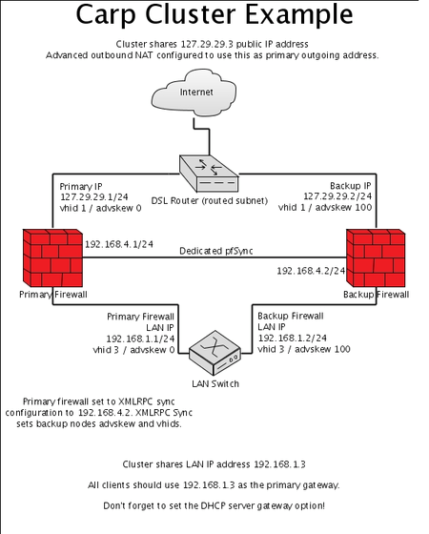
Simple CARP

Slide 12
A tool to control packet filter pfctl
# pfctl -f /etc/pf.conf Load the pf.conf file
# pfctl -nf /etc/pf.conf Parse the file, but don't load it
# pfctl -sr Show the current rule set
# pfctl -ss Show the current state table
# pfctl -si Show filter stats and counters
# pfctl -sa Show EVERYTHING it can show

Slide 13
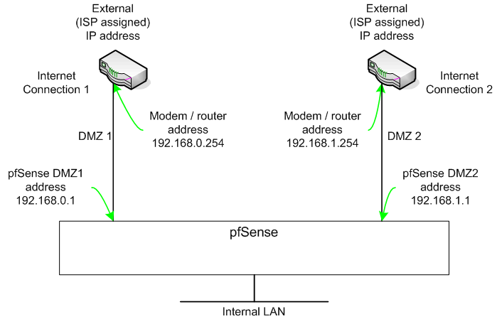
Multi WAN
Modem / router setup for load balancing in router mode
Multi WAN

Slide 14
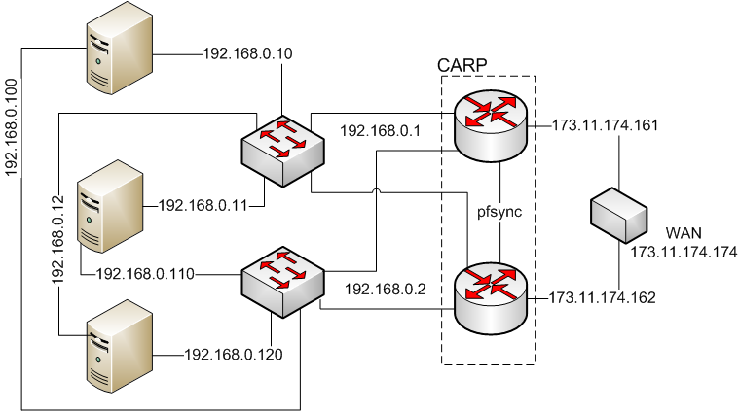
CARP with Dual Tree LAN (Discussion)

Slide 15
Load Balancing
Things to consider:
Stateful vs Stateless
Per destination or per cost
Per packet, for same destination first packet path 1, second packet path 2
Connection Oriented &Connectionless
Rules

Slide 16
Pfsense Load Balancing
Outbound, Outbound load balancing is used with multiple WAN connections to provide load balancing and failover capabilities. Traffic is directed to the desired gateway or load balancing pool on a per-firewall rule basis
Inbound, Inbound load balancing is used to distribute load between multiple servers. This is commonly used with web servers, mail servers, and others. Servers that fail to respond to ping requests or TCP port connections are removed from the pool.

Slide 17
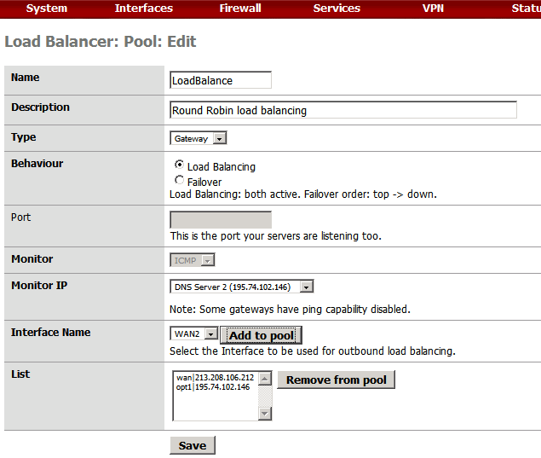
Pfsence Load Balancer Setup

Slide 18
Sample setup
Setting | Pool 1 | Pool 2 | Pool 3
Pool name | LoadBalance | WAN1FailsToWAN2 | WAN2FailsToWAN1
Description | Round Robin load balancing | WAN 2 preferred when WAN 1 fails | WAN 1 preferred when WAN 2 fails
Type | Gateway | Gateway | Gateway
Behavior | Load Balancing | Failover | Failover
Port | Unused | Unused | Unused
1st Monitor IP | DNS server 1 | DNS server 2 | DNS server 1
1st Interface name | WAN | WAN2 | WAN
2nd Monitor IP | DNS server 2 | DNS server 1 | DNS server 2
2nd Interface name | WAN 2 | WAN | WAN2

Slide 19
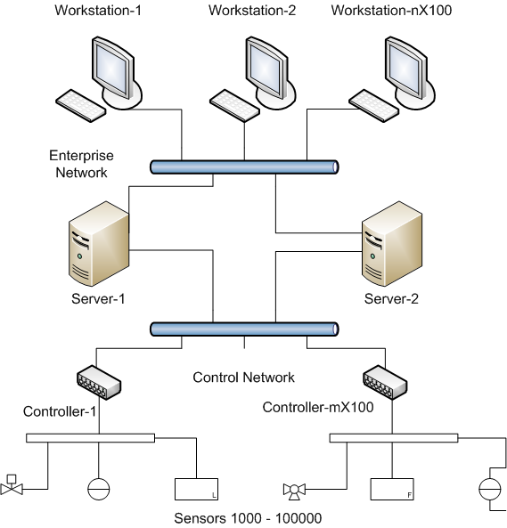
Typical Sensor Network Topology

Slide 20
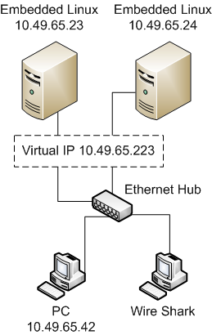
ABB CARP bench test
Environment and tools
Ethernet Hub
PC - accessing data during failover
PC – sniffer/Wire Shark
Redundant servers used a Linux Kernel of the 2.6 tree and version 1.1 of ucarp, each running Apache 2.0 servers

Slide 21
ABB CARP bench test
Average 3 seconds changeover delay
One ping test lost
Average jitter 15.7 msec
Master advertisement timer higher than 1 second
OpenBSD supports advertisement frequency for less than 1 second
Keeping the balance between the too much traffic and faster switchover is left to the user
for industrial applications without requirements for a very fast switchover, CARP can be one choice to provide a good and cost effective solution for high availability concerning access to the control system

Slide 22
Other pfsense Security Features
VPN: OpenVPN, IPSec, PPTP
SSH:
HTTPS
SNORT

Slide 23

Q & A

Slide 24

Thank you for your time

Slide 25
References
Router and Firewall Redundancy with OpenBSD and CARP Garhan Attebury and Byrav Ramamurthy, Department of Computer Science and Engineering University of Nebraska-Lincoln Lincoln, NE 68588-0115 {attebury, byrav}@cse.unl.edu, This full text paper was peer reviewed at the direction of IEEE Communications Society subject matter experts for publication in the IEEE ICC 2006 proceedings
High Availability support for the design of stateful networking equipments, P. Neira, Laurent Lef`evre, R.M. Gasca, {pneira|gasca}@lsi.us.es, QUIVIR Research Group - Department of Languages and Systems, ETS Ingenier´ıa Informatica - Avda. Reina Mercedes, s/n - 41012 SEVILLE - Spain, IEEE Computer Society Proceedings of the First International Conference on Availability, Reliability and Security (ARES’06)
Redundancy Performance of Virtual Network Solutions, Fabian Koch, ABB Corporate Research, Wallstadter Straße 59, 68526 Ladenburg, Germany, Fabian.Koch@de.abb.com, Conference on Emerging Technologies and Factory Automation, 2006. ETFA '06. IEEE
http://www.cisco.com/application/pdf/paws/5212/46.pdf CISCO document number 5212, How Does Load Balancing Works

