Slide 1
Defense against Web Spoofing Network Security – CSCI 5235 Dr. Andrew Yang
Presented By
Jay Dani

Slide 2
Web Spoofing
Web Spoofing is a security attack that allows an adversary to observe and modify all web pages sent to the victim's machine, and observe all information entered into forms by the victim.
Web Spoofing works on the major browsers.
The attack is implemented using JavaScript and Web server plug-ins

Slide 3
How the attack works?
Spoof site: the site or page that is a malicious copy of some legitimate web site
Attacker: the person or organization who set up the spoof site
Honest site: the legitimate site that is been spoofed
The key to this attack is for the attacker's Web server to sit between the victim and the rest of the Web. This kind of arrangement is called a "man in the middle attack" in the security literature.

Slide 4
Sample attack with URL rewriting
Attackers server is on http://www.webmastersforum.com
The user wants to visit http://home.netscape.com
The attacker will rewrite the URL by adding http//:webmastersforum.com to the front of the URL
For example http://home.netscape.com will become http://www.webmastersforum.com/http://home.netscape.com.?

Slide 5
Document source
By using the browser's "view source" feature, the victim can look at the HTML source for the currently displayed page.
By looking for rewritten URLs in the HTML source, the victim can spot the attack.
Unfortunately HTML source is hard for novice users to read, and very few Web surfers bother to look at the HTML source for documents they are visiting

Slide 6
Properties of recent attacks
Logos: spoof site uses the logos found in the honest website to imitate its appearance
Suspicious URL’S: spoof sites are located in server that has no relationship with the honest site
User input: Spoof sites contain messages to fool the user into entering sensitive information like password , SSN etc.
Short lived: most of the spoof sites are short lived i.e available for a few hours a day.

Slide 7
Strategies to Counter Phishing
Make it invisible
Taking down phishing web pages
Filtering out phishing email
Detecting phishing web pages (SpoofGuard, etc)
Provide better user interfaces
Extended certificate verification
Anti-phishing toolbars (SpoofGuard, eBay, Netcraft, etc)

Slide 8
Spoof Guard
Spoof Guard is a tool to help prevent a form of malicious attack called "web spoofing" or "phishing."
Spoof Guard is a browser plug in that is compatible with Microsoft Internet Explorer
Spoof Guard places a traffic light in the browser toolbar that turns from green to yellow to red as the user navigate to a spoof site.
If the user try to enter sensitive information into a form from a spoof site, Spoof Guard will save the data and warn the user.

Slide 9
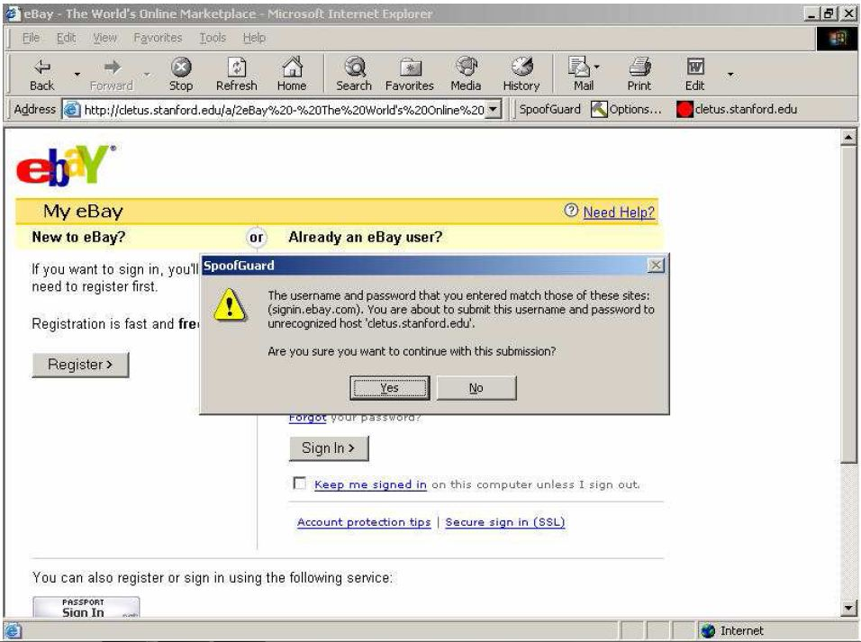

Slide 10
Spoof Guard Architecture
Warn bar: All the site information and post data check is carried out here.
Reflection Wnd: Transparent window that sits on top of the toolbar. Warn bar requests the Reflection Wnd to pop up a warning message when user tries to send a sensitive information to a suspicious server.
UW toolbar: it stores the user settings during runtime. Warn Bar requests UW ToolBar for these settings to determine the traffic lights color and the warning messages that appear in the Current Page Status dialog.

Slide 11
Spoof Guard Architecture(cont..)
Config dlg: opens an option window when user clicks the option button. UW ToolBar updates the user settings based on the result that Config Dlg returns when the window terminates.
DomainDlg: opens the Current Page Status window when the user clicks on the traffic light icon. It contains the warning messages specific to the current page.

Slide 12
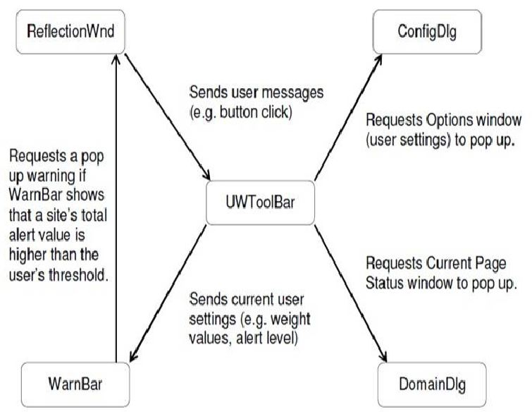
Spoof Guard Architecture

Slide 13
Spoof Guard toolbar
Spoof guard toolbar has three buttons:
Status button: displays the current domain and a brief representation of the status(red, green or yellow)
Settings button: this brings up the settings dialogue
Reset button: removes all data collected by the spoof guard(but won’t remove the user’s internet explorer’s history)

Slide 14
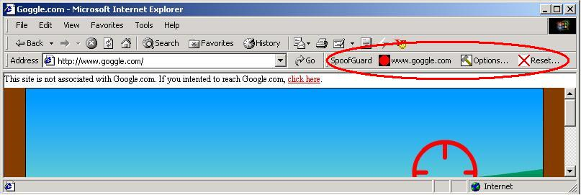
Spoof Guard toolbar(cont..)

Slide 15
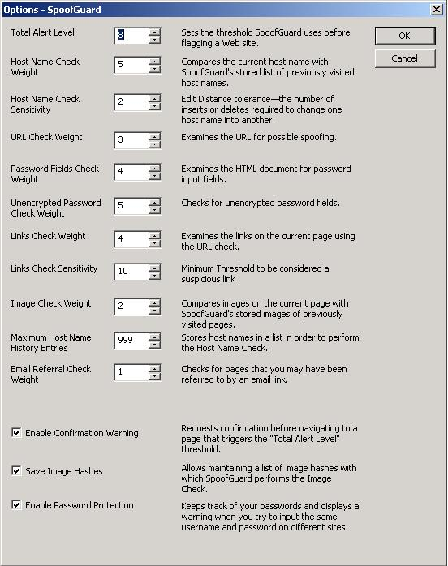
Setting the parameters

Slide 16
Domain name and URL check
Spoof Guard compares the domain name of the attempted URL to the domains in the most recent browser history entries.
A careless user attempting to visit http://www.paypai.com/123/123/123/123 may think that he is visiting http://www.paypal.com/.

Slide 17
CANTINA
CANTINA uses a simple content-based approach
Examines content of a web page and creates a “fingerprint”
Sends that fingerprint as a query to a search engine
Sees if the web page in question is in the top search results
If so, then it is a legitimate web page
Otherwise, it is a phishing web page
Properties:
Fast
Scales well
No maintenance (done by search engines)
Highly accurate

Slide 18
Working of CANTINA
Given a web page, calculate TF-IDF (Term Frequency / Inverse Document Frequency) score for each word in that page
Take five words with highest TF-IDF weights
Feed these five words into a search engine (Google)
If domain name of current web page is in top N search results, we consider it legitimate
N=30 worked well
No improvement by increasing N

Slide 19
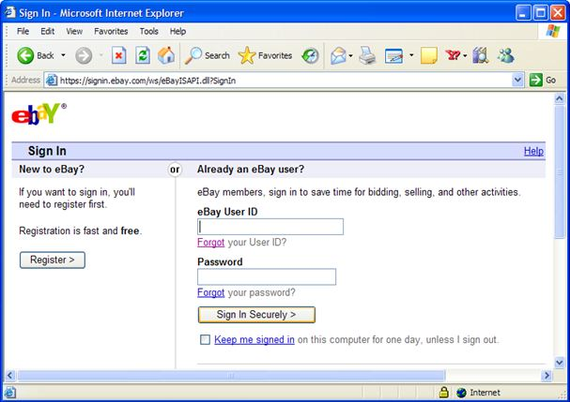

Slide 20
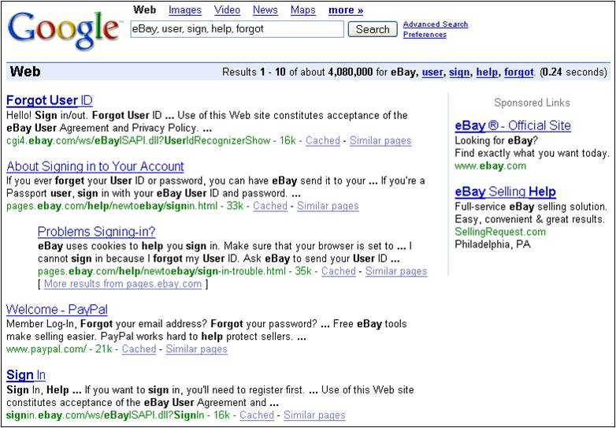

Slide 21
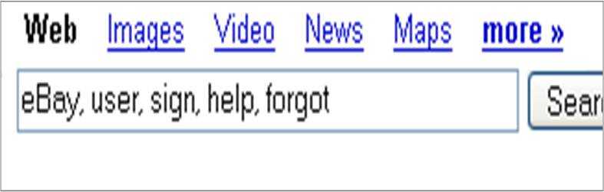

Slide 22
Conclusion
Like virus detection and spam filtering, we expect that any serious effort to combat web spoofing will lead to more sophisticated spoofs and the need for more sophisticated defenses.
From a broader perspective, web spoofing takes advantage of the unauthenticated email and weak web-site authentication.
If challenge-response methods, for example, were widely deployed, then a spoof site authenticating a user would not have any way to impersonate the user on the honest site.

Slide 23
References
“Client-side defense against web-based identity theft” by Neil Chou, Robert Ledesma, Yuka Teraguchi, Dan Boneh and John C. Mitchell, 11th Annual Network and Distributed System Security Symposium (NDSS '04), San Diego, February 2004.
“CANTINA: A Content-Based Approach to Detecting Phishing Web Sites” by Yue Zhang, Jason Hong, Lorrie Cranor, 2007.
“Web Spoofing” by Yougu Yuan, Eileen Zishuang Ye, Sean Smith, Department of Computer Science/Institute for Security Technology Studies, Dartmouth College, July 2001.
“Do Security Toolbars Actually Prevent Phishing Attacks?” by Min Wu, Robert Miller, Simson Garfinkel, MIT CSAIL, MA 02139.

Slide 24
Questions?

Slide 25
Thank You

