Slide 1
Covert Channels
Thomas Arnold
CSCI 5235/Summer 2010
7/12/2010

Slide 2
Outline
Background
Covert Channel Designs
Detection Methods
Example: Passive Covert Channel
Example: Tunneling NDIS

Slide 3
What are covert channels?
You want to communicate with someone without being observed
Cryptography/Encryption is not good enough
  You want to hide the fact you are communicating at all
  Best way is to hide the communication in innocuous-looking network traffic or data
  Firewall must let the traffic pass through

Slide 4
Why would you need covert channels?
Stealing of confidential information
  Government/corporate espionage, Intelligence gathering of criminal/terrorist activity
Malware
  Rootkits, keyloggers, botnets, etc.

Slide 5
Covert Channel Techniques
Storage Channels
  Hide data within unused TCP/IP packet header fields
    TCP Flags field, TCP ISN, etc.
Timing channels
  Modulate system resources in such a way that a receiver can observe and decode it
  Port Knocking, varying packet rates, etc.
Steganography
  Hide messages in email, images

Slide 6
Detection/Prevention
Detection
  Network traffic analysis
    Higher bandwidth usage
    Formatting of HTTP headers
    Request regularity
Prevention
  Block susceptible outbound ports/protocols

Slide 7
Example: Passive TCP Covert Channels
Technique uses existing traffic (does not generate it’s own)
Requires that attacker control the network gateway as well
Uses the TCP ISN field to transmit data
  Compromised gateway filters out secret TCP ISN to send to attacker, and forwards the legitimate traffic to the intended destination
Pros/Cons
  Blends in with existing traffic, difficult to detect
  ISN data must not look too conspicuous, and gateway processing can be very complicated to filter out and forward the legitimate traffic

Slide 8
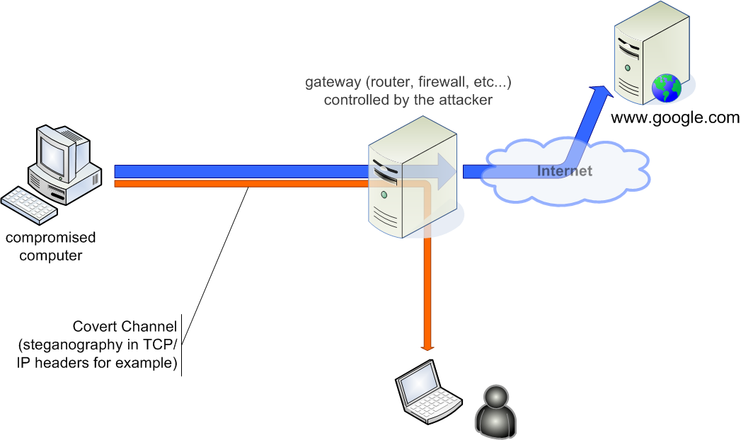
Example: Passive TCP Covert Channels

Slide 9
Example: Tunneling using NDIS
Idea is to tunnel information on existing protocols such as HTTP, DNS, and ICMP
Pros/Cons with each protocol
  HTTP good for large data transfer, but more conspicuous
  DNS not great for data transfer, but good for C&C
  ICMP is good for C&C but is often blocked
Author of The Rootkit Arsenal proposes writing your own TCP/IP stack using MS Windows NDIS

Slide 10
Example: Tunneling using NDIS
Since you have already have root privileges, you can implement a Kernel Mode NDIS Driver
  Complete control, can act as a NIC and create your own MAC/IP addresses, and format any of the protocol headers as you wish
Built in diagnostic tools such as ipconfig, netstat, etc. (as well as firewalls) can’t see it because they use the native TCP/IP stack
Pros/Cons
  Extremely difficult to detect, but also hard to implement

