Slide 1
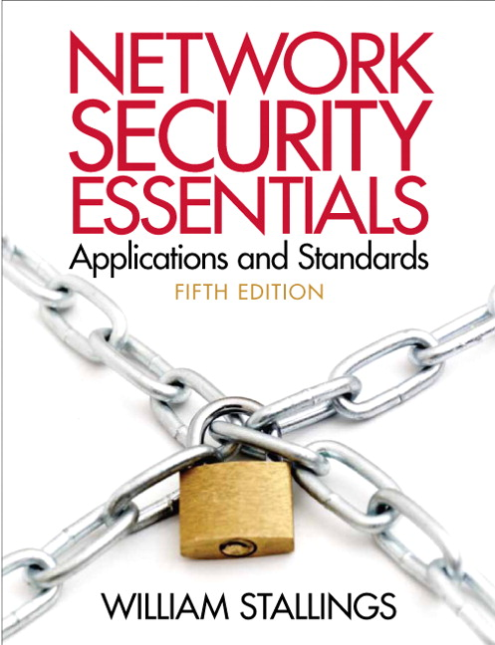
Network Security Essentials
Fifth Edition
by William Stallings
Notes:
Lecture slides prepared for “Network Security Essentials”, 5/e, by William Stallings, Chapter 12 – “Firewalls”.

Slide 2
Chapter 12
Firewalls
Notes:
Firewalls can be an effective means of protecting a local system or network of systems
from network-based security threats while at the same time affording access to the
outside world via wide area networks and the Internet.

Slide 3
The function of a strong position is to make the forces holding it practically unassailable.
— On War, Carl Von Clausewitz
On the day that you take up your command, block the frontier passes, destroy the official tallies, and stop the passage of all emissaries.
—The Art of War, Sun Tzu
Notes:
Opening quote.

Slide 4
The Need for firewalls
Internet connectivity is no longer optional for organizations
  Individual users within the organization want and need Internet access
While Internet access provides benefits to the organization, it enables the outside world to reach and interact with local network assets
  This creates a threat to the organization
  While it is possible to equip each workstation and server on the premises network with strong security features, this may not be sufficient and in some cases is not cost-effective
Firewall
  An alternative, or at least complement, to host-based security services
  Is inserted between the premises network and the Internet to establish a controlled link and to erect an outer security wall or perimeter
  The aim of this perimeter is to protect the premises network from Internet-based attacks and to provide a single choke point where security and auditing can be imposed
  May be a single computer system or a set of two or more systems that cooperate to perform the firewall function
Notes:
Information systems in corporations, government agencies, and other organizations
have undergone a steady evolution. The following are notable developments:
• Centralized data processing system, with a central mainframe supporting a
number of directly connected terminals
• Local area networks (LANs) interconnecting PCs and terminals to each other
and the mainframe
• Premises network, consisting of a number of LANs, interconnecting PCs,
servers, and perhaps a mainframe or two
• Enterprise-wide network, consisting of multiple, geographically distributed
premises networks interconnected by a private wide area network (WAN)
• Internet connectivity, in which the various premises networks all hook into the
Internet and may or may not also be connected by a private WAN
Internet connectivity is no longer optional for organizations. The information
and services available are essential to the organization. Moreover, individual users
within the organization want and need Internet access, and if this is not provided via
their LAN, they will use dial-up capability from their PC to an Internet service provider
(ISP). However, while Internet access provides benefits to the organization, it
enables the outside world to reach and interact with local network assets. This creates
a threat to the organization. While it is possible to equip each workstation and
server on the premises network with strong security features, such as intrusion protection,
this may not be sufficient and in some cases is not cost-effective. Consider
a network with hundreds or even thousands of systems, running various operating
systems, such as different versions of UNIX and Windows. When a security flaw
is discovered, each potentially affected system must be upgraded to fix that flaw.
This requires scaleable configuration management and aggressive patching to function
effectively. While difficult, this is possible and is necessary if only host-based
security is used. A widely accepted alternative or at least complement to host-based
security services is the firewall. The firewall is inserted between the premises network
and the Internet to establish a controlled link and to erect an outer security
wall or perimeter. The aim of this perimeter is to protect the premises network from
Internet-based attacks and to provide a single choke point where security and auditing
can be imposed. The firewall may be a single computer system or a set of two or
more systems that cooperate to perform the firewall function.
The firewall, then, provides an additional layer of defense, insulating the
internal systems from external networks. This follows the classic military doctrine of
“defense in depth,” which is just as applicable to IT security.

Slide 5
Firewall characteristics
Design goals for a firewall:
  All traffic from inside to outside, and vice versa, must pass through the firewall
  Only authorized traffic, as defined by the local security policy, will be allowed to pass
  The firewall itself is immune to penetration
Techniques that firewalls use to control access and enforce the site’s security policy:
Notes:
[BELL94] lists the following design goals for a firewall:
1. All traffic from inside to outside, and vice versa, must pass through the firewall.
This is achieved by physically blocking all access to the local network
except via the firewall. Various configurations are possible, as explained later
in this chapter.
2. Only authorized traffic, as defined by the local security policy, will be allowed
to pass. Various types of firewalls are used, which implement various types of
security policies, as explained later in this chapter.
3. The firewall itself is immune to penetration. This implies the use of a hardened
system with a secured operating system. Trusted computer systems are
suitable for hosting a firewall and often required in government applications.
[SMIT97] lists four general techniques that firewalls use to control access and
enforce the site’s security policy. Originally, firewalls focused primarily on service
control, but they have since evolved to provide all four:
• Service control: Determines the types of Internet services that can be accessed,
inbound or outbound. The firewall may filter traffic on the basis of IP
address, protocol, or port number; may provide proxy software that receives
and interprets each service request before passing it on; or may host the server
software itself, such as a Web or mail service.
• Direction control: Determines the direction in which particular service
requests may be initiated and allowed to flow through the firewall.
• User control: Controls access to a service according to which user is attempting
to access it. This feature is typically applied to users inside the firewall
perimeter (local users). It may also be applied to incoming traffic from external
users; the latter requires some form of secure authentication technology,
such as is provided in IPsec (Chapter 9).
• Behavior control: Controls how particular services are used. For example, the
firewall may filter e-mail to eliminate spam, or it may enable external access to
only a portion of the information on a local Web server.

Slide 6
Firewall expectations
Notes:
Before proceeding to the details of firewall types and configurations, it is best
to summarize what one can expect from a firewall. The following capabilities are
within the scope of a firewall:
1. A firewall defines a single choke point that keeps unauthorized users out of
the protected network, prohibits potentially vulnerable services from entering
or leaving the network, and provides protection from various kinds of IP
spoofing and routing attacks. The use of a single choke point simplifies security
management because security capabilities are consolidated on a single
system or set of systems.
2. A firewall provides a location for monitoring security-related events. Audits
and alarms can be implemented on the firewall system.
3. A firewall is a convenient platform for several Internet functions that are not
security related. These include a network address translator, which maps local
addresses to Internet addresses, and a network management function that
audits or logs Internet usage.
4. A firewall can serve as the platform for IPsec. Using the tunnel mode capability
described in Chapter 9, the firewall can be used to implement virtual
private networks.

Slide 7
Firewall limitations
A Firewall
Notes:
Firewalls have their limitations, including the following:
1. The firewall cannot protect against attacks that bypass the firewall. Internal
systems may have dial-out capability to connect to an ISP. An internal LAN
may support a modem pool that provides dial-in capability for traveling
employees and telecommuters.
2. The firewall may not protect fully against internal threats, such as a disgruntled
employee or an employee who unwittingly cooperates with an external
attacker.
3. An improperly secured wireless LAN may be accessed from outside the
organization. An internal firewall that separates portions of an enterprise
network cannot guard against wireless communications between local
systems on different sides of the internal firewall.
4. A laptop, PDA, or portable storage device may be used and infected outside
the corporate network, and then attached and used internally.

Slide 8
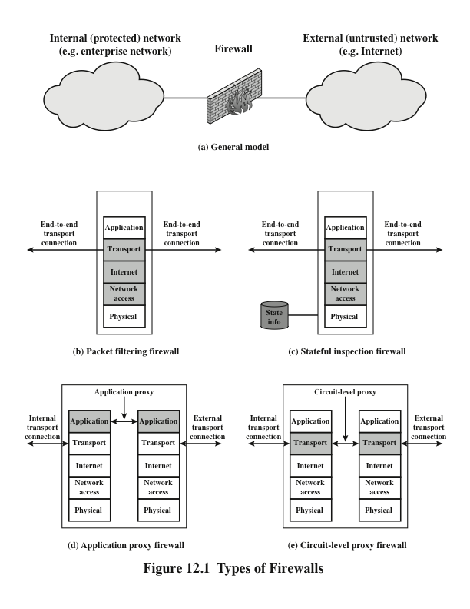
Notes:
A packet filtering firewall applies a set of rules to each incoming and outgoing
IP packet and then forwards or discards the packet (Figure 12.1b). The firewall
is typically configured to filter packets going in both directions (from and to
the internal network). Filtering rules are based on information contained in a
network packet:
• Source IP address: The IP address of the system that originated the IP packet
(e.g., 192.178.1.1)
• Destination IP address: The IP address of the system the IP packet is trying to
reach (e.g., 192.168.1.2)
• Source and destination transport-level address: The transport-level (e.g., TCP
or UDP) port number, which defines applications such as SNMP or TELNET
• IP protocol field: Defines the transport protocol
• Interface: For a firewall with three or more ports, which interface of the
firewall the packet came from or which interface of the firewall the packet is
destined for
The packet filter is typically set up as a list of rules based on matches to fields
in the IP or TCP header. If there is a match to one of the rules, that rule is invoked
to determine whether to forward or discard the packet. If there is no match to any
rule, then a default action is taken. Two default policies are possible:
• Default discard: That which is not expressly permitted is prohibited.
• Default forward: That which is not expressly prohibited is permitted.
The default discard policy is more conservative. Initially, everything is
blocked, and services must be added on a case-by-case basis. This policy is more
visible to users, who are more likely to see the firewall as a hindrance. However,
this is the policy likely to be preferred by businesses and government organizations.
Further, visibility to users diminishes as rules are created. The default forward
policy increases ease of use for end users but provides reduced security; the
security administrator must, in essence, react to each new security threat as it
becomes known. This policy may be used by generally more open organizations,
such as universities.

Slide 9
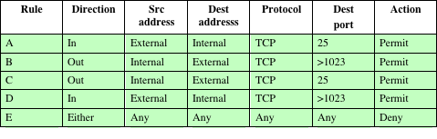
Table 12.1
Packet-Filtering Example
Notes:
Table 12.1 is a simplified example of a ruleset for SMTP traffic. The goal is to
allow inbound and outbound e-mail traffic but to block all other traffic. The rules
are applied top to bottom to each packet.

Slide 10
Packet Filtering firewalls
Notes:
One advantage of a packet filtering firewall is its simplicity. Also, packet
filters typically are transparent to users and are very fast. [SCAR09b] lists the
following weaknesses of packet filter firewalls:
• Because packet filter firewalls do not examine upper-layer data, they cannot
prevent attacks that employ application-specific vulnerabilities or functions.
For example, a packet filter firewall cannot block specific application
commands; if a packet filter firewall allows a given application, all functions
available within that application will be permitted.
• Because of the limited information available to the firewall, the logging functionality
present in packet filter firewalls is limited. Packet filter logs normally
contain the same information used to make access control decisions (source
address, destination address, and traffic type).
• Most packet filter firewalls do not support advanced user authentication
schemes. Once again, this limitation is mostly due to the lack of upper-layer
functionality by the firewall.
• Packet filter firewalls are generally vulnerable to attacks and exploits that take
advantage of problems within the TCP/IP specification and protocol stack,
such as network layer address spoofing . Many packet filter firewalls cannot
detect a network packet in which the OSI Layer 3 addressing information has
been altered. Spoofing attacks are generally employed by intruders to bypass
the security controls implemented in a firewall platform.
• Finally, due to the small number of variables used in access control decisions,
packet filter firewalls are susceptible to security breaches caused by improper
configurations. In other words, it is easy to accidentally configure a packet
filter firewall to allow traffic types, sources, and destinations that should be
denied based on an organization’s information security policy.

Slide 11
Attacks and countermeasures
Notes:
Some of the attacks that can be made on packet filtering firewalls and the appropriate
countermeasures are the following:
• IP address spoofing: The intruder transmits packets from the outside with a
source IP address field containing an address of an internal host. The attacker
hopes that the use of a spoofed address will allow penetration of systems that
employ simple source address security, in which packets from specific trusted
internal hosts are accepted. The countermeasure is to discard packets with an
inside source address if the packet arrives on an external interface. In fact, this
countermeasure is often implemented at the router external to the firewall.
• Source routing attacks: The source station specifies the route that a packet
should take as it crosses the Internet, in the hopes that this will bypass security
measures that do not analyze the source routing information. The countermeasure
is to discard all packets that use this option.
• Tiny fragment attacks: The intruder uses the IP fragmentation option to create
extremely small fragments and force the TCP header information into a
separate packet fragment. This attack is designed to circumvent filtering rules
that depend on TCP header information. Typically, a packet filter will make a
filtering decision on the first fragment of a packet. All subsequent fragments
of that packet are filtered out solely on the basis that they are part of the
packet whose first fragment was rejected. The attacker hopes that the filtering
firewall examines only the first fragment and that the remaining fragments
are passed through. A tiny fragment attack can be defeated by enforcing a
rule that the first fragment of a packet must contain a predefined minimum
amount of the transport header. If the first fragment is rejected, the filter can
remember the packet and discard all subsequent fragments.

Slide 12
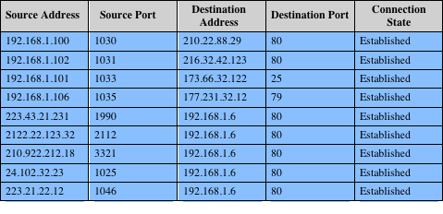
Table 12.2
Example Stateful Firewall Connection State Table [SCAR09b]
Notes:
A stateful inspection packet firewall tightens up the rules for TCP traffic by
creating a directory of outbound TCP connections, as shown in Table 12.2. There is
an entry for each currently established connection. The packet filter will now allow
incoming traffic to high-numbered ports only for those packets that fit the profile of
one of the entries in this directory.
A stateful packet inspection firewall reviews the same packet information
as a packet filtering firewall, but also records information about TCP connections
(Figure 12.1c). Some stateful firewalls also keep track of TCP sequence numbers
to prevent attacks that depend on the sequence number, such as session hijacking.
Some even inspect limited amounts of application data for some well-known
protocols like FTP, IM and SIPS commands, in order to identify and track related
connections.

Slide 13
Application Level Gateway
Also called an application proxy
Acts as a relay of application-level traffic
If the gateway does not implement the proxy code for a specific application, the service is not supported and cannot be forwarded across the firewall
The gateway can be configured to support only specific features of an application that the network administrator considers acceptable while denying all other features
Tend to be more secure than packet filters
Disadvantage:
  The additional processing overhead on each connection
Notes:
An application-level gateway, also called an application proxy , acts as a relay of
application-level traffic (Figure 12.1d). The user contacts the gateway using a TCP/
IP application, such as Telnet or FTP, and the gateway asks the user for the name
of the remote host to be accessed. When the user responds and provides a valid
user ID and authentication information, the gateway contacts the application on
the remote host and relays TCP segments containing the application data between
the two endpoints. If the gateway does not implement the proxy code for a specific
application, the service is not supported and cannot be forwarded across the firewall.
Further, the gateway can be configured to support only specific features of an
application that the network administrator considers acceptable while denying all
other features.
Application-level gateways tend to be more secure than packet filters. Rather
than trying to deal with the numerous possible combinations that are to be allowed
and forbidden at the TCP and IP level, the application-level gateway need only
scrutinize a few allowable applications. In addition, it is easy to log and audit all
incoming traffic at the application level.
A prime disadvantage of this type of gateway is the additional processing
overhead on each connection. In effect, there are two spliced connections between
the end users, with the gateway at the splice point, and the gateway must examine
and forward all traffic in both directions.

Slide 14
Circuit-Level Gateway
Also called circuit-level proxy
Can be a stand-alone system or it can be a specialized function performed by an application-level gateway for certain applications
Does not permit an end-to-end TCP connection
The security function consists of determining which connections will be allowed
Typical use is a situation in which the system administrator trusts the internal users
Can be configured to support application-level or proxy service on inbound connections and circuit-level functions for outbound connections
Example of implementation is the SOCKS package
Notes:
A fourth type of firewall is the circuit-level gateway or circuit-level proxy
(Figure 12.1e). This can be a stand-alone system or it can be a specialized function
performed by an application-level gateway for certain applications. As with
an application gateway, a circuit-level gateway does not permit an end-to-end TCP
connection; rather, the gateway sets up two TCP connections, one between itself
and a TCP user on an inner host and one between itself and a TCP user on an outside
host. Once the two connections are established, the gateway typically relays
TCP segments from one connection to the other without examining the contents.
The security function consists of determining which connections will be allowed.
A typical use of circuit-level gateways is a situation in which the system administrator
trusts the internal users. The gateway can be configured to support
application-level or proxy service on inbound connections and circuit-level functions
for outbound connections. In this configuration, the gateway can incur the processing
overhead of examining incoming application data for forbidden functions
but does not incur that overhead on outgoing data.
An example of a circuit-level gateway implementation is the SOCKS package
[KOBL92]; version 5 of SOCKS is specified in RFC 1928. The RFC defines SOCKS
in the following fashion:
The protocol described here is designed to provide a framework for
client-server applications in both the TCP and UDP domains to conveniently
and securely use the services of a network firewall. The
protocol is conceptually a “shim-layer” between the application layer
and the transport layer, and as such does not provide network-
layer gateway services, such as forwarding of ICMP messages.
SOCKS consists of the following components:
• The SOCKS server, which often runs on a UNIX-based firewall. SOCKS is
also implemented on Windows systems.
• The SOCKS client library, which runs on internal hosts protected by the firewall.
• SOCKS-ified versions of several standard client programs such as FTP and
TELNET. The implementation of the SOCKS protocol typically involves
either the recompilation or relinking of TCP-based client applications or the
use of alternate dynamically loaded libraries, to use the appropriate encapsulation
routines in the SOCKS library.
When a TCP-based client wishes to establish a connection to an object that is
reachable only via a firewall (such determination is left up to the implementation),
it must open a TCP connection to the appropriate SOCKS port on the SOCKS
server system. The SOCKS service is located on TCP port 1080. If the connection
request succeeds, the client enters a negotiation for the authentication method to
be used, authenticates with the chosen method, and then sends a relay request. The
SOCKS server evaluates the request and either establishes the appropriate connection
or denies it. UDP exchanges are handled in a similar fashion. In essence, a TCP
connection is opened to authenticate a user to send and receive UDP segments, and
the UDP segments are forwarded as long as the TCP connection is open.

Slide 15
Bastion Host
A system identified by the firewall administrator as a critical strong point in the network’s security
Typically serves as a platform for an application-level or circuit-level gateway
Common characteristics:
  Executes a secure version of its operating system, making it a hardened system
  Only the services that the network administrator considers essential are installed
  May require additional authentication before a user is allowed access to the proxy services
  Each proxy is configured to support only a subset of the standard application’s command set
  Each proxy is configured to allow access only to specific host systems
  Each proxy maintains detailed audit information by logging all traffic, each connection, and the duration of each connection
  Each proxy module is a very small software package specifically designed for network security
  Each proxy is independent of other proxies on the bastion host
  A proxy generally performs no disk access other than to read its initial configuration file
  Each proxy runs as a nonprivileged user in a private and secured directory on the bastion host
Notes:
A bastion host is a system identified by the firewall administrator as a critical strong
point in the network’s security. Typically, the bastion host serves as a platform for
an application-level or circuit-level gateway. Common characteristics of a bastion
host are as follows:
• The bastion host hardware platform executes a secure version of its operating
system, making it a hardened system.
• Only the services that the network administrator considers essential are
installed on the bastion host. These could include proxy applications for DNS,
FTP, HTTP, and SMTP.
• The bastion host may require additional authentication before a user is
allowed access to the proxy services. In addition, each proxy service may
require its own authentication before granting user access.
• Each proxy is configured to support only a subset of the standard application’s
command set.
• Each proxy is configured to allow access only to specific host systems. This
means that the limited command/feature set may be applied only to a subset
of systems on the protected network.
• Each proxy maintains detailed audit information by logging all traffic, each
connection, and the duration of each connection. The audit log is an essential
tool for discovering and terminating intruder attacks.
• Each proxy module is a very small software package specifically designed for
network security. Because of its relative simplicity, it is easier to check such
modules for security flaws. For example, a typical UNIX mail application may
contain over 20,000 lines of code, while a mail proxy may contain fewer than 1000.
• Each proxy is independent of other proxies on the bastion host. If there is a
problem with the operation of any proxy, or if a future vulnerability is discovered,
it can be uninstalled without affecting the operation of the other proxy
applications. Also, if the user population requires support for a new service, the
network administrator can easily install the required proxy on the bastion host.
• A proxy generally performs no disk access other than to read its initial configuration
file. Hence, the portions of the file system containing executable code
can be made read only. This makes it difficult for an intruder to install Trojan
horse sniffers or other dangerous files on the bastion host.
• Each proxy runs as a nonprivileged user in a private and secured directory on
the bastion host.

Slide 16
Host-Based Firewall
A software module used to secure an individual host
Is available in many operating systems or can be provided as an add-on package
Filters and restricts the flow of packets
Common location is a server
Advantages:
  Filtering rules can be tailored to the host environment
  Protection is provided independent of topology
  Used in conjunction with stand-alone firewalls, provides an additional layer of protection
Notes:
A host-based firewall is a software module used to secure an individual host. Such
modules are available in many operating systems or can be provided as an add-on
package. Like conventional stand-alone firewalls, host-resident firewalls filter and
restrict the flow of packets. A common location for such firewalls is a server. There
are several advantages to the use of a server-based or workstation-based firewall:
• Filtering rules can be tailored to the host environment. Specific corporate security
policies for servers can be implemented, with different filters for servers
used for different application.
• Protection is provided independent of topology. Thus both internal and external
attacks must pass through the firewall.
• Used in conjunction with stand-alone firewalls, the host-based firewall provides
an additional layer of protection. A new type of server can be added to
the network, with its own firewall, without the necessity of altering the network
firewall configuration.

Slide 17
Personal Firewall
Controls the traffic between a personal computer or workstation on one side and the Internet or enterprise network on the other side
Can be used in the home environment and on corporate intranets
Typically is a software module on the personal computer
Can also be housed in a router that connects all of the home computers to a DSL, cable modem, or other Internet interface
Primary role is to deny unauthorized remote access to the computer
Can also monitor outgoing activity in an attempt to detect and block worms and other malware
Notes:
A personal firewall controls the traffic between a personal computer or workstation
on one side and the Internet or enterprise network on the other side. Personal firewall
functionality can be used in the home environment and on corporate intranets.
Typically, the personal firewall is a software module on the personal computer. In
a home environment with multiple computers connected to the Internet, firewall
functionality can also be housed in a router that connects all of the home computers
to a DSL, cable modem, or other Internet interface.
Personal firewalls are typically much less complex than either server-based
firewalls or stand-alone firewalls. The primary role of the personal firewall is to
deny unauthorized remote access to the computer. The firewall can also monitor
outgoing activity in an attempt to detect and block worms and other malware.

Slide 18
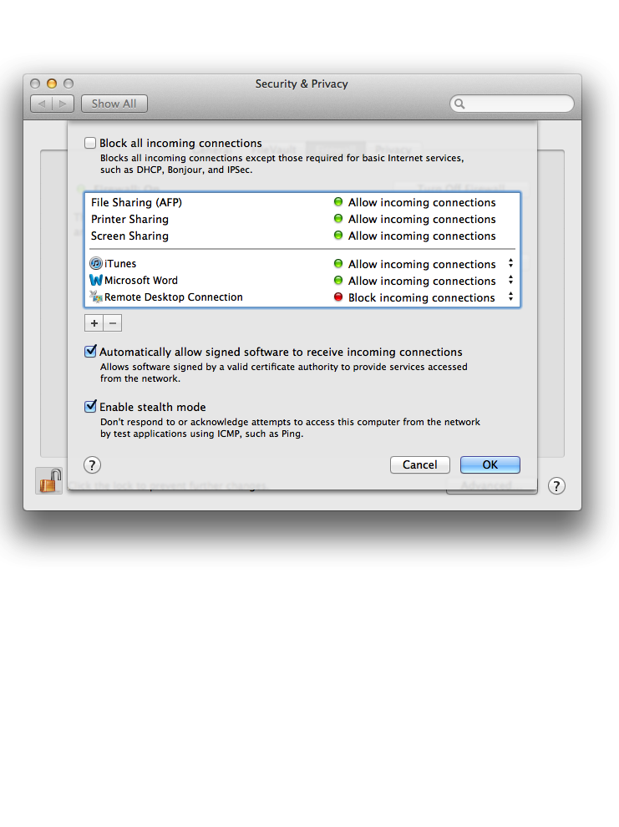
Figure 12.2
Example Personal Firewall Interface
Notes:
An example of a personal firewall is the capability built in to the Mac OS X
operating system. This relatively simple utility can be turned on or off. If it is turned
on, any applications, programs, and services unauthorized by the system won’t be
allowed to automatically accept incoming network traffic. Any active sharing services,
such as file or printer sharing, are unaffected. In addition, there are three
options available to the user, as shown in Figure 12.2. “Block all incoming connections”
blocks all sharing services while allowing basic Internet connections. If this option
is unchecked, then the window below that option lists individual programs and
services. Above the horizontal line in the window, features of OS X itself are listed.
These are features selected by the user in another window. The user can add applications
to a list displayed below the line and designate each as blocked or unblocked.
The firewall also allows the user to enable a feature that allows software
signed by a valid certificate authority to provide services accessed from the network.
Stealth mode hides the Mac on the Internet by dropping unsolicited communication
packets, making it appear as though no Mac is present.

Slide 19
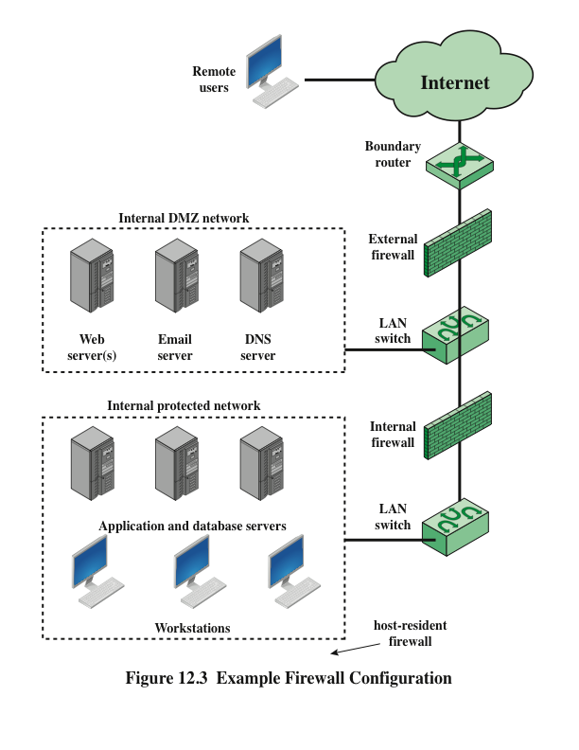
Notes:
Figure 12.3 suggests the most common distinction, that between an internal and an
external firewall. An external firewall is placed at the edge of a local or enterprise network,
just inside the boundary router that connects to the Internet or some wide area
network (WAN). One or more internal firewalls protect the bulk of the enterprise
network. Between these two types of firewalls are one or more networked devices in a
region referred to as a DMZ (demilitarized zone) network. Systems that are externally
accessible but need some protections are usually located on DMZ networks.
Typically, the systems in the DMZ require or foster external connectivity, such as a corporate
Web site, an e-mail server, or a DNS (domain name system) server.
The external firewall provides a measure of access control and protection for
the DMZ systems consistent with their need for external connectivity. The external
firewall also provides a basic level of protection for the remainder of the enterprise
network. In this type of configuration, internal firewalls serve three purposes:
The internal firewall adds more stringent filtering capability, compared to t
2. The internal firewall provides two-way protection with respect to the DMZ.
First, the internal firewall protects the remainder of the network from
attacks launched from DMZ systems. Such attacks might originate from worms,
rootkits, bots, or other malware lodged in a DMZ system. Second, an internal
firewall can protect the DMZ systems from attack from the internal
protected network.
3. Multiple internal firewalls can be used to protect portions of the internal
network from each other. For example, firewalls can be configured so that
internal servers are protected from internal workstations and vice versa.
A common practice is to place the DMZ on a different network interface on
the external firewall from that used to access the internal networks.

Slide 20
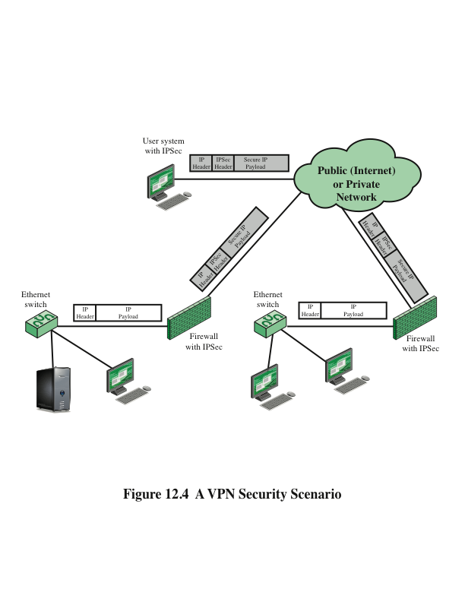
Notes:
In today’s distributed computing environment, the virtual private network (VPN)
offers an attractive solution to network managers. In essence, a VPN consists of
a set of computers that interconnect by means of a relatively unsecure network
and that make use of encryption and special protocols to provide security. At each
corporate site, workstations, servers, and databases are linked by one or more local
area networks (LANs). The Internet or some other public network can be used to
interconnect sites, providing a cost savings over the use of a private network and
offloading the wide area network management task to the public network provider.
That same public network provides an access path for telecommuters and other
mobile employees to log on to corporate systems from remote sites.
But the manager faces a fundamental requirement: security. Use of a public
network exposes corporate traffic to eavesdropping and provides an entry point for
unauthorized users. To counter this problem, a VPN is needed. In essence, a VPN
uses encryption and authentication in the lower protocol layers to provide a secure
connection through an otherwise insecure network, typically the Internet. VPNs are
generally cheaper than real private networks using private lines but rely on having
the same encryption and authentication system at both ends. The encryption may
be performed by firewall software or possibly by routers. The most common protocol
mechanism used for this purpose is at the IP level and is known as IPsec.
Figure 12.4 (Compare Figure 9.1) is a typical scenario of IPSec usage. An
organization maintains LANs at dispersed locations. Nonsecure IP traffic is conducted
on each LAN. For traffic off site, through some sort of private or public
WAN, IPSec protocols are used. These protocols operate in networking devices,
such as a router or firewall, that connect each LAN to the outside world. The IPSec
networking device will typically encrypt and compress all traffic going into the
WAN and decrypt and uncompress traffic coming from the WAN; authentication
may also be provided. These operations are transparent to workstations and servers
on the LAN. Secure transmission is also possible with individual users who dial into
the WAN. Such user workstations must implement the IPSec protocols to provide
security. They must also implement high levels of host security, as they are directly
connected to the wider Internet. This makes them an attractive target for attackers
attempting to access the corporate network.
A logical means of implementing an IPSec is in a firewall, as shown in
Figure 12.4. If IPSec is implemented in a separate box behind (internal to) the firewall,
then VPN traffic passing through the firewall in both directions is encrypted.
In this case, the firewall is unable to perform its filtering function or other security
functions, such as access control, logging, or scanning for viruses. IPSec could be
implemented in the boundary router, outside the firewall. However, this device is
likely to be less secure than the firewall and thus less desirable as an IPSec platform.

Slide 21
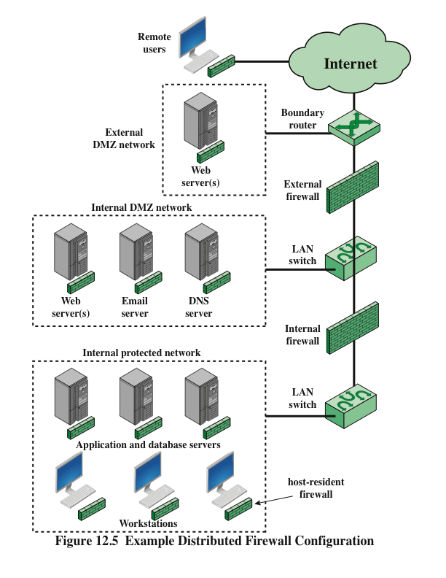
Notes:
A distributed firewall configuration involves stand-alone firewall devices plus
host-based firewalls working together under a central administrative control.
Figure 12.5 suggests a distributed firewall configuration. Administrators can configure
host-resident firewalls on hundreds of servers and workstations as well as
configure personal firewalls on local and remote user systems. Tools let the network
administrator set policies and monitor security across the entire network. These
firewalls protect against internal attacks and provide protection tailored to specific
machines and applications. Stand-alone firewalls provide global protection, including
internal firewalls and an external firewall, as discussed previously.
With distributed firewalls, it may make sense to establish both an internal
and an external DMZ. Web servers that need less protection because they have
less critical information on them could be placed in an external DMZ, outside the
external firewall. What protection is needed is provided by host-based firewalls on
these servers.
An important aspect of a distributed firewall configuration is security
monitoring. Such monitoring typically includes log aggregation and analysis, firewall
statistics, and fine-grained remote monitoring of individual hosts if needed.

Slide 22
Summary of Firewall Locations and Topologies
Host-resident firewall
  This category includes personal firewall software and firewall software on servers
  Can be used alone or as part of an in-depth firewall deployment
Screening router
  A single router between internal and external networks with stateless or full packet filtering
  This arrangement is typical for small office/home office (SOHO) applications
Single bastion inline
  A single firewall device between an internal and external router
  This is the typical firewall appliance configuration for small-to-medium sized organizations
Single bastion T
  Similar to single bastion inline but has a third network interface on bastion to a DMZ where externally visible servers are placed
Double bastion inline
  DMZ is sandwiched between bastion firewalls
Double bastion T
  DMZ is on a separate network interface on the bastion firewall
Distributed firewall configuration
  Used by some large businesses and government organizations
Notes:
We can now summarize the discussion from Sections 12.4 and 12.5 to define a spectrum
of firewall locations and topologies. The following alternatives can be identified:
• Host-resident firewall: This category includes personal firewall software and
firewall software on servers. Such firewalls can be used alone or as part of an
in-depth firewall deployment.
• Screening router: A single router between internal and external networks with
stateless or full packet filtering. This arrangement is typical for small office/
home office (SOHO) applications.
• Single bastion inline: A single firewall device between an internal and external
router (e.g., Figure 12.1a). The firewall may implement stateful filters and/
or application proxies. This is the typical firewall appliance configuration for
small- to medium-sized organizations.
• Single bastion T: Similar to single bastion inline but has a third network interface
on bastion to a DMZ where externally visible servers are placed. Again,
this is a common appliance configuration for medium to large organizations.
• Double bastion inline: Figure 12.3 illustrates this configuration, where the
DMZ is sandwiched between bastion firewalls. This configuration is common
for large businesses and government organizations.
• Double bastion T: The DMZ is on a separate network interface on the bastion
firewall. This configuration is also common for large businesses and government
organizations and may be required. For example, this configuration is
required for Australian government use (Australian Government Information
Technology Security Manual—ACSI33).
• Distributed firewall configuration: Illustrated in Figure 12.5. This configuration
is used by some large businesses and government organizations.

Slide 23
Summary
  The need for firewalls
  Firewall characteristics
  Types of firewalls
    Packet filtering firewall
    Stateful inspection firewalls
    Application level gateway
    Circuit level gateway
Firewall basing
  Bastion host
  Host based firewalls
  Personal firewall
Firewall locations and configurations
  DMZ networks
  Virtual private networks
  Distributed firewalls
  Firewall location and topologies summary
Notes:
Chapter 12 summary.

