Slide 1
Chapter 18
- basic definitions
- binary trees
- tree traversals
Intro. to Trees

Slide 2
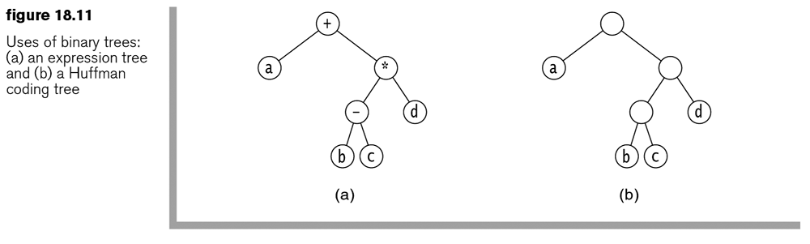
Trees
A recursively defined data structure
  Each node has links to two or more subtrees/children-nodes.
  Each node itself can be the beginning of a new tree.
  Nodes with no children nodes are called leaves or leaf nodes.
  The root node has no parent.
Example
  class BinaryNode<AnyType> {
    private AnyType element;
    private BinaryNode<AnyType> left;
    private BinaryNode<AnyType> right;
  …
  }

Slide 3
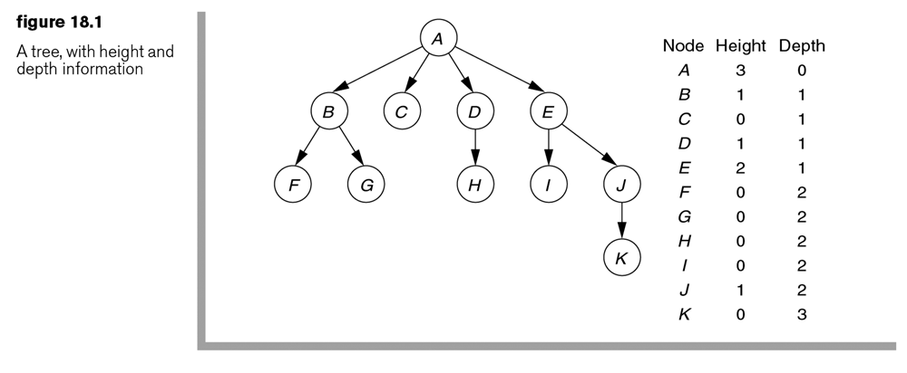
Trees
Depth of a node: the length of the path from the root to the node.
Height of a node: the length of the path from the node to the deepest leaf.
Nodes in a tree are linked by edges.
Sibling nodes: nodes with the same parent.
Ancestor nodes vs descendent nodes
The size of a node is the number of descendents plus itself.

Slide 4
More Tree Properties
The depth of any node is 1 more than the depth of its parent.
The height of any node is 1 more than the height of its maximum-height child.
The height of a tree is the height of the root node.
The size of a tree is the size of its root.
A tree with N nodes has N-1 edges. (Except for the root, each of the other nodes has one incoming edge.)

Slide 5
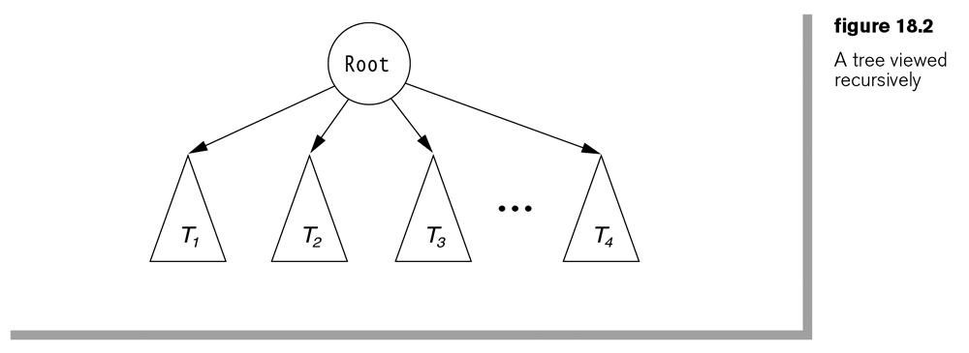
Implementation of Trees
Each node is allocated space for data plus a number of references to other nodes (children, siblings).
Exercise: Define the tree shown below as a class.
Q: What’s the space allocation for each of the nodes in the following tree?

Slide 6
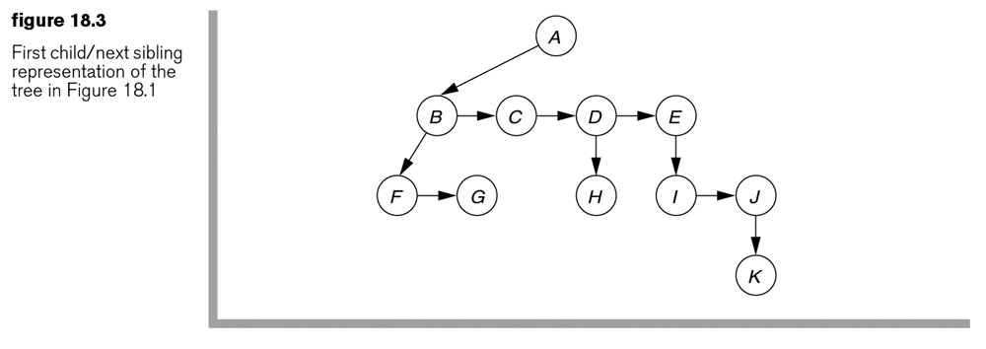
Implementation of Trees
An alternative implementation
Exercise: Define a class to represent such a tree.
Q: What’s the space allocation for each of the nodes in this tree?

Slide 7
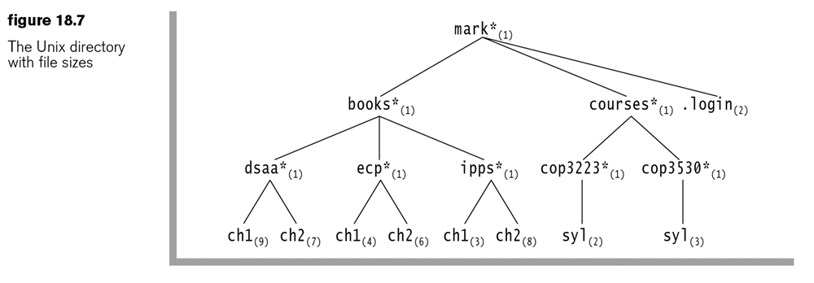
Applications of Trees
Many applications in computing systems
Typically a tree is used as an index to the stored data.
Examples:
  The file system directory/folder structure
  a secondary index to a primary file
  An index to a database
  etc.

Slide 8
Binary Trees
A tree in which no node has more than two children.
Many applications:
  expression trees (in compiler design),
  Huffman coding tree (in data compression),
  binary search tree
  Priority queues

Slide 9
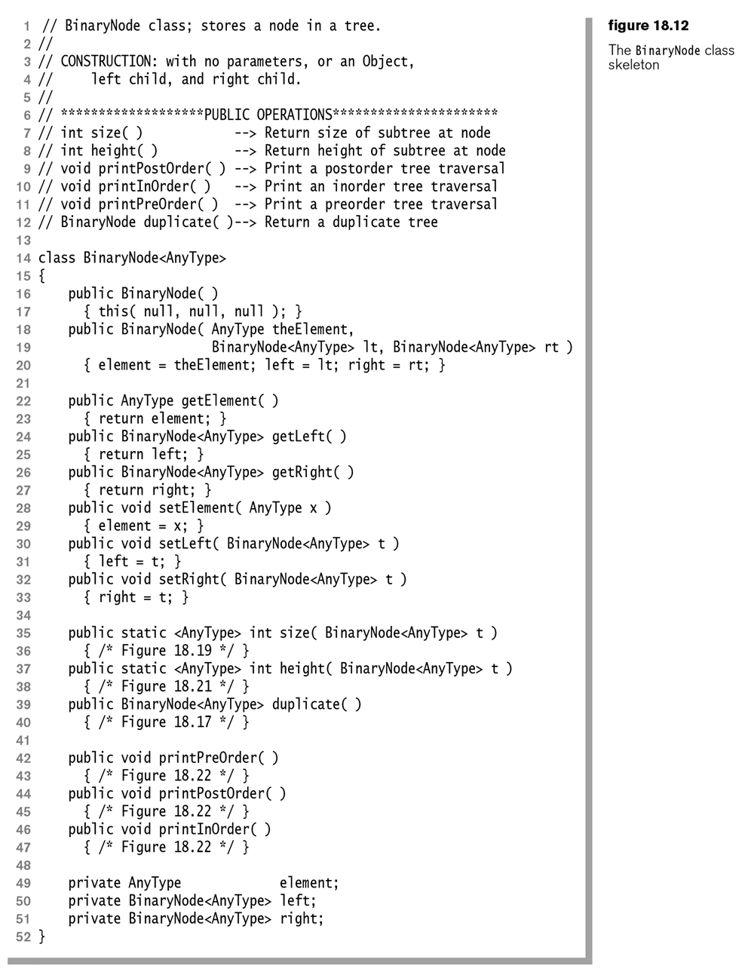
BinaryNode.java

Slide 10
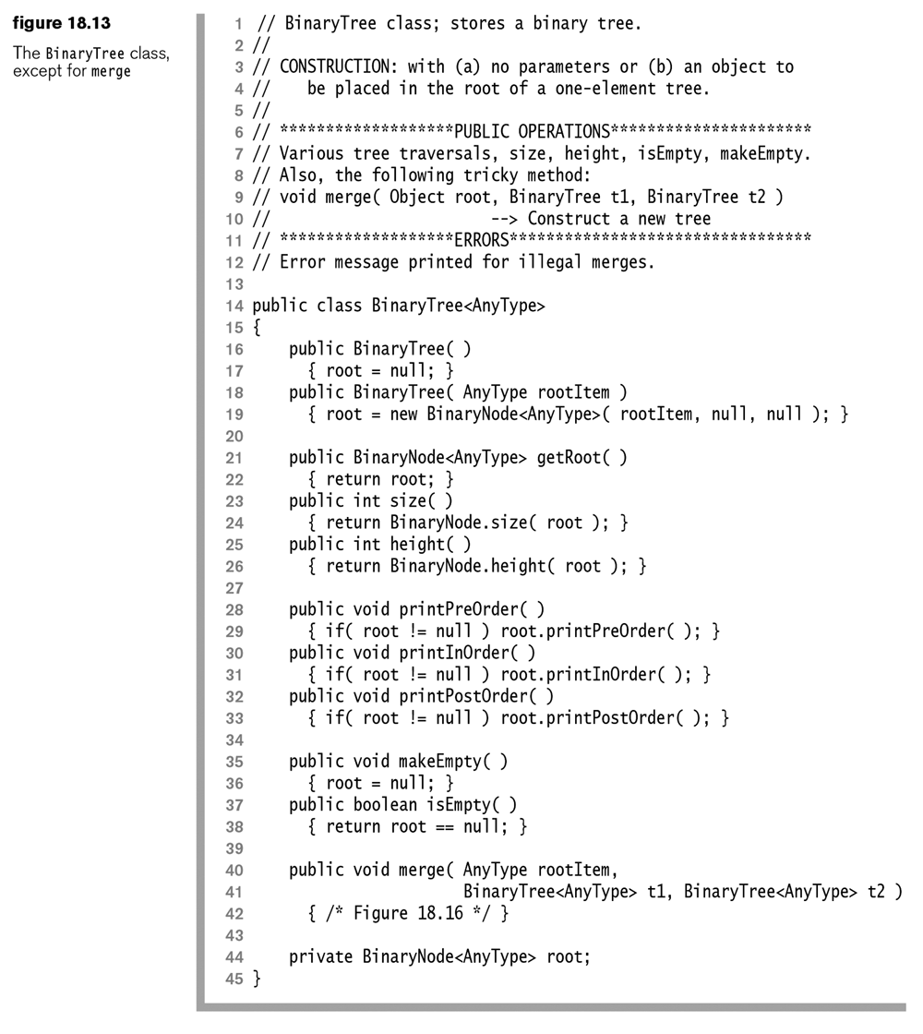
BinaryTree.java

Slide 11
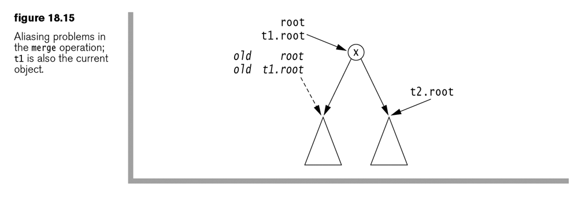
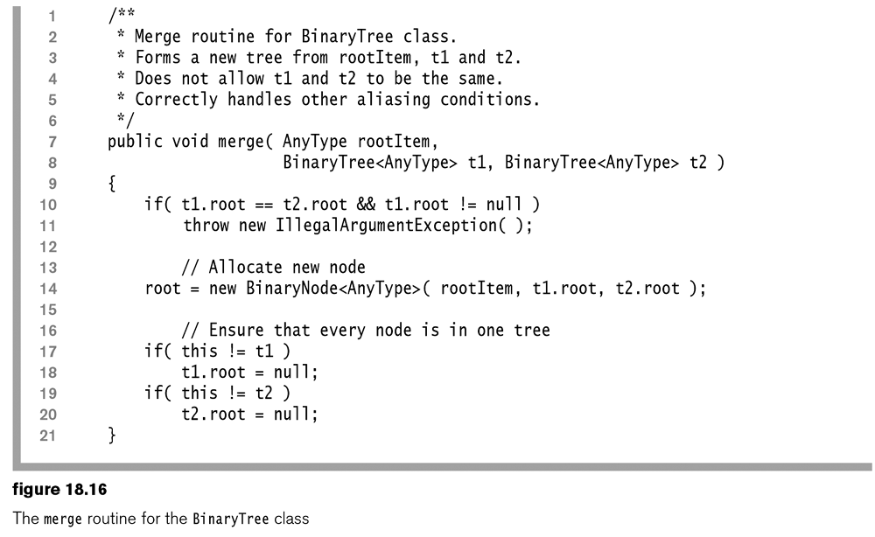

Slide 12
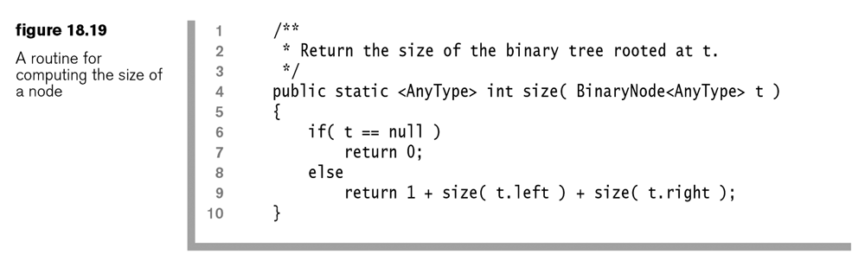
Recursion and Trees
Most methods in trees are defined as recursive methods.
Example: find the size of a tree

Slide 13
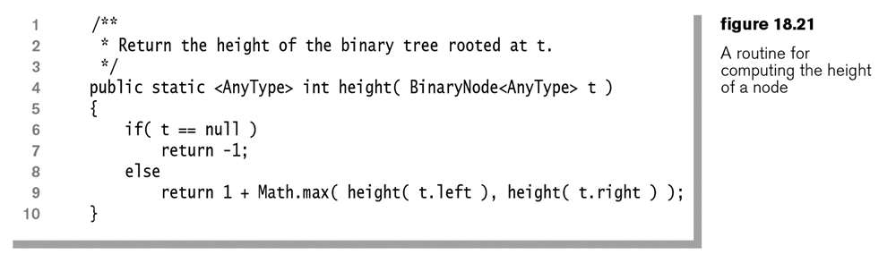
Recursion and Trees
Example: find the height of a tree

Slide 14
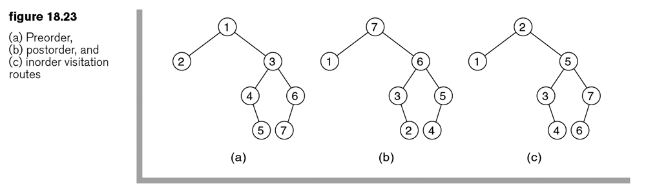
Tree Traversal
Preorder traversal: the node itself + the left child + the right child
Postorder traversal: the left child + the right child + the node
Inorder traversal: the left child + the node + the right child

Slide 15
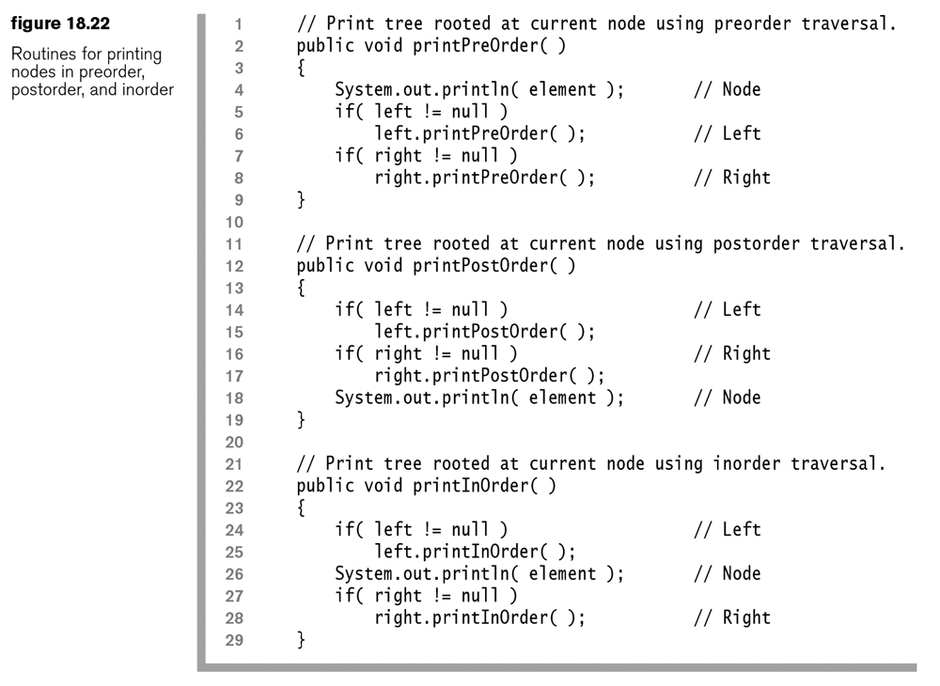

Slide 16
Tree Traversals and Stacks
The task: Use a stack to maintain the states of a tree when traversing the nodes
Example: postorder traversal
  Each node in the stack is associated with one of the three counters to represent its state:
    If we are about to process the node’s left child
    If we are about to process the node’s right child
    If we are about to process the node itself
    Default counter value = 0;
    The counter value represents the number of times popped.

Slide 17
Example program: TestTreeIterators.java http://users.cis.fiu.edu/~weiss/dsj4/code/TestTreeIterators.java
public static <AnyType> void testItr( String type, TreeIterator<AnyType> itr )
{
try
{
System.out.print( type + ":" );
for( itr.first( ); itr.isValid( ); itr.advance( ) )
System.out.print( " " + itr.retrieve( ) );
System.out.println( );
itr.advance( );
}
catch( NoSuchElementException e )
{ System.out.println( e + " (as expected)" ); }
}

Slide 18
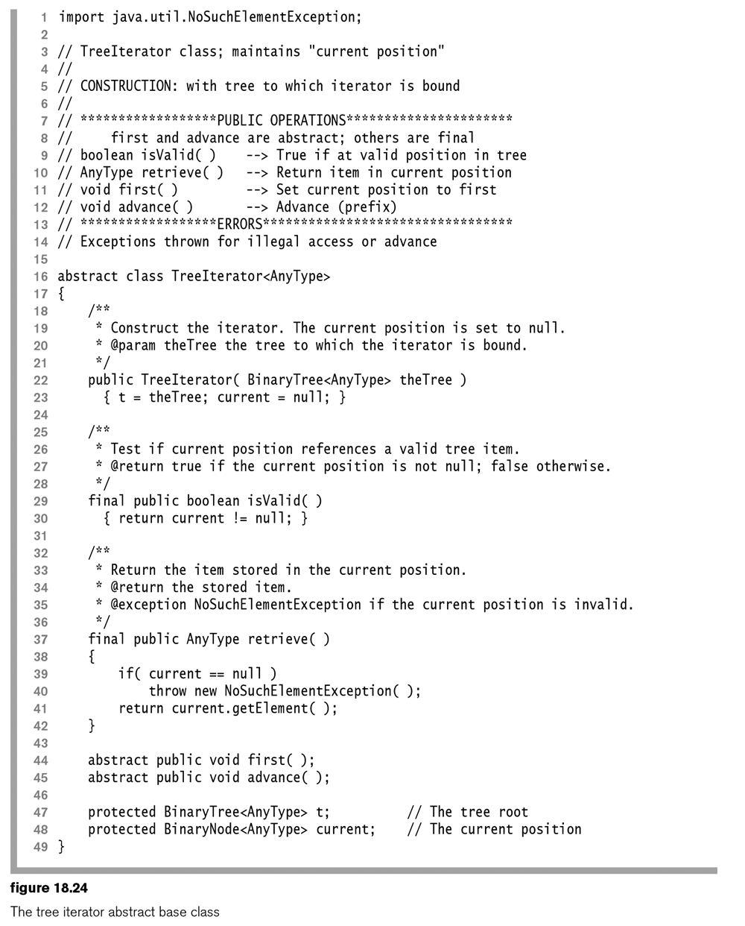

Slide 19
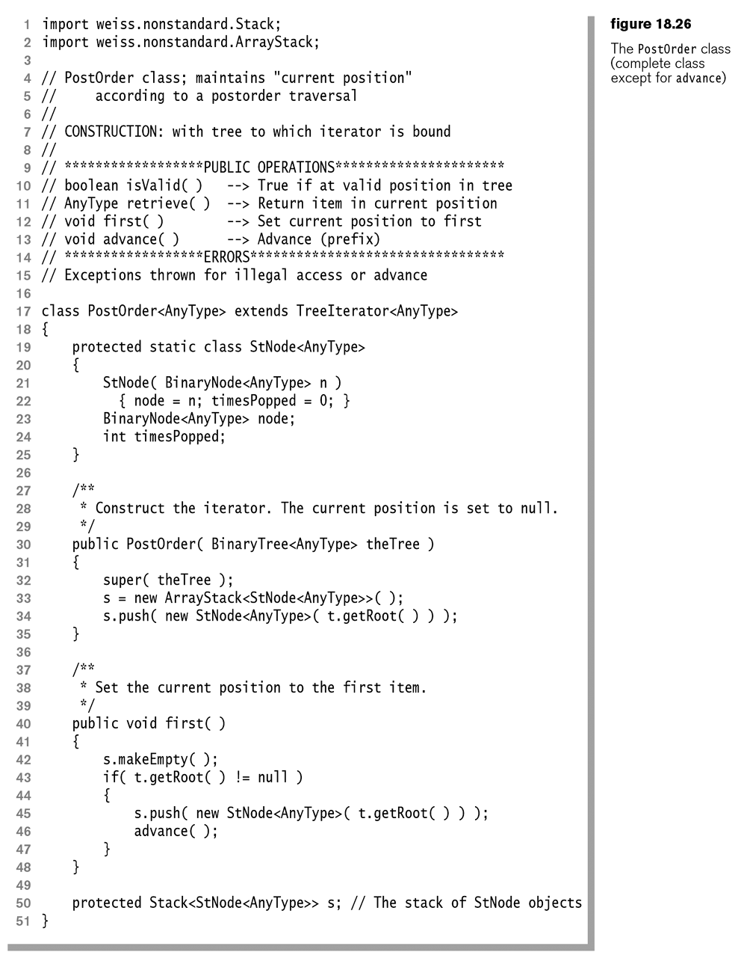

Slide 20
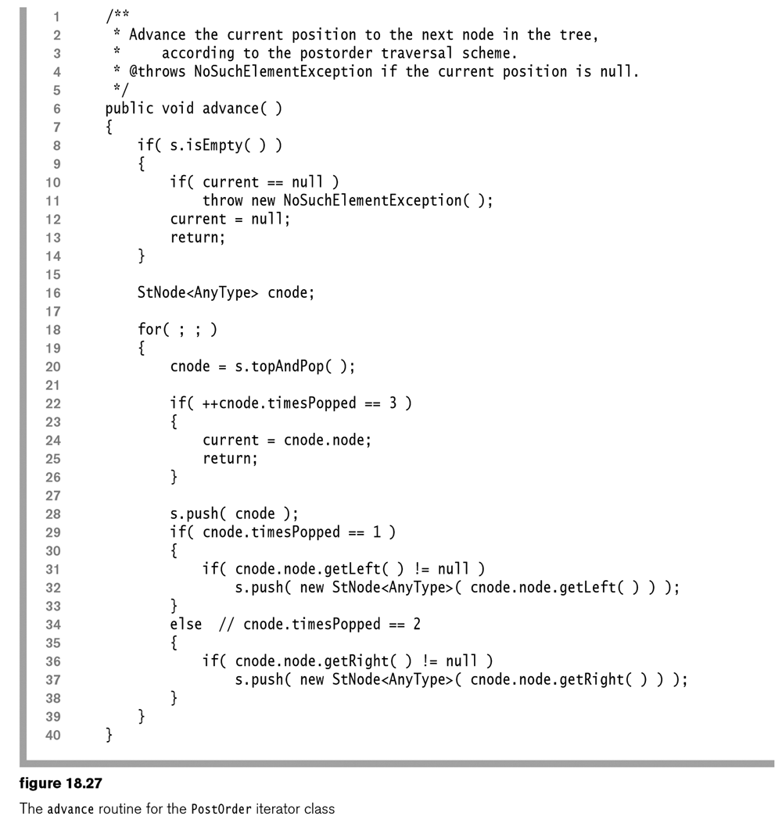

Slide 21
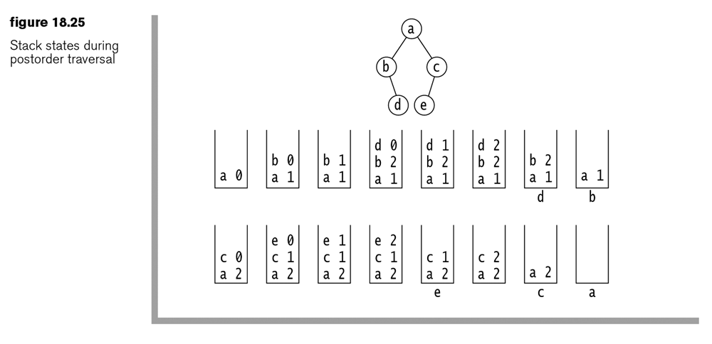
Tree Traversals using Stacks
Example: postorder traversal

Slide 22
Tree Traversals using Stacks
Exercise 18.4:
  Show the stack operations when a preorder traversal is applied to the tree shown in Figure 18.25.
  Inorder traversal ? Lab 5.

Slide 23
Level-order traversal
Nodes in the tree are processed starting at the root and going from top to bottom, left to right.
  Level 0 nodes
  Level 1 nodes
  Level 2 nodes
  …
Exercise: What are the order of printed data if the following trees are level-order traversed?

