Slide 1
Chapter 19 - basic definitions - order statistics ( findkth( ) ) - balanced binary search trees - Java implementations
Binary Search Trees

Slide 2
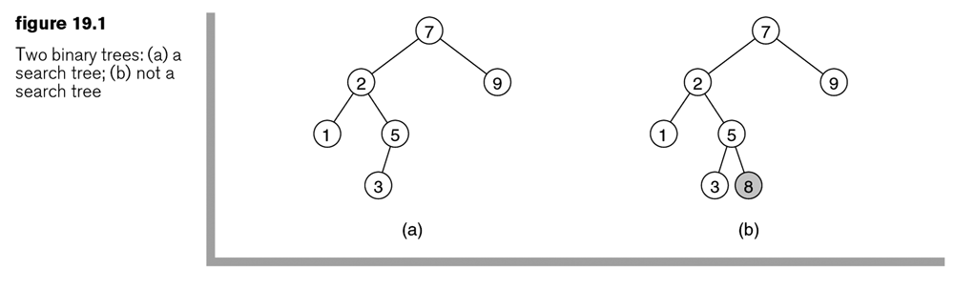
Binary Search Trees
A binary tree that satisfies the search order property
For every node X in the tree, the values of all the keys in the left subtree are smaller than the key in X and the values of all the keys in the right subtree are larger than the key in X.
Duplicates are not allowed.
An inorder traversal yields the items in sorted order.

Slide 3
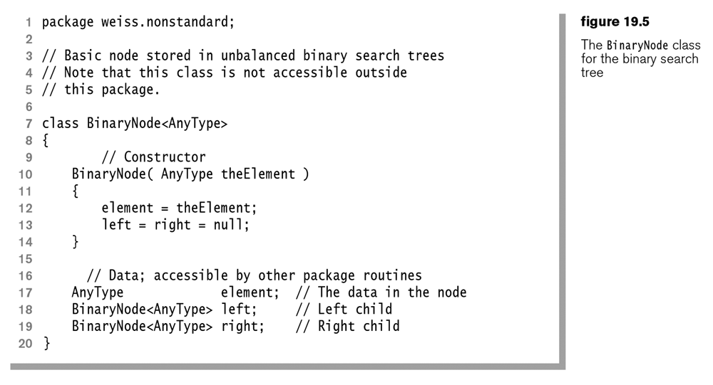

Slide 4
Operations & Efficiency
Find(key), findMin(), findMax(), insert(newKey): The cost is proportional to the number of nodes along the search path (i.e., the height of the tree), typically O(logN).
The worst case scenario: When the input sequence is sorted, the binary search tree is reduced to a linked list; the cost is O(N).

Slide 5
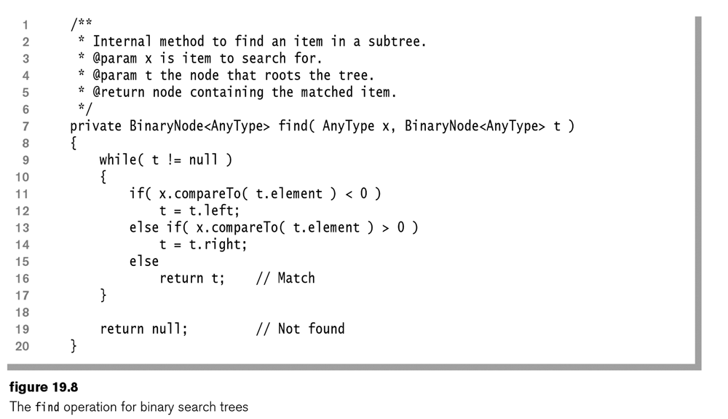
The find( ) operation:

Slide 6
The find( ) operation:
Exercise: Rewrite the find( ) method as a recursive method.

Slide 7
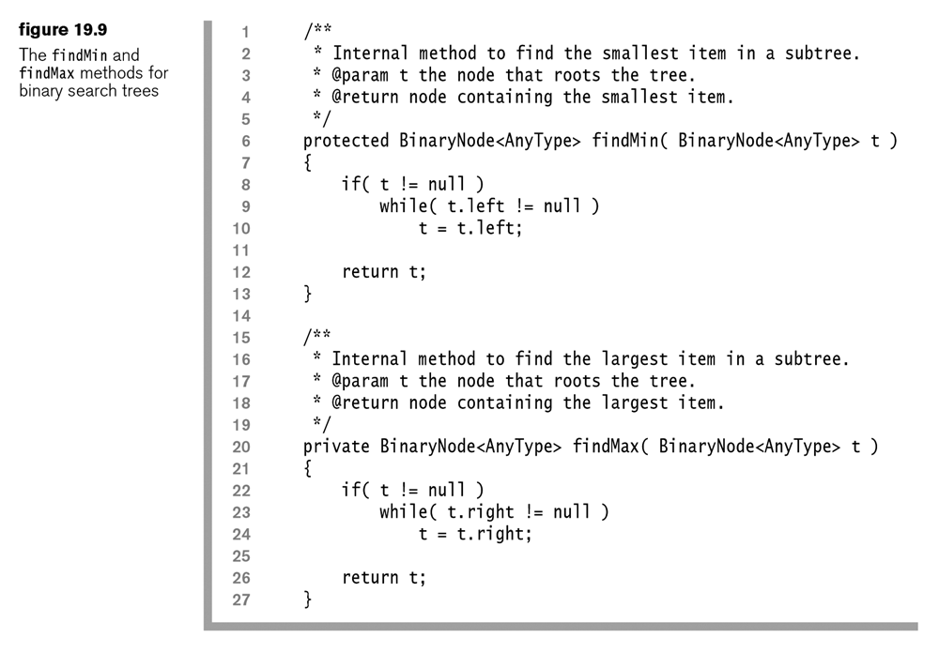
The findMin( ) & findMax( ) operation:

Slide 8
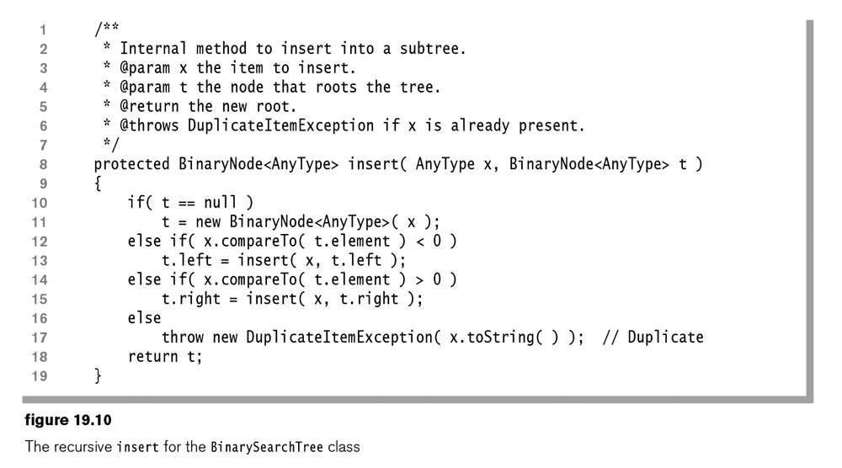
Insert( )

Slide 9
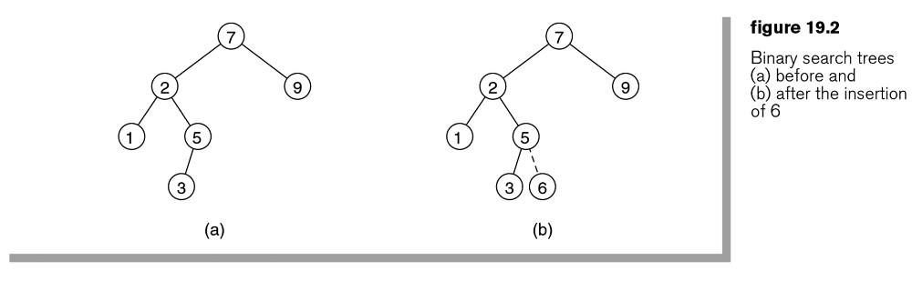
Insert( )

Slide 10
Insert( )
Exercise: Rewrite the insert( ) method as an iterative method.

Slide 11
Operations & Efficiency
Exercise: Insert the following numbers into a binary search tree: 40, 5, 100, 50, 70, 9, 30, 15.
Exercise: Insert the following numbers into a binary search tree: 100, 50, 70, 9, 40, 5, 30, 15.
Exercise: Insert the following numbers into a binary search tree: 5, 9, 15, 30, 40, 50, 70, 100.

Slide 12
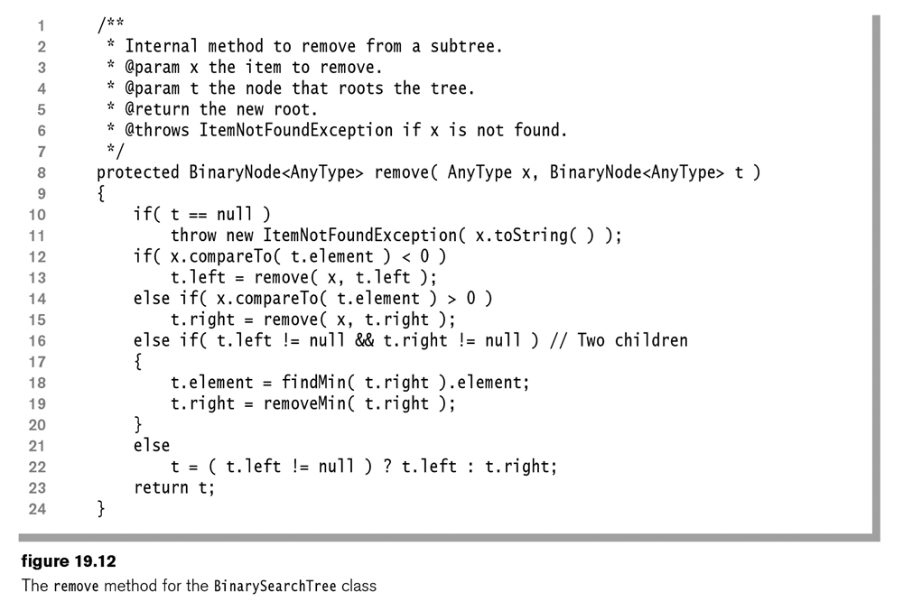
Remove( ) / Delete( )

Slide 13
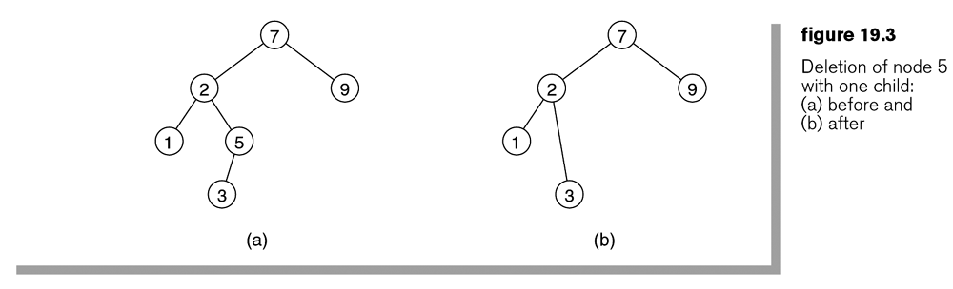
Remove( ) / Delete( )

Slide 14
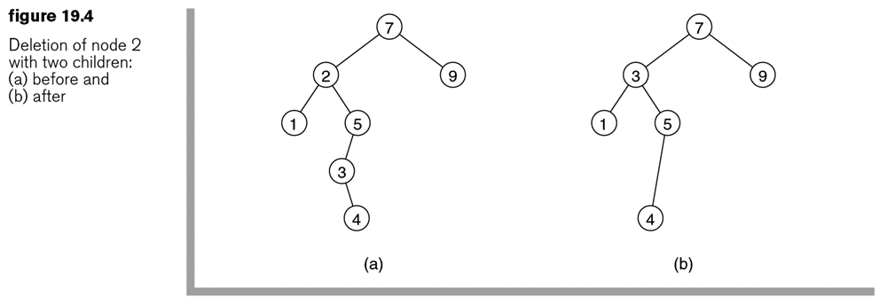
Remove( ) / Delete( )

Slide 15
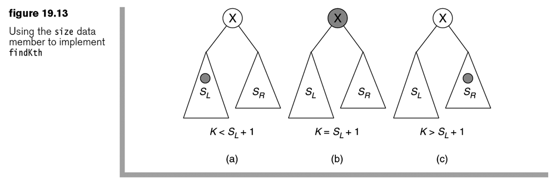
Order statistics: Find the kth smallest element
The findkth( ) method can be implemented by maintaining the size of each node as we update the tree.

Slide 16
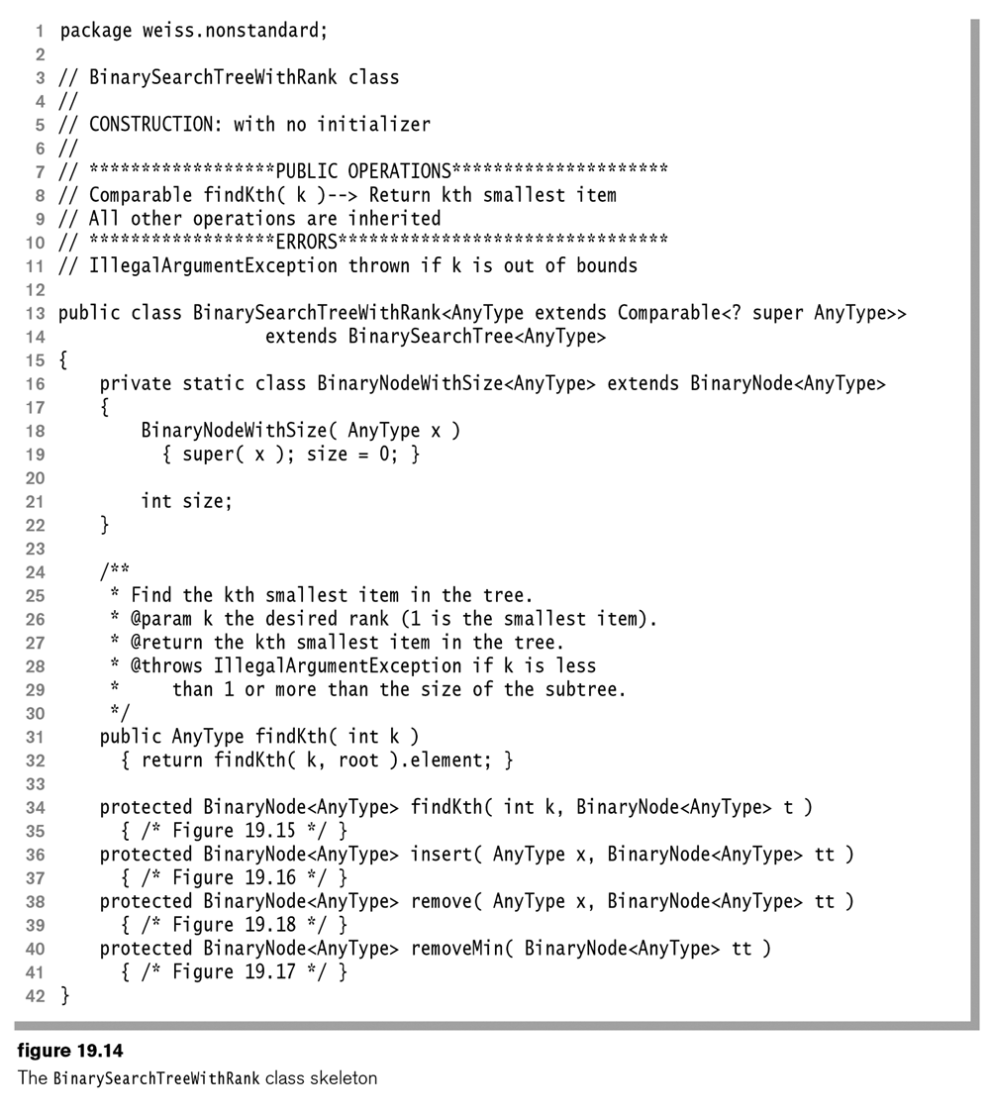
Order statistics

Slide 17
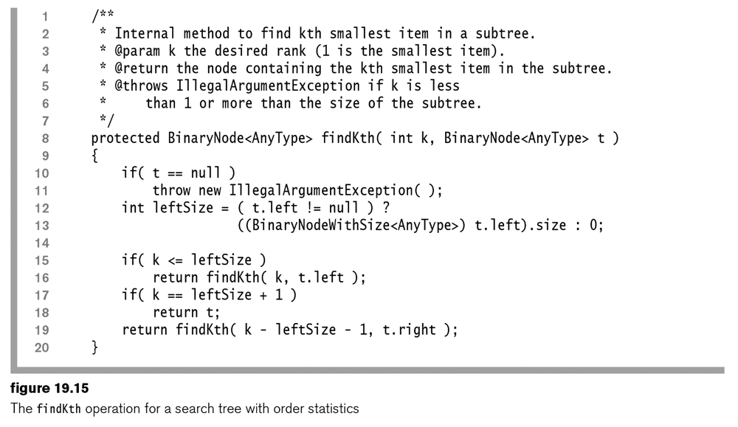
Order statistics

Slide 18
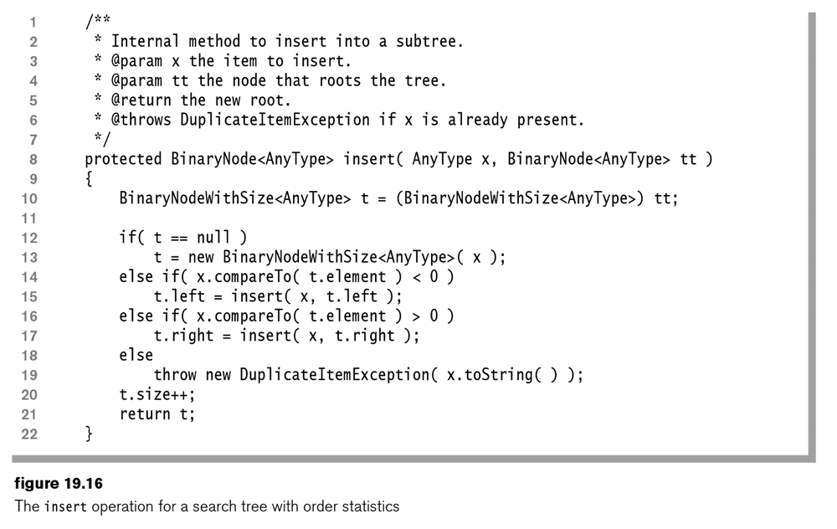
Order statistics
The insert( ) and remove( ) operations also need to be revised in order to maintain order statistics in the tree.

Slide 19
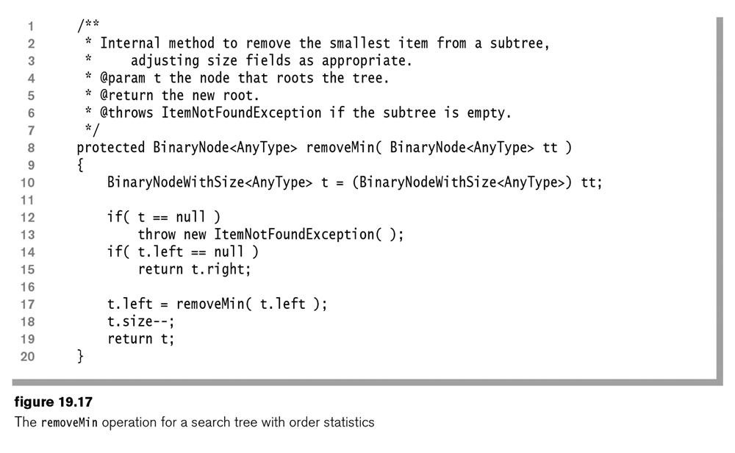
Order statistics

Slide 20
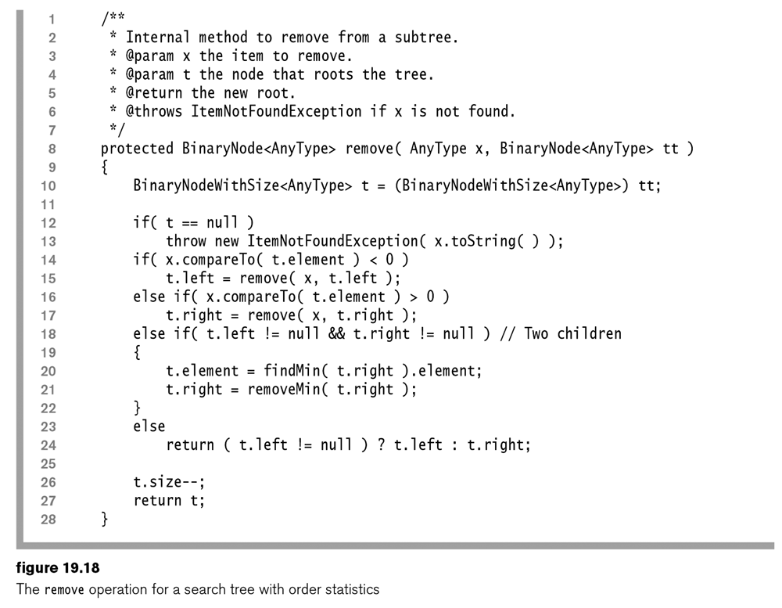
Order statistics

Slide 21
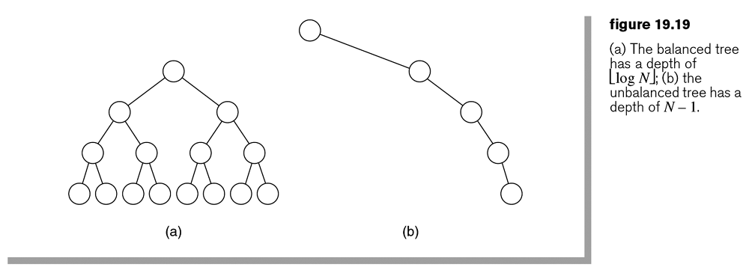
Analysis of binary search tree operations
The cost of an operation is the depth of the last accessed node plus 1 (that is, the number of nodes along the path).
The cost is in general logarithmic for a well-balanced tree.
For a degenerate tree, the cost could be as bad as linear.

Slide 22
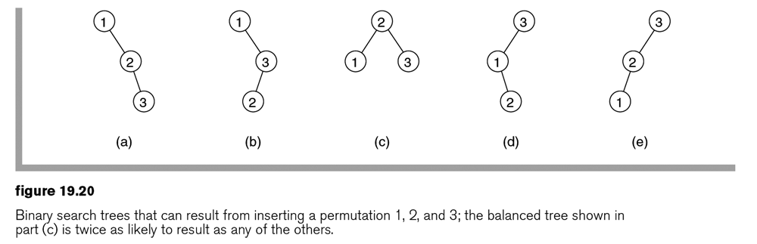
Construction of Trees out of randomly selected numbers
With the same set of keys, different trees will be constructed out of the different permutations of the keys.
Example: The following are trees that may be constructed out of the set of {1, 2, 3}.

Slide 23
Construction of Trees out of randomly selected numbers
Assumption: Each insertion order is equally likely.
Learned:
Some trees are more likely to result than others.
Balanced trees are more likely than unbalanced trees.
A balanced binary search tree has an added structure property to guarantee logarithmic depth in the worst case.
e.g., An AVL tree is a balanced binary search tree that, for any node in the tree, the height of the left and the right subtrees can differ by at most 1. (The height of an empty subtree is -1.)

Slide 24
Construction of Trees out of randomly selected numbers
Exercise: What are the trees that may be constructed out of the set of {1, 2, 3, 4}?
Note: The number of permutations of N different numbers is N!.
Show the different trees and the probability of each.

