Slide 1
More on Object-Oriented Programming: Inheritance
Based on slides from Deitel & Associates, Inc.
Revised by T. A. Yang

Slide 2
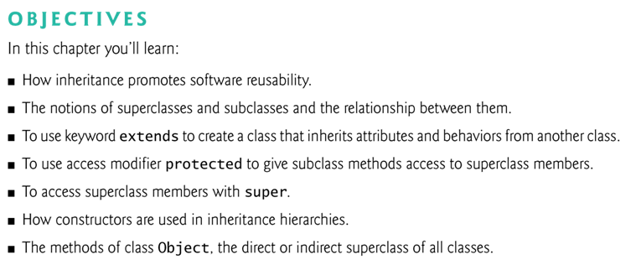

Slide 3
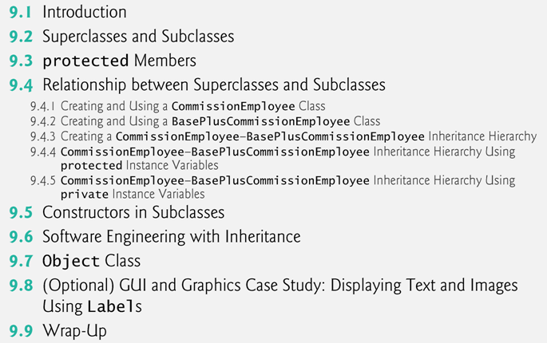

Slide 4
9.1 Introduction
Inheritance
A form of software reuse in which a new class is created by absorbing an existing class’s members and typically tailoring them with new or modified capabilities.
Benefits:
Efficient software development: Can save time during program development by basing new classes on existing proven and debugged high-quality software.
Effective software maintenance: Increases the likelihood that a system will be maintained effectively.

Slide 5
Inheritance (cont.)
When creating a class, rather than declaring completely new members, you can designate that the new class should inherit the members of an existing class.
Existing class is the superclass
New class is the subclass
Each subclass can be a superclass of future subclasses.
A subclass can add its own fields and methods.
A subclass is more specific than its superclass and represents a more specialized group of objects.
The subclass exhibits the behaviors of its superclass and can add behaviors that are specific to the subclass.
This is why inheritance is sometimes referred to as specialization.

Slide 6
The direct superclass is the superclass from which the subclass explicitly inherits.
An indirect superclass is any class above the direct superclass in the class hierarchy.
The Java class hierarchy begins with class Object (in package java.lang)
Every class in Java directly or indirectly extends (or “inherits from”) the Object class.
Java supports only single inheritance, in which each class is derived from exactly one direct superclass.

Slide 7
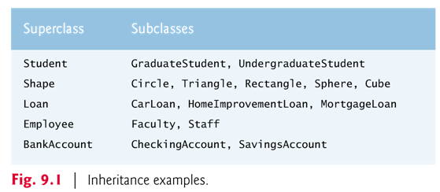
is-a relationship vs has-a relationship
Is-a represents inheritance
In an is-a relationship, an object of a subclass can also be treated as an object of its superclass
e.g., a student is also a person; an employee is a person

Slide 8
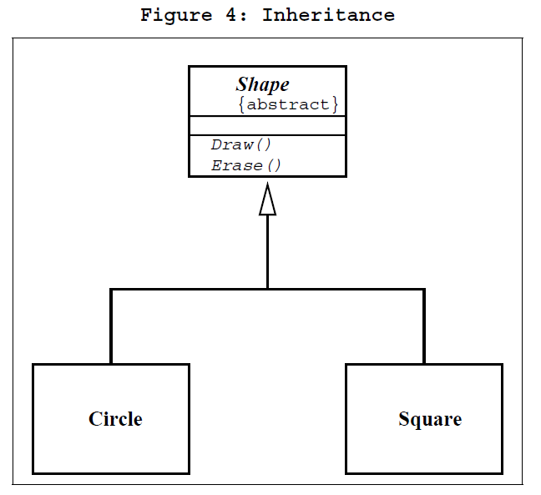
Inheritance in UML class diagram
From: http://www.objectmentor.com/resources/articles/umlClassDiagrams.pdf
The inheritance relationship in UML is depicted by a peculiar triangular arrowhead.
This arrowhead points to the base (or super) class.
One or more lines proceed from the base of the arrowhead connecting it to the derived (or sub) classes.

Slide 9
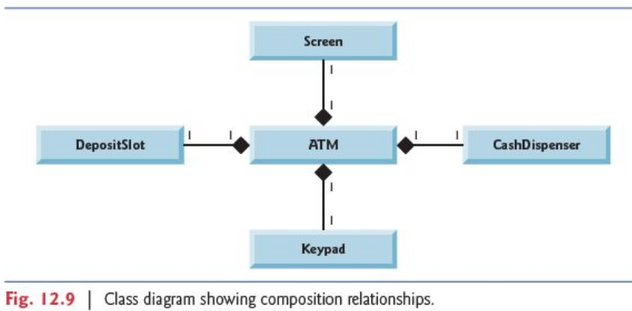
is-a relationship vs has-a relationship
Has-a represents composition
In a has-a relationship, an object contains as members references to other objects
e.g., a car has an engine; a person has a date of birth;
Fig. 12.9: an ATM has a deposit slot, a screen, a keypad, and a cash dispenser.

Slide 10
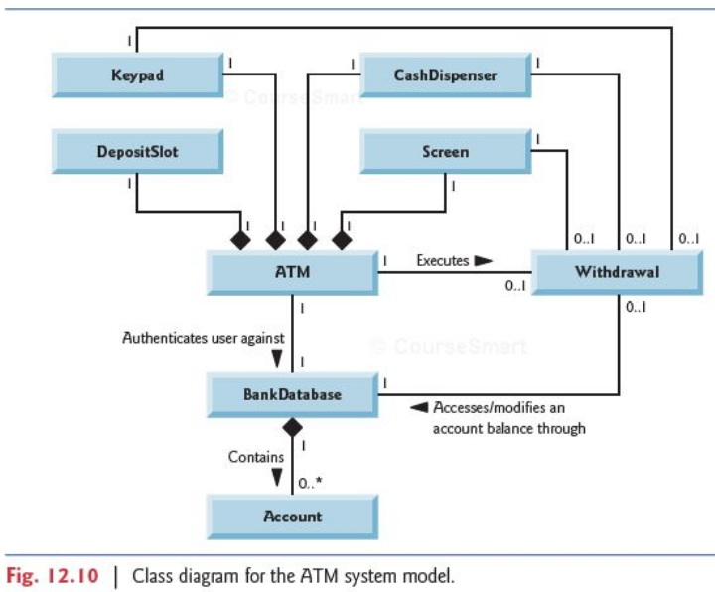
Example System Models

Slide 11
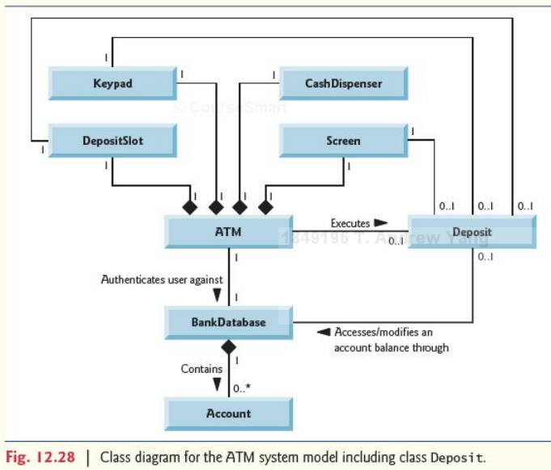
Example System Models (cont.)

Slide 12
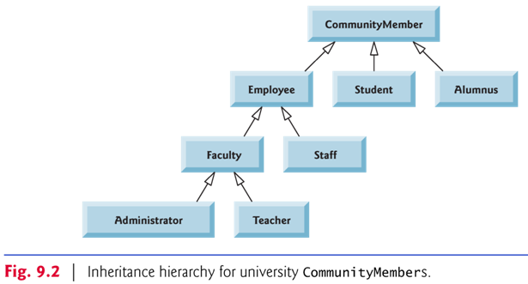
inheritance hierarchy
Fig. 9.2 shows a sample university community class hierarchy (aka inheritance hierarchy).
Each arrow in the hierarchy represents an is-a relationship.
Follow the arrows upward in the class hierarchy
an Employee is a CommunityMember”
“a Teacher is a Faculty member.”
Starting from the bottom, you can follow the arrows and apply the is-a relationship up to the topmost superclass.

Slide 13
Objects of all classes that extend a common superclass can be treated as objects of that superclass.
Overriding of methods in superclasses
A subclass can inherit methods that it does not need or should not have.
Even when a superclass method is appropriate for a subclass, that subclass often needs a customized version of the method.
The subclass can override (redefine) the superclass method with an appropriate implementation.
Q: When both the subclass and the superclass have methods with the same signature, which one will be called?

Slide 14
9.3 protected Members
A class’s public members are accessible wherever the program has a reference to an object of that class or one of its subclasses.
A class’s private members are accessible only within the class itself.
protected access is an intermediate level of access between public and private.
A class’s protected members can be accessed by members of that class itself, by members of its subclasses, and by members of other classes in the same package.
protected members also have package access.
All public and protected superclass members retain their original access modifier when they become members of the subclass.

Slide 15
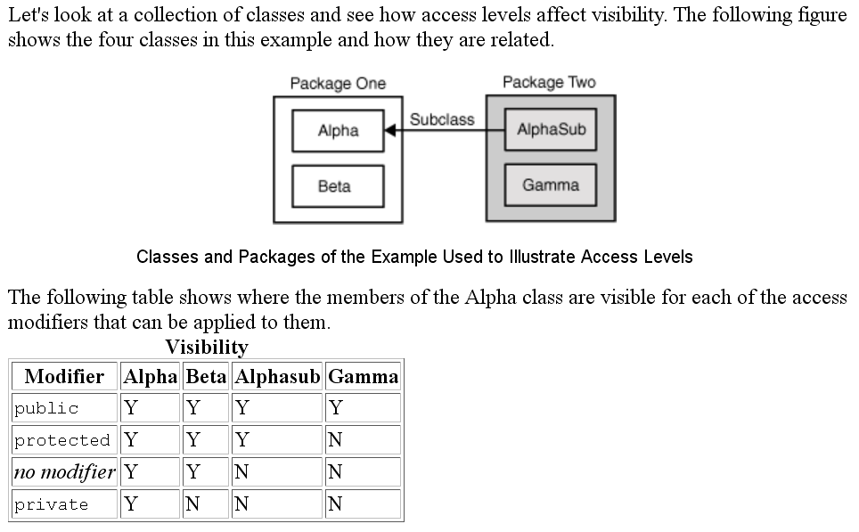
Source: http://download.oracle.com/javase/tutorial/java/javaOO/accesscontrol.html

Slide 16
A class’s private members are hidden in its subclasses.
They can be accessed only through the public or protected methods inherited from the superclass.
Subclass methods can refer to public and protected members inherited from the superclass simply by using the member names.
When a subclass method overrides an inherited superclass method, the superclass method can be accessed from the subclass by preceding the superclass method name with keyword super and a dot (.) separator.

Slide 17
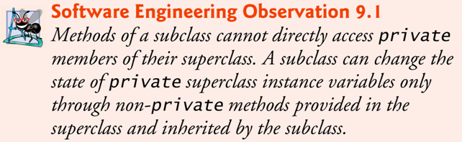
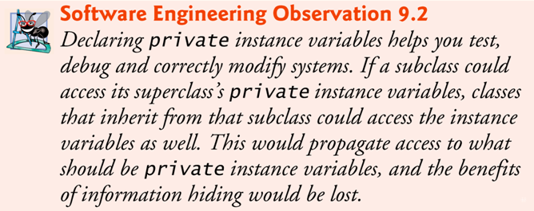

Slide 18
9.4.1 Creating and Using a CommissionEmployee Class
Inheritance hierarchy containing types of employees in a company’s payroll application:
Commission employees are paid a percentage of their sales
Base-salaried commission employees receive a base salary plus a percentage of their sales.
Class CommissionEmployee (Fig. 9.4) extends class Object (from package java.lang).
If you don’t explicitly specify which class a new class extends, the class extends Object implicitly.

Slide 19
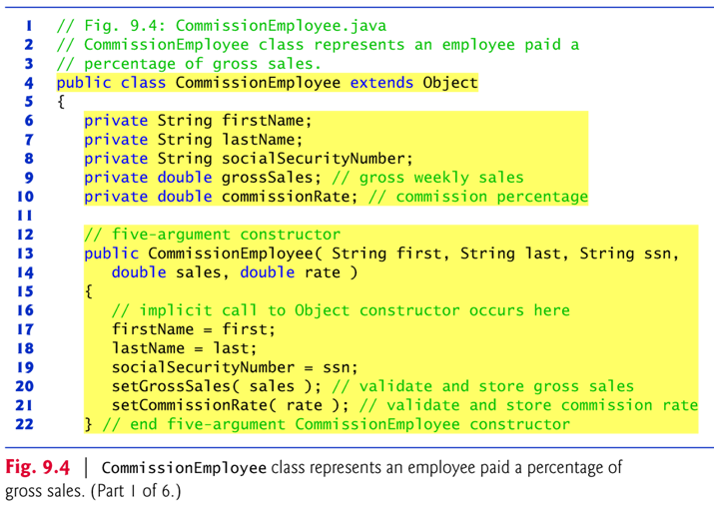
Exercise: Draw a UML class diagram to show the design of the CommissionEmployee class.

Slide 20
Constructors are not inherited.
The first task of a subclass constructor is to call its direct superclass’s constructor explicitly or implicitly.
Ensures that the instance variables inherited from the superclass are initialized properly.
If the code does not include an explicit call to the superclass constructor, Java implicitly calls the superclass’s default or no-argument constructor.
A class’s default constructor calls the superclass’s default or no-argument constructor.

Slide 21
To override a superclass method, a subclass must declare a method with the same signature as the superclass method
@Override annotation
Indicates that a method should override a superclass method with the same signature.
If it does not, a compilation error occurs.
Annotations provide data about a program that is not part of the program itself. They have no direct effect on the operation of the code they annotate.
Annotations have a number of uses, among them:
Information for the compiler — Annotations can be used by the compiler to detect errors or suppress warnings.
Compiler-time and deployment-time processing — Software tools can process annotation information to generate code, XML files, and so forth.
Runtime processing — Some annotations are available to be examined at runtime.
From: http://download.oracle.com/javase/tutorial/java/javaOO/annotations.html

Slide 22
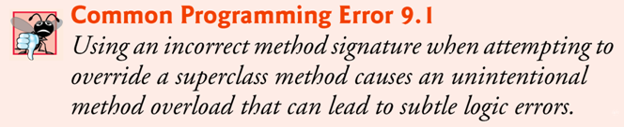
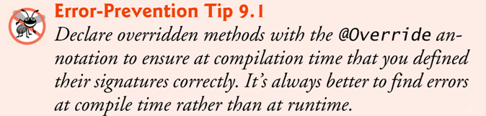

Slide 23
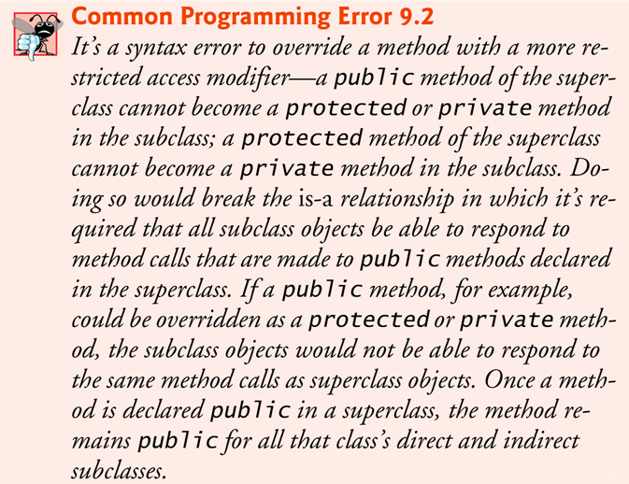

Slide 24
9.4.2 Creating and Using a BasePlusCommissionEmployee Class
Class BasePlusCommissionEmployee (Fig. 9.6) contains a first name, last name, social security number, gross sales amount, commission rate and base salary.
All but the base salary are in common with class CommissionEmployee.
Class BasePlusCommissionEmployee’s public services include a constructor, and methods earnings, toString and get and set for each instance variable
Most of these are in common with class CommissionEmployee.

Slide 25
Observations:
Although Class BasePlusCommissionEmployee (Fig. 9.6) shares many common features as the CommissionEmployee class (Fig. 9.4), it does not specify “extends CommissionEmployee” .
It implicitly extends Object.
Much of BasePlusCommissionEmployee’s code is similar, or identical, to that of CommissionEmployee.
private instance variables firstName and lastName and methods setFirstName, getFirstName, setLastName and getLastName are identical.
Both classes also contain corresponding get and set methods.
The constructors are almost identical
BasePlusCommissionEmployee’s constructor also sets the base-Salary.
The toString methods are nearly identical
BasePlusCommissionEmployee’s toString also outputs instance variable baseSalary

Slide 26
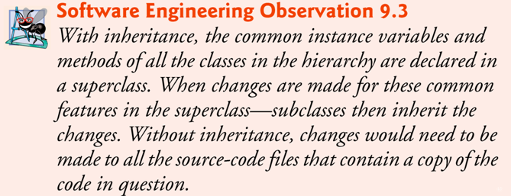
CommissionEmployee’s code was literally copied and pasted into BasePlusCommissionEmployee and then modified to include a base salary and methods that manipulate the base salary.
This “copy-and-paste” approach is often error prone and time consuming.
It spreads copies of the same code throughout a system, creating a code-maintenance nightmare. → Ripple effect of software maintenance

Slide 27
9.4.3 Creating a CommissionEmployee and BasePlusCommissionEmployee Inheritance Hierarchy
Class BasePlusCommissionEmployee class extends class CommissionEmployee.
A BasePlusCommissionEmployee object is a CommissionEmployee.
Subclass BasePlusCommissionEmployee inherits CommissionEmployee’s instance variables and methods
Only the superclass’s public and protected members are directly accessible in the subclass.
Class BasePlusCommissionEmployee has an instance variable baseSalary.

Slide 28
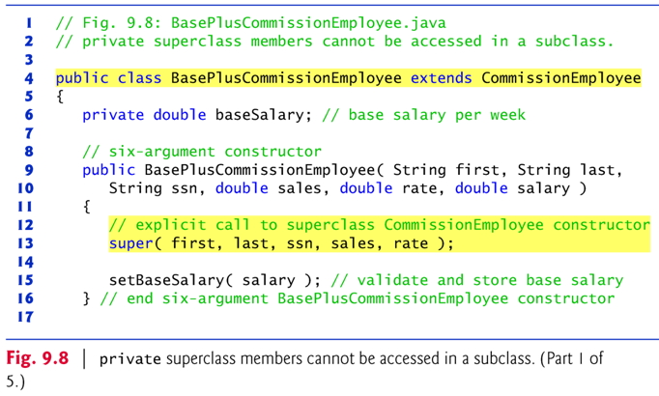
Fig. 9.8: BasePlusCommissionEmployee.java

Slide 29
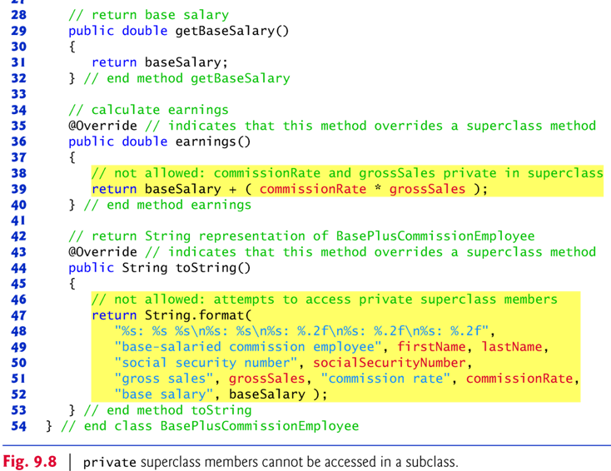

Slide 30
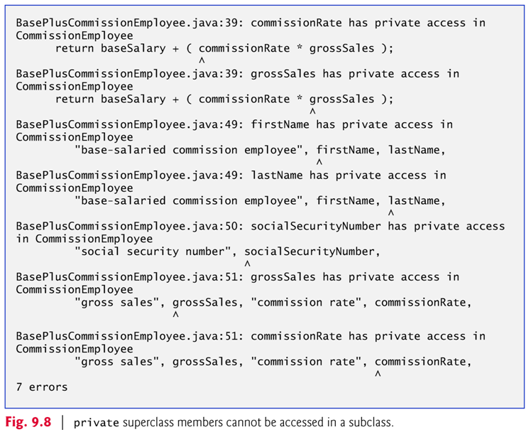

Slide 31
Issues: Compilation errors occur when the subclass attempts to access the superclass’s private instance variables.
Lesson learned: These lines could have used appropriate get methods to retrieve the values of the superclass’s instance variables.

Slide 32
Each subclass constructor must implicitly or explicitly call its superclass constructor to initialize the instance variables inherited from the superclass.
Superclass constructor call syntax — keyword super, followed by a set of parentheses containing the superclass constructor arguments.
Must be the first statement in the subclass constructor’s body.
If the subclass constructor did not invoke the superclass’s constructor explicitly, Java would attempt to invoke the superclass’s no-argument or default constructor.
Issue: Class CommissionEmployee does not have such a constructor, so the compiler would issue an error.

Slide 33
9.4.4 CommissionEmployee and BasePlusCommissionEmployee Inheritance Hierarchy Using protected Instance Variables
To enable a subclass to directly access superclass instance variables, we can declare those members as protected in the superclass.
New CommissionEmployee class modified only lines 6–10 of Fig. 9.4 as follows:
protected String firstName; protected String lastName; protected String socialSecurityNumber; protected double grossSales; protected double commissionRate;
With protected instance variables, the subclass gets access to the instance variables, but classes that are not subclasses and classes that are not in the same package cannot access these variables directly.

Slide 34
Class BasePlusCommissionEmployee (Fig. 9.9) extends the new version of class CommissionEmployee with protected instance variables.
These variables are now protected members of BasePlusCommissionEmployee.
If another class extends this version of class BasePlusCommissionEmployee, the new subclass also can access the protected members.
The source code in Fig. 9.9 (51 lines) is considerably shorter than that in Fig. 9.6 (128 lines).
Most of the functionality is now inherited from CommissionEmployee.
There is now only one copy of the functionality.
Code is easier to maintain, modify and debug — the code related to a commission employee exists only in class CommissionEmployee.

Slide 35
protected versus private instance variables
Inheriting protected instance variables slightly increases performance, because we can directly access the variables in the subclass without incurring the overhead of a set or get method call.
In most cases, it’s better to use private instance variables to encourage proper software engineering, and leave code optimization issues to the compiler.
Code will be easier to maintain, modify and debug.

Slide 36
Software Maintenance Issues with using protected instance variables
Using protected instance variables creates several potential problems.
The subclass object can set an inherited variable’s value directly without using a set method.
A subclass object can assign an invalid value to the variable
Subclass methods are more likely to be written so that they depend on the superclass’s data implementation.
Subclasses should depend only on the superclass services and not on the superclass data implementation.

Slide 37
With protected instance variables in the superclass, we may need to modify all the subclasses of the superclass if the superclass implementation changes.
Such software is said to be fragile or brittle, because a small change in the superclass can “break” subclass implementation.
With good object-oriented programming practice, you should be able to change the superclass implementation while still providing the same services to the subclasses (thus without the need to revise each and every subclass).
Another issue: A class’s protected members are visible to all classes in the same package as the class containing the protected members — this is not always desirable.

Slide 38

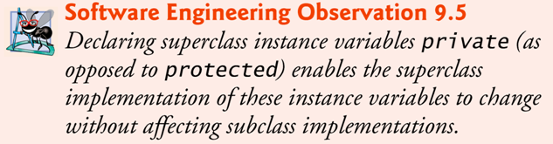
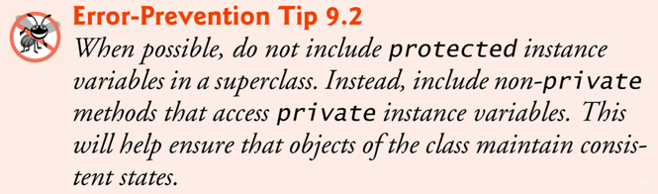

Slide 39
9.4.5 CommissionEmployee and BasePlusCommissionEmployee Inheritance Hierarchy Using private Instance Variables
Hierarchy reengineered using good software engineering practices.
Class CommissionEmployee (Fig. 9.10) declares instance variables firstName, lastName, socialSecurityNumber, grossSales and commissionRate as private and provides public methods for manipulating these values.

Slide 40
CommissionEmployee methods earnings and toString use the class’s get methods to obtain the values of its instance variables.
If we decide to change the internal representation of the data (e.g., variable names) only the bodies of the get and set methods that directly manipulate the instance variables will need to change.
These changes occur solely within the superclass — no changes to the subclass are needed.
Localizing the effects of changes like this is a good software engineering practice.
Subclass BasePlusCommissionEmployee (Fig. 9.11) inherits Commission-Employee’s non-private methods and can access the private superclass members via those methods.

Slide 41
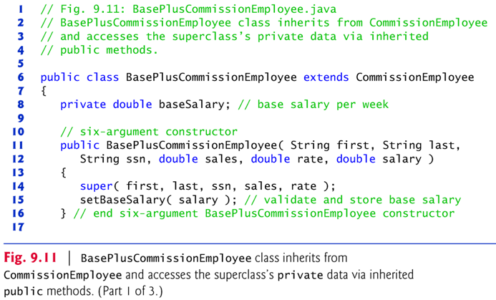
Class BasePlusCommissionEmployee (Fig. 9.11) has several changes that distinguish it from Fig. 9.9.
Methods earnings and toString each invoke their superclass versions and do not access instance variables directly.

Slide 42
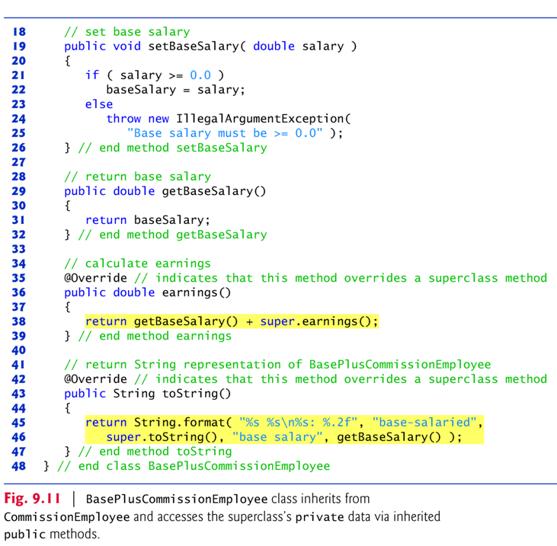

Slide 43
Method earnings overrides class the superclass’s earnings method.
The new version calls CommissionEmployee’s earnings method with super.earnings().
Obtains the earnings based on commission alone
Placing the keyword super and a dot (.) separator before the superclass method name invokes the superclass version of an overridden method.
Good software engineering practice:
If a method performs all or some of the actions needed by another method, call that method rather than duplicate its code.

Slide 44
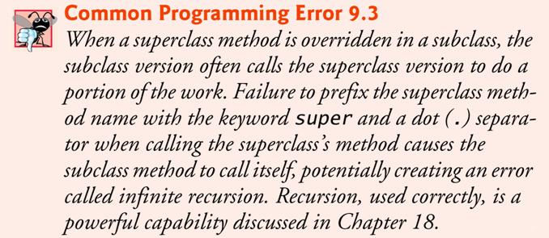
Another example of reuse:
BasePlusCommissionEmployee’s toString method overrides class CommissionEmployee’s toString method.
The new version creates part of the String representation by calling CommissionEmployee’s toString method with the expression super.toString().

Slide 45
9.5 Constructors in Subclasses
Instantiating a subclass object begins a chain of constructor calls.
The subclass constructor, before performing its own tasks, invokes its direct superclass’s constructor.
If the superclass is derived from another class, the superclass constructor invokes the constructor of the next class up the hierarchy, and so on.
The last constructor called in the chain is always class Object’s constructor.
Original subclass constructor’s body finishes executing last.
Each superclass’s constructor manipulates that superclass’s instance variables that the subclass object inherits.

Slide 46
9.6 Software Engineering with Inheritance
When you extend a class, the new class inherits the superclass’s members — though the private superclass members are hidden in the new class.
You can customize the new class to meet your needs by including additional members and by overriding superclass members.
Doing this does not require the subclass programmer to change (or even have access to) the superclass’s source code.
Java simply requires access to the superclass’s .class file.

Slide 47
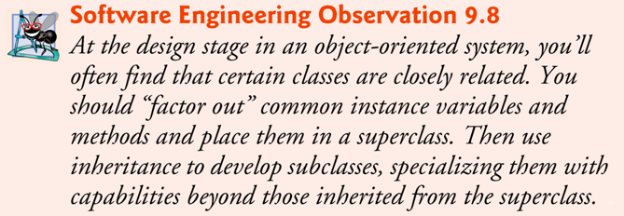
Object-Oriented Design and Inheritance Hierarchy

Slide 48
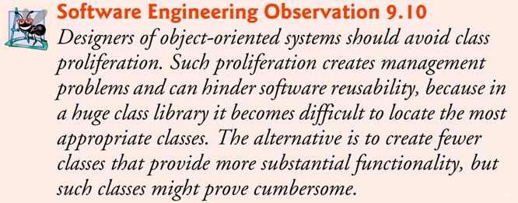
So the question is: To inherit or not to inherit? The challenge: Designing an object-oriented software system that benefits from software reuse via inheritance without the drawbacks of class proliferation.

Slide 49
Exercise: Object-Oriented Design
Show the design of an Java application with the following classes: Person, Employee, Customer, CommissionEmployee, and BasePlusCommissionEmployee.
How would the inheritance hierarchy look like?
How would the UML class diagram (with associations) look like?

Slide 50
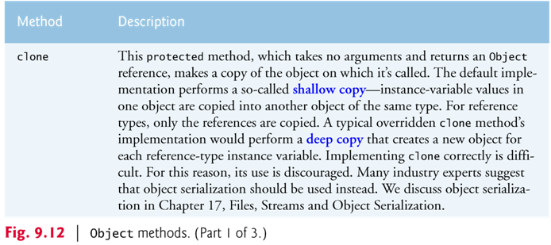
9.7 The Object Class
All classes in Java inherit directly or indirectly from Object, so its 11 methods are inherited by all other classes.
Figure 9.12 summarizes Object’s methods.
Every array has an overridden clone method that copies the array.
If the array stores references to objects, the objects are not copied — a shallow copy is performed.

Slide 51
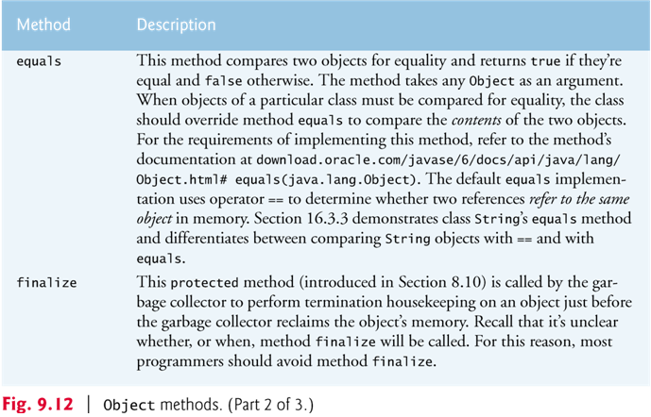

Slide 52
