Slide 1
Control Structures
Selections
Repetitions/iterations
(part 2)
Based on slides from Deitel & Associates, Inc.
Revised by T. A. Yang

Slide 2
Outline
for loops
do … while loops
Multiple selections using switch
Logical operators

Slide 3
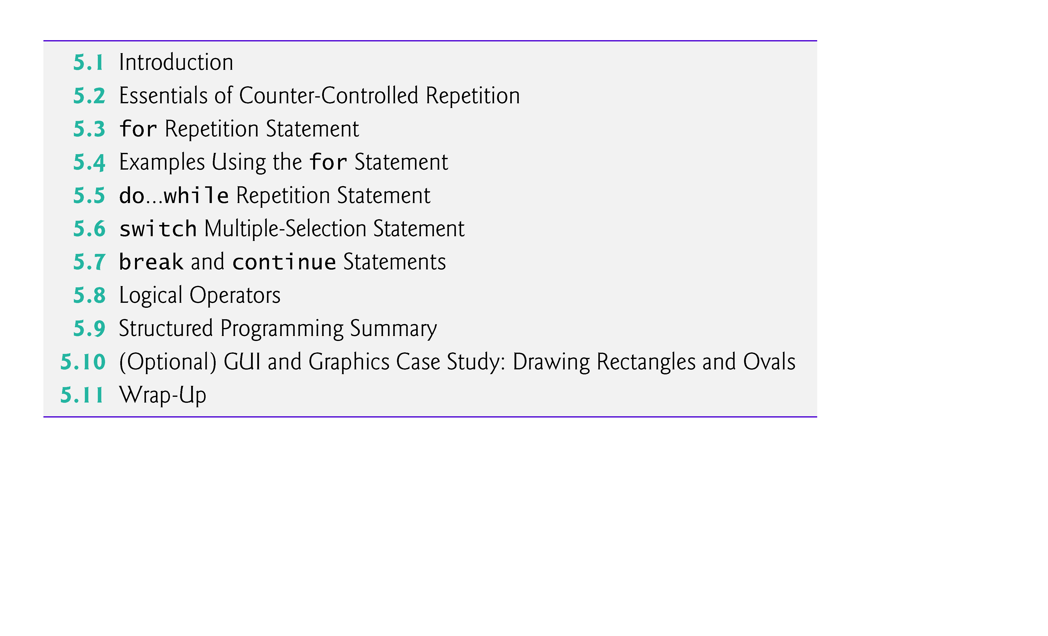

Slide 4
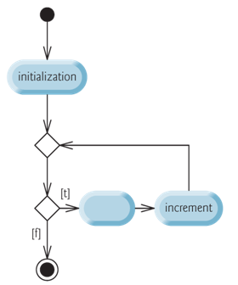
5.2 Counter-Controlled Repetition
Counter-controlled repetition requires
a control variable (or loop counter)
the initial value of the control variable
the loop-continuation condition that determines if looping should continue.
the increment (or decrement) by which the control variable is modified each time through the loop (also known as each iteration of the loop)
Note: The change within the loop should eventually cause the loop to terminate.

Slide 5
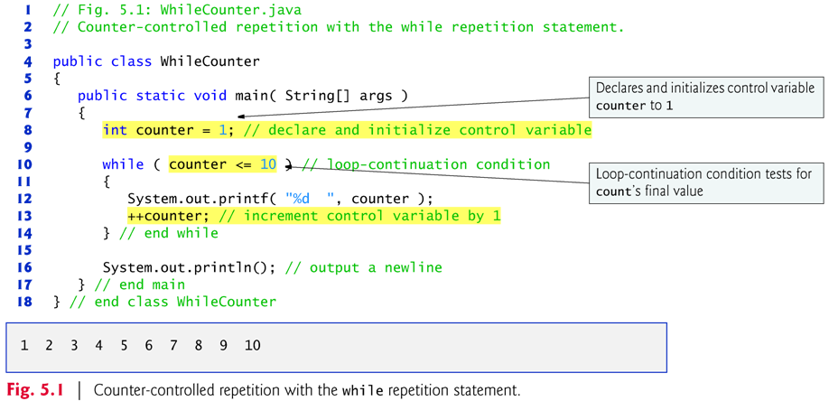

Slide 6
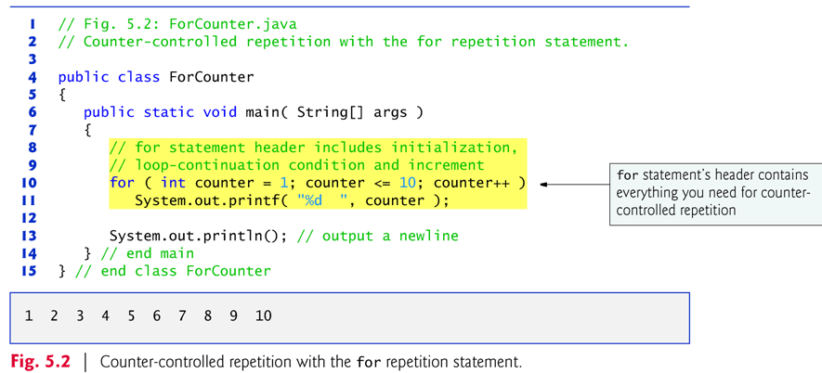
5.3 for Repetition Statement
Specifies the counter-controlled-repetition details in a single line of code.
Figure 5.2 implements the application of Fig. 5.1 using for.

Slide 7
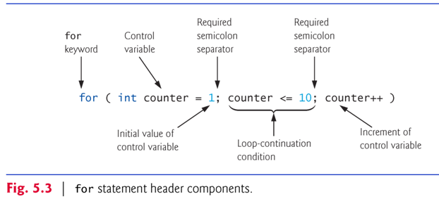
The general format of the for statement is
for ( initialization; loopContinuationCondition; changes) statement(s)

Slide 8
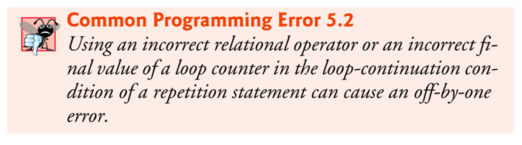
For example, instead of counter <= 10, counter < 10 is used.
Or wrong initial value is assigned to the control variable.
Lesson: Be aware of the boundary conditions.

Slide 9
Q: Would the following for loops print the sequence of even numbers 2, 4, 6, …, 100?
for (int x = 2; x < 100; x = x + 2)
System.out.printf("%d\n", x);
for (int x = 1; x <= 50; x++)
System.out.printf("%d\n", x*2);
for (int x = 0; x <= 100; x = x + 2)
System.out.printf("%d\n", x);

Slide 10
Another common error: infinite loops
Q: What’s the output of the following loops?
for (int x = 1; x != 10; x = x + 2)
System.out.printf("%d\n", x);
for (int x = 100; x >= 100; ++x)
System.out.printf("%d\n", x);
for (int x = 100, y = 100; x >= y; x++, y--)
System.out.printf("%d\t%d\n", x, y);

Slide 11
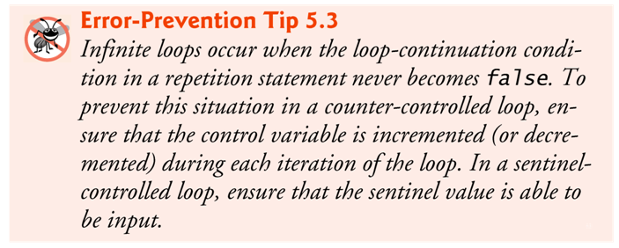

Slide 12
Each for statement can be represented as an equivalent while statement as follows:
initialization;
while ( loopContinuationCondition ) { statement increment; }
Similarly, each while statement can be represented as an equivalent for statement.
Typically, for statements are used for counter-controlled repetition and while statements for sentinel-controlled repetition.
If the initialization expression in the for header declares the control variable, the control variable can be used only in that for statement.

Slide 13
All three expressions in a for header are optional.
If the loopContinuationCondition is omitted, the condition is always true, thus creating an infinite loop (unless a break statement is included inside the loop)
You might omit the initialization expression if the program initializes the control variable before the loop.
You might omit the increment if the program calculates it with statements in the loop’s body or if no increment is needed.

Slide 14
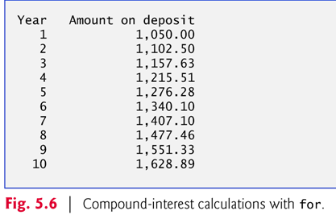
Sample problem: Compound interest application
A person invests $1000 in a savings account yielding 5% interest. Assuming that all the interest is left on deposit, calculate and print the amount of money in the account at the end of each year for 10 years. Use the following formula to determine the accumulated amount for each of the n years:
a = p (1 + r)^{n}
where
p is the original amount invested (i.e., the principal) r is the annual interest rate (e.g., use 0.05 for 5%) n is the number of years a is the amount on deposit at the end of the nth year.

Slide 15
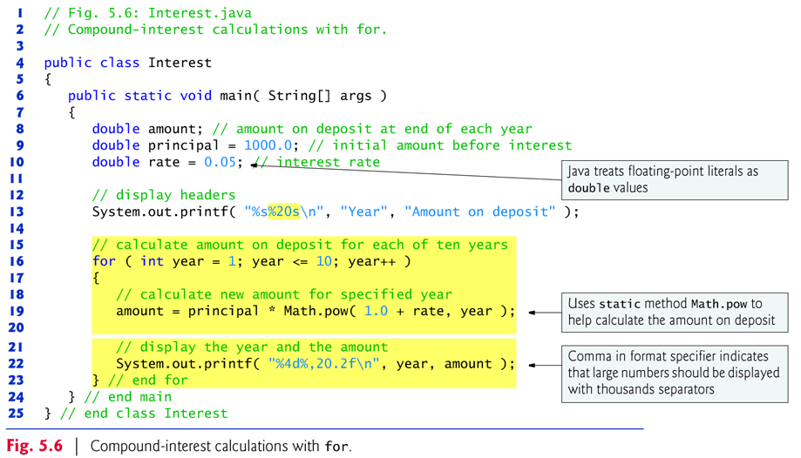
In the format specifier %,20.2f, the comma (,) formatting flag indicates that the floating-point value should be output with a grouping separator.
Note: To indicate that values should be output left justified, precede the field width with the minus sign (–) formatting flag (e.g., %-20s).

Slide 16
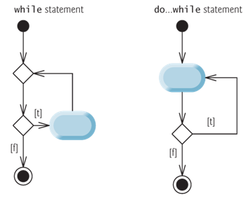
5.5 do…while Repetition Statement
In the while, the program tests the loop-continuation condition at the beginning of the loop, before executing the loop’s body; if the condition is false, the body never executes.
The do…while statement tests the loop-continuation condition after executing the loop’s body; therefore, the body always executes at least once.

Slide 17
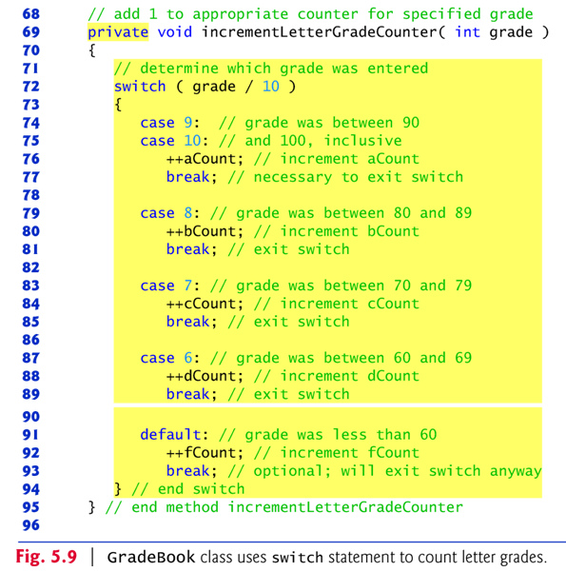
5.6 switch Multiple-Selection Statement
performs different actions based on the possible values of a constant integral expression of type byte, short, int or char.

Slide 18
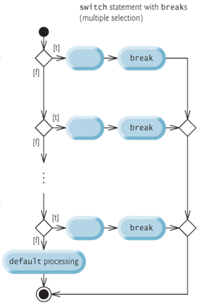
Exercise:
Draw a flowchart or a UML activity diagram to show the logic control of the above switch statement.

Slide 19
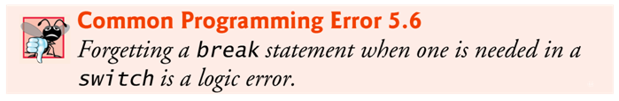
int x = 5;
switch (x) {
case 6:
System.out.println("case 6");
break;
case 5:
System.out.println("case 5");
case 4:
System.out.println("case 4");
case 3:
System.out.println("case 3");
case 2:
System.out.println("case 2");
break;
case 1:
System.out.println("case 1");
default:
System.out.println("None of the above");
break;
} //switch
Q: What’s the output of the sample statements?
Q: What’s the output when x is 6?
Q: What’s the output when x is 1?
Q: What’s the output when x is 10?

Slide 20
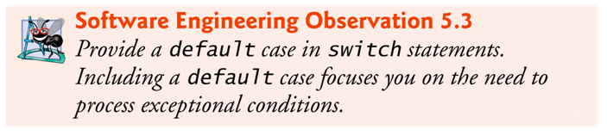
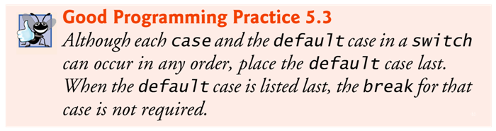

Slide 21
switch versus nested if … else …
A switch statement can be represented as a nested if/else statement.

Slide 22
5.7 break and continue Statements
The break statement, when executed in a while, for, do…while or switch, causes immediate exit from that statement.
Execution continues with the first statement after that control statement.
Common uses of the break statement are to escape early from a loop or to skip the remainder of a switch.

Slide 23
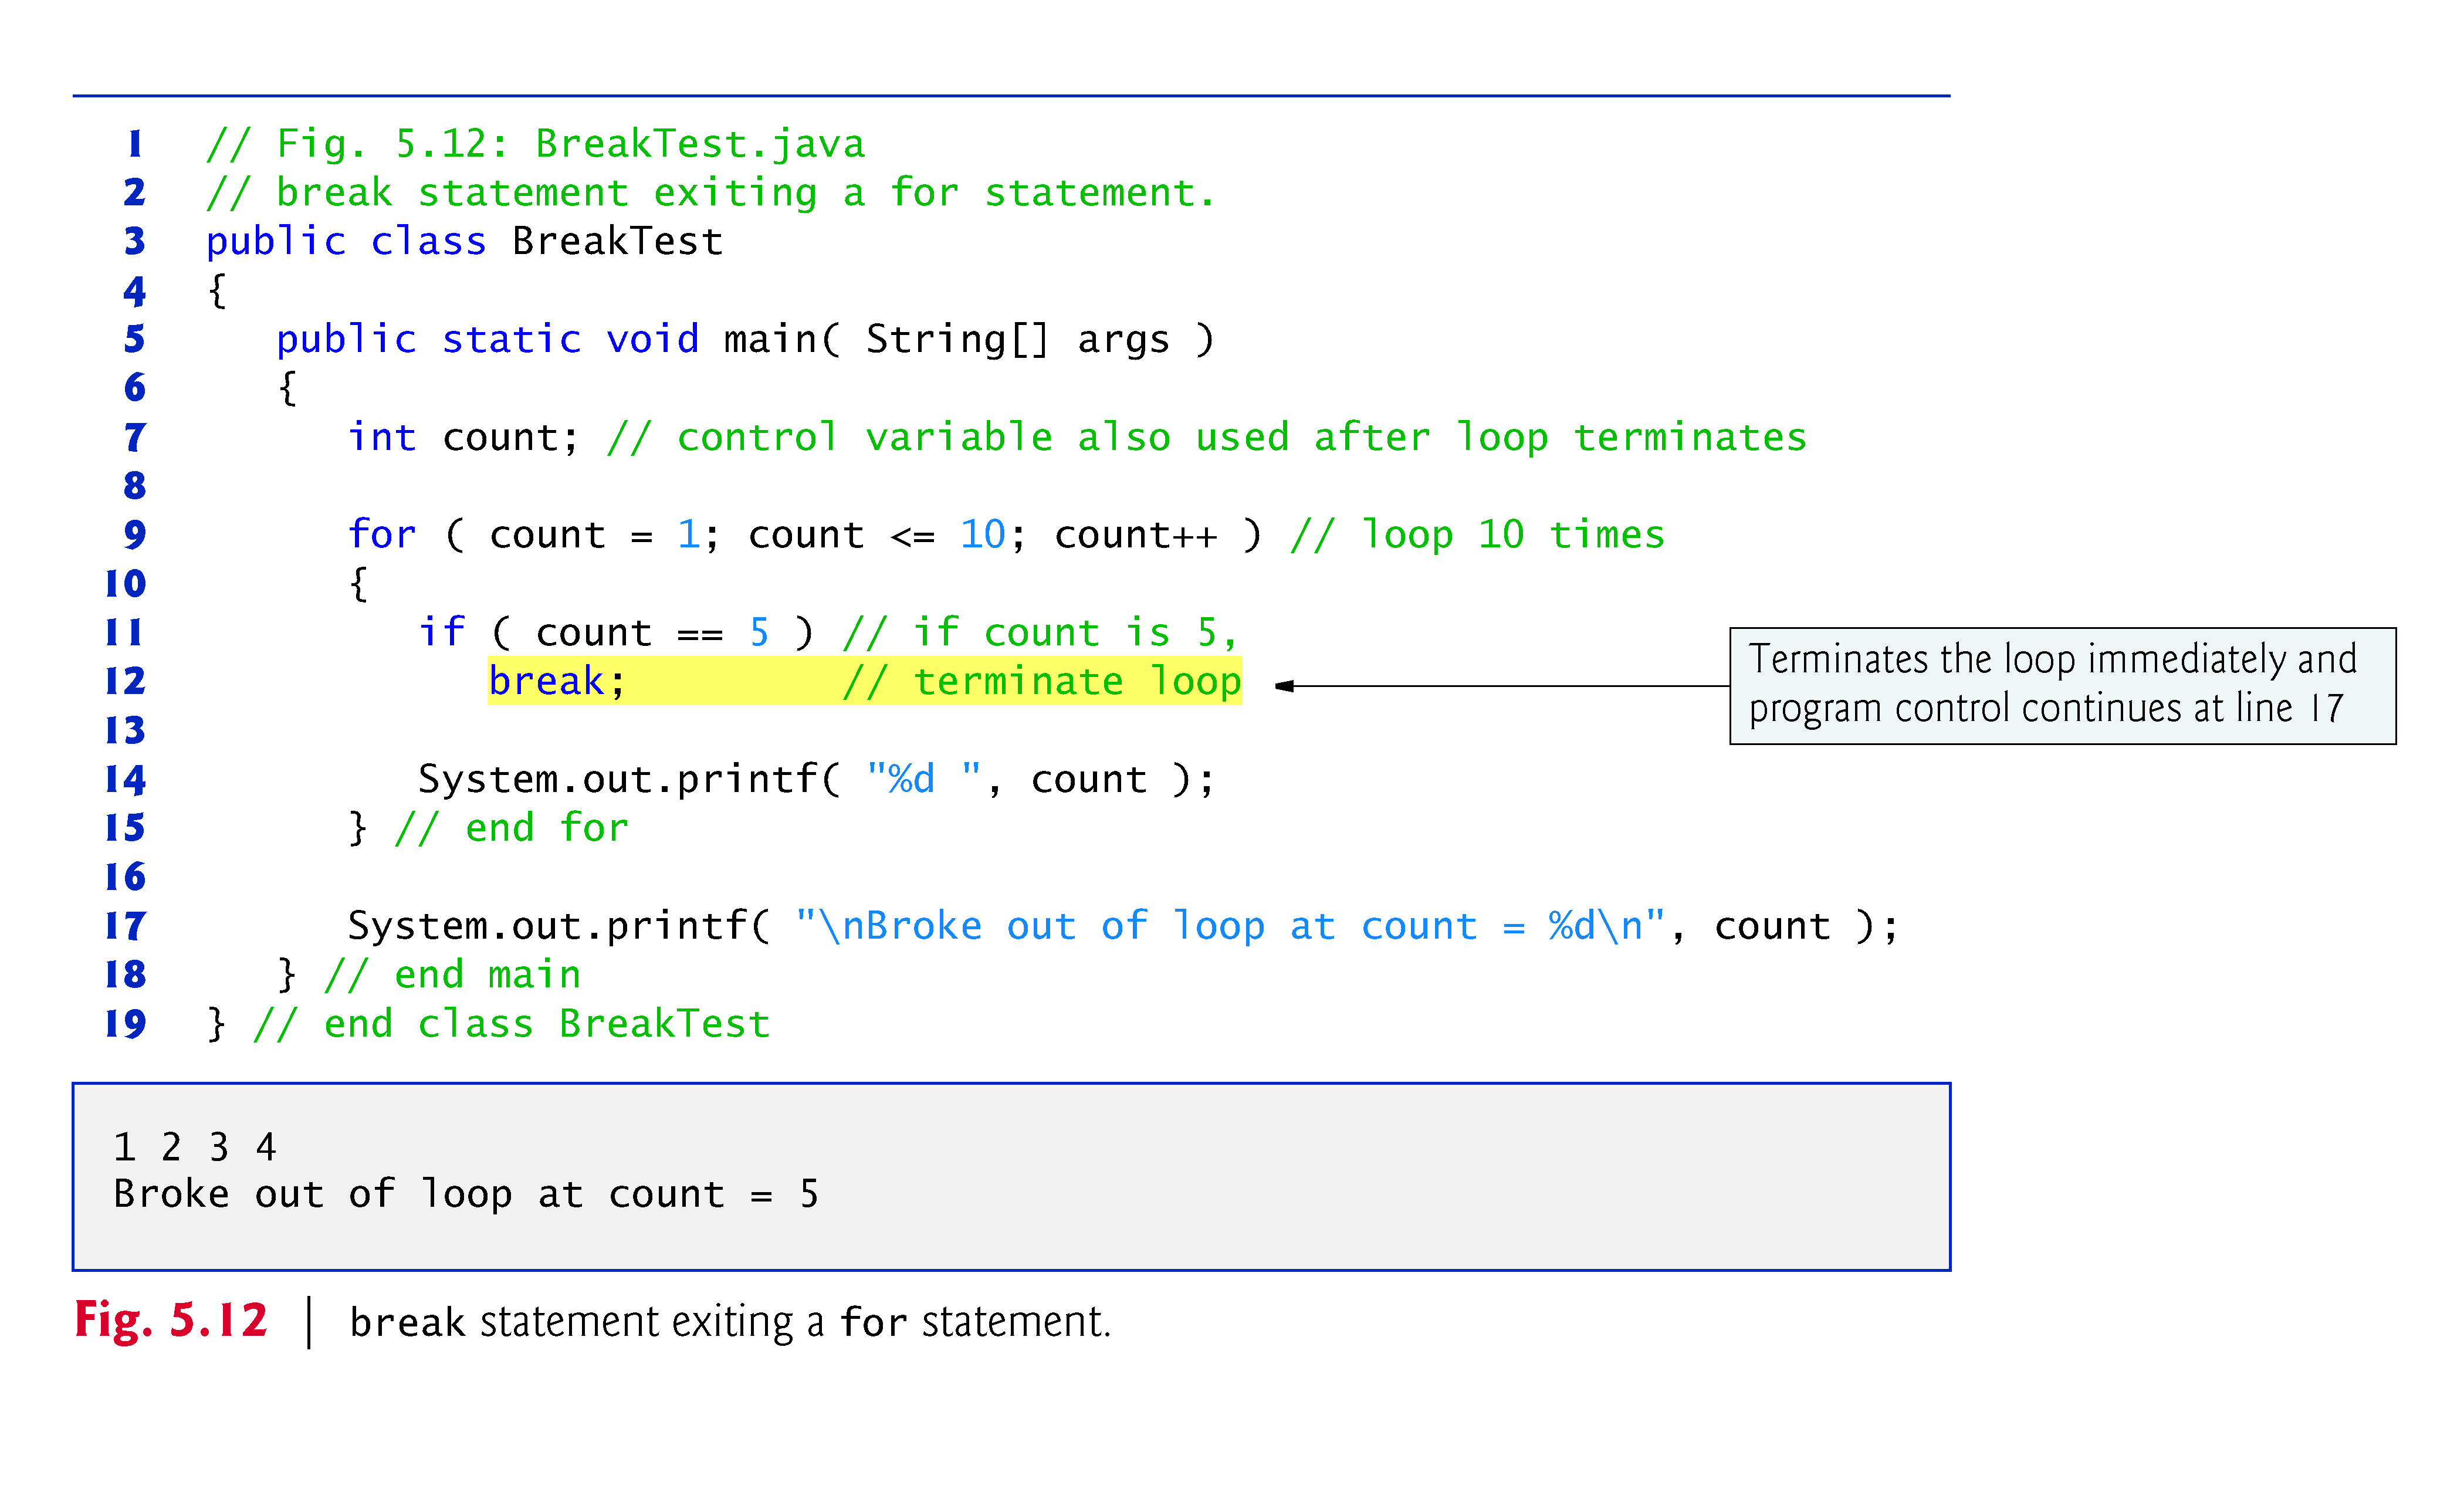

Slide 24
The continue statement, when executed in a while, for or do…while, skips the remaining statements in the loop body and proceeds with the next iteration of the loop.
In while and do…while statements, the program evaluates the loop-continuation test immediately after the continue statement executes.
In a for statement, the increment expression executes, then the program evaluates the loop-continuation test.

Slide 25
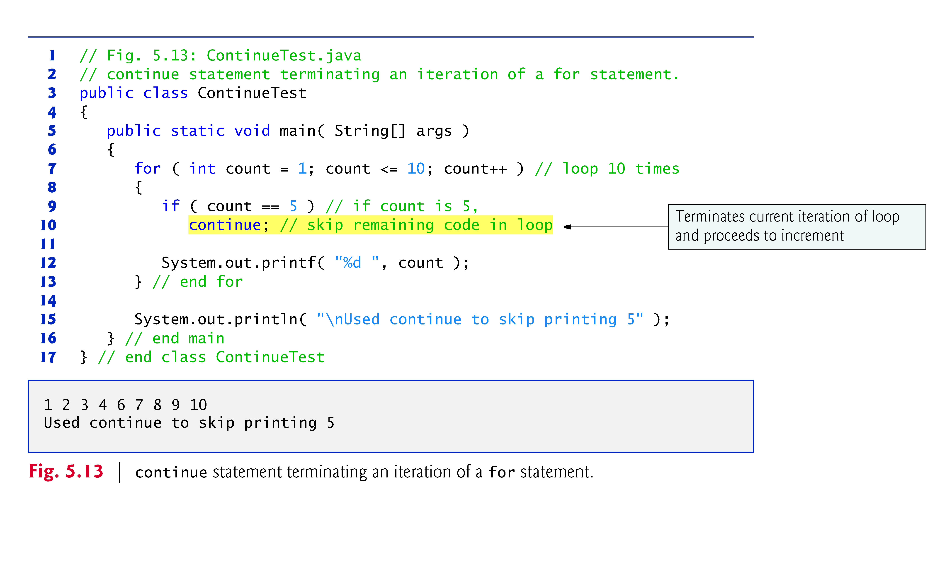

Slide 26
5.8 Logical Operators
Java’s logical operators enable you to form more complex conditions by combining simple conditions.
The logical operators are
&& (conditional AND)
|| (conditional OR)
& (boolean logical AND)
| (boolean logical inclusive OR)
^ (boolean logical exclusive OR)
! (logical NOT).
[Note: The &, | and ^ operators are also bitwise operators when they are applied to integral operands.]

Slide 27
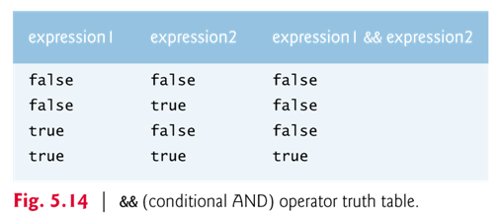
Truth Tables for &&
Alternative truth tables
&& | True | False
True | True | False
False | False | False
&& | 1 | 0
1 | 1 | 0
0 | 0 | 0

Slide 28
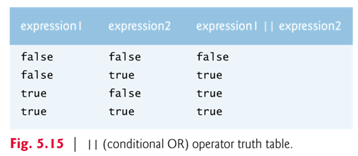
Truth Tables for ||

Slide 29
The parts of an expression containing && or || operators are evaluated only until it’s known whether the condition is true or false.
This feature of conditional AND and conditional OR expressions is called short-circuit evaluation.
Examples:
x = 10;
y= 20;
Q: Which of the following conditions are true?
if (x < y && x%5 == 0) … if (x > y && x%5 == 0) …
if (x < y || x > 1000) … if (x > y || x > 1000) …

Slide 30
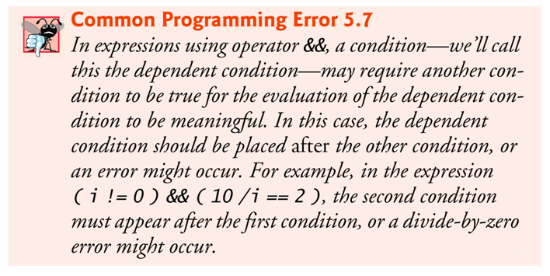

Slide 31
&& versus & || versus |
The boolean logical AND (&) and boolean logical inclusive OR (|) operators are identical to the && and || operators, except that the & and | operators always evaluate both of their operands (i.e., they do not perform short-circuit evaluation).

Slide 32
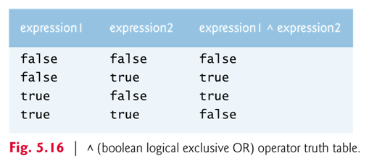
A simple condition containing the boolean logical exclusive OR (^) operator is true if and only if one of its operands is true and the other is false.
If both are true or both are false, the entire condition is false.
This operator is guaranteed to evaluate both of its operands.

Slide 33
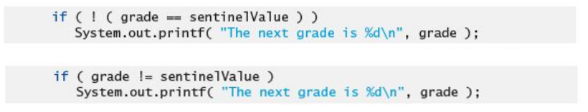
The ! (logical NOT, also called logical negation or logical complement) operator “reverses” the meaning of a condition.
The logical negation operator is a unary operator that has only a single condition as an operand.
The logical negation operator is placed before a condition to choose a path of execution if the original condition (without the logical negation operator) is false.
In most cases, you can avoid using logical negation by expressing the condition differently with an appropriate relational or equality operator.

Slide 34
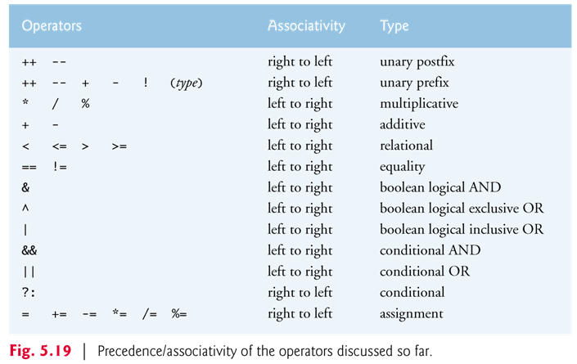

Slide 35
Exercise: Show the output of the following code segment.
int x = 6;
int y = 2;
if ( x < y == x > 3) {
if (x < y)
System.out.println ("x < y and x > 3");
else
System.out.println(“x >= y and x <= 3");
}
else if (x < y)
System.out.println("x < y");
else
System.out.println("x > 3");
Q: Can the expression x < y == x > 3 be replaced by !(x < y ^ x > 3)? Justify your answer.

Slide 36
More Exercises:
Implement the following pseudocode using the for statement.
Let number = 100
Let sum = 0
while number >= 10
sum = sum + number
number = number / 2
Print number
Print number, sum
Implement the pseudocode using the do … while statement.
Repeat the exercise by using the while statement.

