Slide 1
Files and Streams
Based on slides from Deitel & Associates, Inc.
Revised by T. A. Yang

Slide 2
Outline
Streams
Files, Text files vs Binary files
Related Java classes:
java.io.FileReader (for reading streams of characters)
java.io.FileWriter (for writing streams of characters)
java.io.File (for handling file attributes, folders, etc.)
java.io.InputStream (for reading streams of raw bytes)
java.io.FileInputStream
java.io.ObjectInputStream
java.io.OutputStream (for writing streams of raw bytes)
java.io.FileOutputStream
java.io.ObjectOutputStream

Slide 3
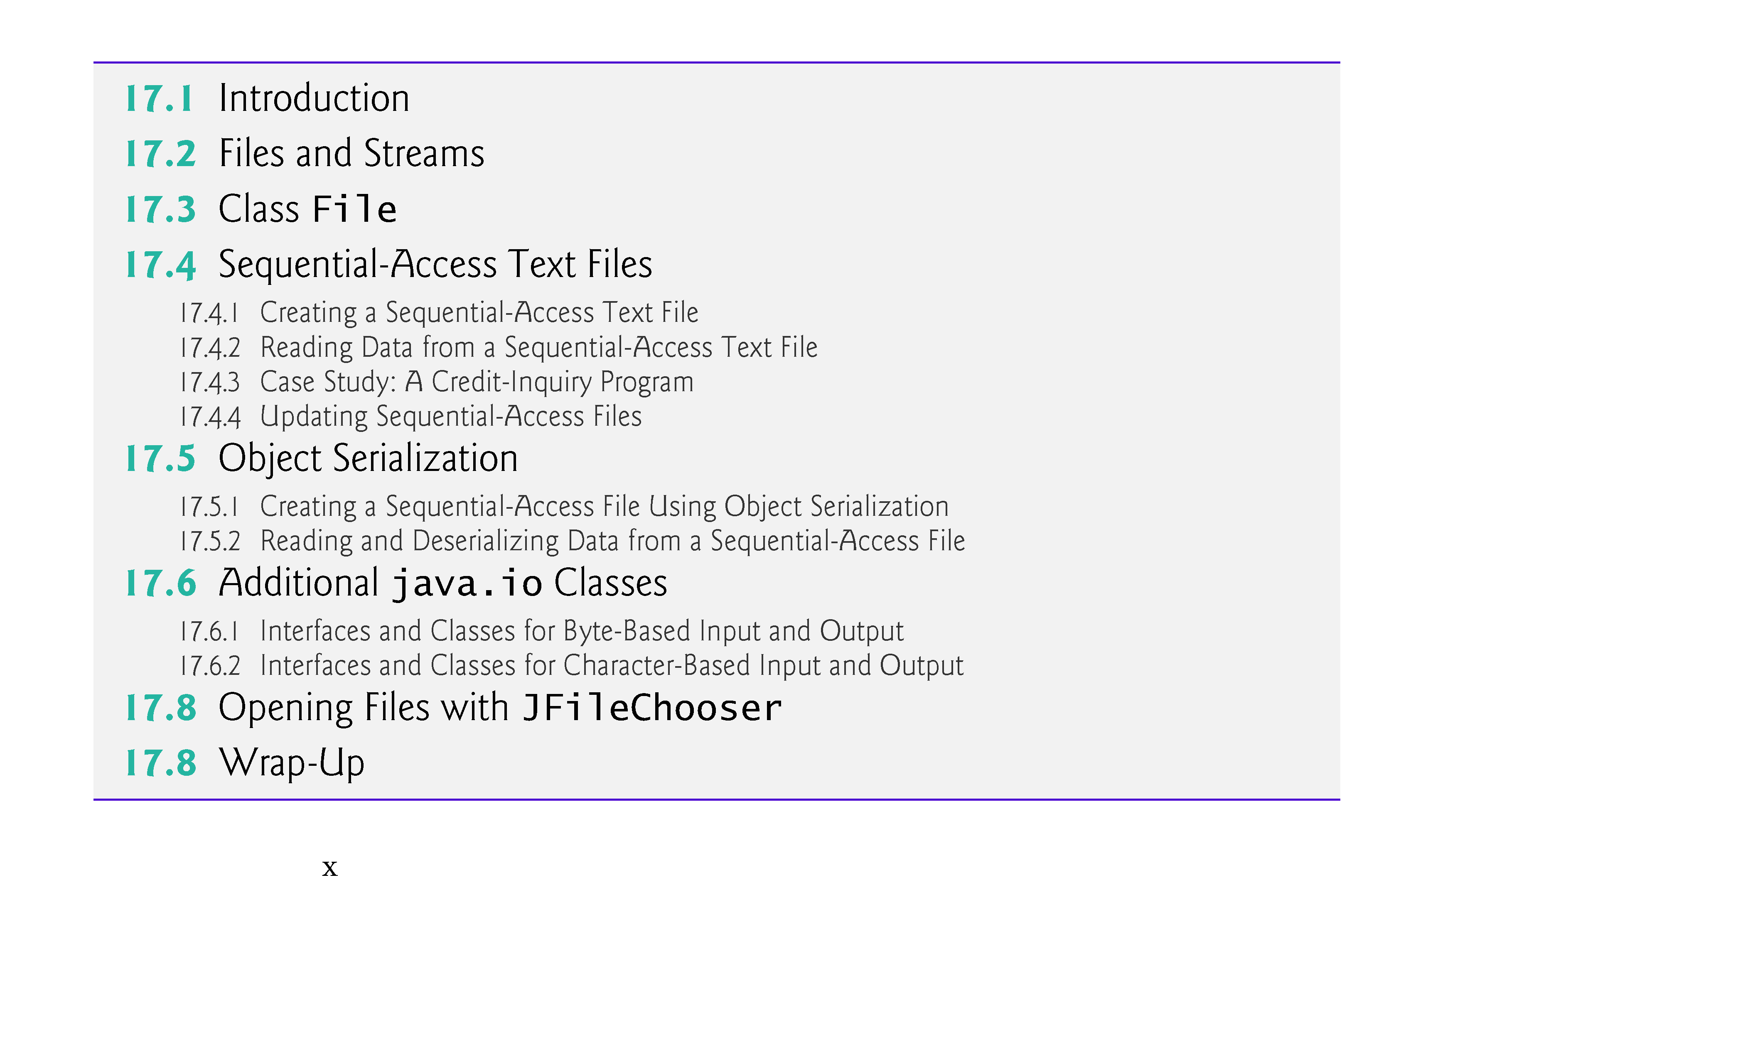

Slide 4
17.1 Introduction
Why use files?
Data stored in variables and arrays are temporary (in memory)
For long-term retention of data, computers use files.
Computers store files on secondary storage devices
hard disks, optical disks, flash drives and magnetic tapes.
Data maintained in files are persistent data because they exist beyond the duration of program execution.

Slide 5
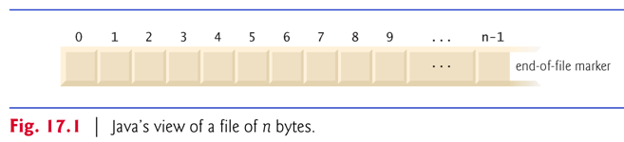
Java views each file as a sequential stream of bytes.
Every operating system provides a mechanism to determine the end of a file, such as an end-of-file marker or a count of the total bytes in the file.
A Java program simply receives an indication from the operating system when it reaches the end of the stream. (system independent)
How about objects in your program? Can they be saved in files and retrieved later?

Slide 6
Text vs Binary Files
File streams can be used to input and output data as bytes or characters.
Streams that input and output characters are known as character-based streams, representing data as a sequence of characters.
Files created using character-based streams are referred to as text files. Text files can be read by text editors.
Streams that input and output bytes are known as byte-based streams, representing data in its binary format.
Files that are created using byte-based streams are referred to as binary files.
Binary files are read by programs that understand the specific content of the file and the ordering of that content.

Slide 7
Java programs perform file processing by using classes from package java.io.
FileReader (for character-based input from a file)
FileWriter (for character-based output to a file)
FileInputStream (for byte-based input from a file)
FileOutputStream (for byte-based output to a file)
You open a file by creating an object of one of these stream classes. The object’s constructor opens the file.

Slide 8
Examples of Basic File Processing
Example Java applications by topics: http://sce.uhcl.edu/yang/teaching/JavaProgrammingExamplesandRelatedTopics.htm
FileReaderTest // Demonstration of reading input from a data file using FileReader class
FileInputStreamExample // Demonstration of reading input from a data file using FileInputStream class
Scanning a data file using the Scanner class
Reading a data file into an array of bytes and printing words by words on console output //based on FileReaderTest

Slide 9
A Java program opens a file by creating an object and associating a stream of bytes or characters with it.
e.g., FileInputStream fStream = new FileInputStream(args[0]);
Can also associate streams with different devices.
e.g., network cards, game controllers, mouse, …
Java creates three stream objects when a program begins executing:
System.in (the standard input stream object) normally inputs bytes from the keyboard
System.out (the standard output stream object) normally outputs character data to the screen
System.err (the standard error stream object) normally outputs character-based error messages to the screen.

Slide 10
The java.io package
Pre-defined classes support input and output of various types of data:
Primitive data
Objects
To perform such input and output operations, objects of classes ObjectInputStream and ObjectOutputStream can be used together with the byte-based file stream classes FileInputStream and FileOutputStream.
The complete hierarchy of classes in package java.io can be viewed in the online documentation at http://download.oracle.com/javase/6/docs/api/java/io/package-tree.html

Slide 11
For example, to write an object that can be read later:
FileOutputStream fos = new FileOutputStream("t.tmp");
ObjectOutputStream oos = new ObjectOutputStream(fos);
oos.writeInt(12345);
oos.writeObject("Today");
oos.writeObject(new Date());
oos.close();
Src: http://download.oracle.com/javase/6/docs/api/java/io/ObjectOutputStream.html
To read the object saved in t.tmp:
FileInputStream fis = new FileInputStream("t.tmp");
ObjectInputStream ois = new ObjectInputStream(fis);
int i = ois.readInt();
String today = (String) ois.readObject();
Date date = (Date) ois.readObject();
ois.close();
Src: http://download.oracle.com/javase/6/docs/api/java/io/ObjectInputStream.html

Slide 12
Exercise: Combine the code segments from the page above to create a Java application that first writes some objects into the file t.tmp and then reads the data back and have them displayed on the console output.
Challenges:
Appropriate import statements need to be added.
Appropriate exception handling are needed.
Sample solution: ObjectInputOutputDemo.java

Slide 13
The File Class
Class java.io.File provides information about files and directories.
Figure 17.2 lists some common File methods.
http://download.oracle.com/javase/6/docs/api/java/io/File.html

Slide 14
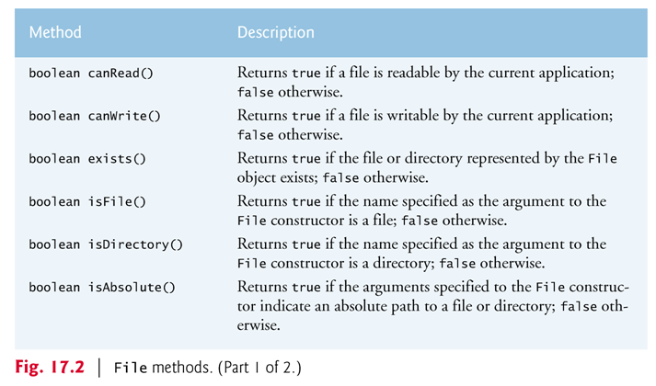

Slide 15
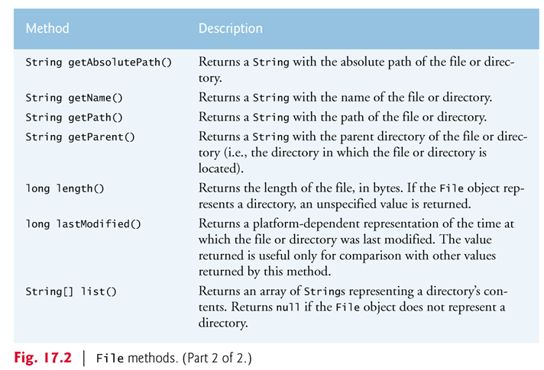

Slide 16
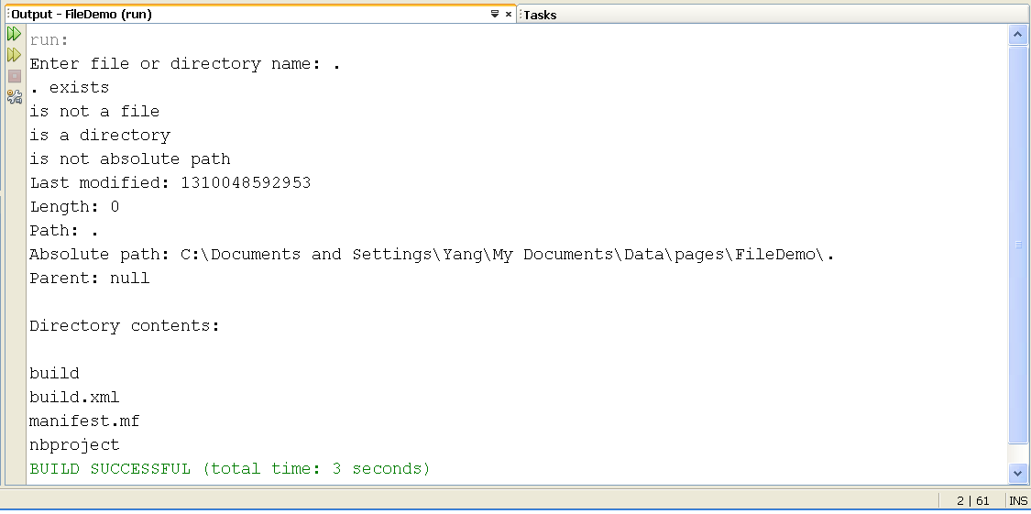
Sample Application using the File class: FileDemonstration.java
//Fig. 17.3 from Deitel & Deitel, Java How to Program, 9e.

Slide 17
The for-each loop in Java:
File name = new File( path );
…
String[] directory = name.list();
for ( String directoryName : directory )
System.out.println( directoryName );
Syntax: for (x : y) …
Meaning: For each x in y, …
y must be of type array or collection
See http://leepoint.net/notes-java/flow/loops/foreach.html
More information about the enum type: http://download.oracle.com/javase/tutorial/java/javaOO/enum.html

Slide 18
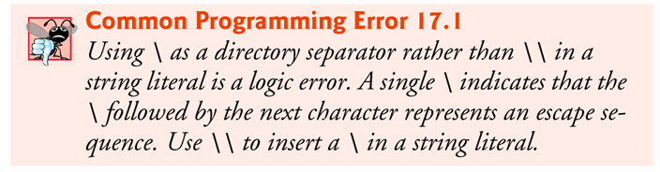
A separator character is used to separate directories and files in the path.
On Windows, the separator character is a backslash (\).
On Linux/UNIX, it’s a forward slash (/).
Java processes both characters identically in a path name.
When building Strings that represent path information, use File.separator to obtain the local computer’s proper separator.
This constant returns a String consisting of one character—the proper separator for the system.

Slide 19
Exercises:
Test the FileDemonstration.java program to see how the File.getParent( ) method work. When would null be returned? When would the parent information be returned?
How would you modify the FileDemonstration.java program such that it always displays the parent information of the given file/folder?

